Slide 1
Serving QUEST Disaster DWG Clients
September 28th, 2023

Slide 2
Objective
The objective of this presentation is to discuss the details about the Quality Jobs, Equity, Strategy, and Training (QUEST) Disaster National Dislocated Worker Grants (DWG), and how the various eligibility can be recorded within Illinois Workforce Development System (IWDS).

Slide 3
National Disaster Worker Grants
For terminology in this PowerPoint, a Disaster National Dislocated Worker Grants (DWG) could include any current/active Emergency and Disaster Grant that might have been issued in the recent past and any DWG that could be awarded in the future.
These newest QUEST Disaster DWG grants are considered Emergency and Disaster grants.

Slide 4
QUEST Disaster National Dislocated Worker Grants
GRANT PERIOD - October 1, 2023, through September 30, 2025
Participating LWIAs: 1, 3, 7, 10, 20, 21, 25, 26 - Grant Number Series: 23-671xxx (e.g. 23-671001, etc.)
LWIA’s 10 and 26 have not received a QUEST grant in the past; all other LWIA’s currently have a PY22 QUEST grant.
LWIA 1 – DWG #23-671001
LWIA 3 – DWG #23-671003
LWIA 7 – DWG #23-671007
LWIA 10 – DWG #23-671010
LWIA 20 – DWG #23-671020
LWIA 21 – DWG #23-671021
LWIA 25 – DWG #23-671025
LWIA 26 – DWG #23-671026

Slide 5
Emergency and Disaster Participants
These grants allow any traditional Dislocated Worker client to receive services under any Emergency and Disaster grant.
In addition, there is alternative criteria that was added for individuals who would not meet traditional Dislocated Worker criteria but would meet any of the alternative Emergency and Disaster criteria that has been established.

Slide 6
Emergency and Disaster Participants
Under an Emergency and Disaster grant (which includes QUEST Disaster DWG), an eligible individual could get services related to Disaster Relief Employment only (in that case the client would be excluded from Performance implications); OR,
An eligible individual could get Employment and Training Activities only (client would be in Performance); OR,
An eligible individual could get both Disaster Relief Employment and Employment and Training Activities (client would be in Performance).

Slide 7
Emergency and Disaster Criteria
As a reminder, any client who has been certified under any traditional Dislocated Worker (DW) title, the client will be eligible for services under the QUEST Disaster DWG.
You only need to use the alternative criteria that was added to IWDS for individuals who do not meet traditional DW criteria that you want to serve under your QUEST Disaster DWG.

Slide 8
Emergency and Disaster Participants
Eligible Emergency and Disaster participants must be one of the following:
A dislocated worker as defined in WIOA Section 3(15);
A long-term unemployed¹ individual, defined by the State for Disaster Recovery grant-specified disasters or emergencies as an individual who: 1.) has no work history; has not worked for an extended period of at least six weeks (including incarcerated individuals); or has an intermittent, erratic, or day-to-day employment work history (e.g., multiple terminations, employment gap, temporary/seasonal/day labor employment, justice-involved history, etc.); 2.) is unemployed and has an employment barrier² as defined by the State or the local Board; or 3.) is underemployed³, including working or needing to work multiple jobs or earning less than $15/hour;

Slide 9
Emergency and Disaster Participants
(Continued from previous slide)
An individual temporarily or permanently laid off as a consequence of the grant-specified disaster or emergency (e.g., flood, tornado, severe storm, fire, COVID-19, etc.), including individuals who were fired or voluntarily left their job (quit, resigned) due to the disaster/emergency;
Examples of layoffs resulting from the COVID-19 disaster/emergency include, but are not limited to, individuals who: contracted or were exposed to COVID and stayed home to quarantine/isolate or to care for a COVID-impacted individual or a child schooling at home; were in an at-risk health category; lacked access to adequate daycare; no longer felt safe in their job/career, in their work environment, or during their work commute due to COVID; experienced a change in work hours or shifts due to reduced schedule of business operations; were impacted by compliance with Federal/State/local COVID requirements (e.g., required vaccinations, quarantine/isolation, testing, masking, etc.).
A self-employed individual who became unemployed due to the grant-specified disaster/emergency, or a self-employed individual who became significantly underemployed due to the grant-specified disaster/emergency as evidenced by a substantial change in the need or demand for, or the ability to deliver their product or service; were unable to find or retain adequate staffing, suppliers, or vendors resulting in significant impact to operations; or experienced a substantial change in their costs or pricing because of the grant-specified disaster/emergency

Slide 10
Underserved and Historically Marginalized
A key point for all QUEST Disaster DWG, regardless if the client had met traditional WIOA Dislocated Worker Eligibility criteria, or if the client had met the alternative eligibility criteria, the client must also meet the criteria of “Underserved and Historically Marginalized”.
Then in the case notes either prior to the client being enrolled in services under the QUEST Disaster DWG or right at the beginning of services under the QUEST Disaster DWG there needs to be descriptive case note describing how the individual met the criteria of “Underserved and Historically Marginalized”.

Slide 11
Underserved and Historically Marginalized
Directly below is the state’s criteria for determining “Underserved and Historically Marginalized” individual:
LWIAs will identify underserved and historically marginalized populations and communities based on their local assessment of community need and service gaps, utilizing partnership and community data. Such populations of underserved and historically marginalized individuals include, but are not limited to: Veterans; individuals with disabilities; persons of color; women; justice-involved individuals; immigrants; refugees; homeless individuals and those at risk of homelessness; low-income individuals; individuals in or aged-out of Foster Care; GED candidates and recipients; public assistance recipients; individuals who are basic skills deficient; UI Profilees; individuals unemployed for an extended period; individuals age 55 and over; lower-wage workers; child-care-challenged workers; high-unemployment-area residents; rural residents; individuals residing in a Qualified Census Tract (QSI) or a Disproportionately Impacted Area (DIA); individuals who have exhausted their unemployment insurance benefit; and individuals with other employment barriers.

Slide 12
Underserved and Historically Marginalized
To wrap up this portion about “Underserved and Historically Marginalized” individual getting served under any QUEST Disaster DWG, regardless if the client had met traditional WIOA Dislocated Worker Eligibility criteria, or if the client had met the alternative DWG eligibility criteria, the client must also have an initial case note recording how the client met the specific criteria of “Underserved and Historically Marginalized”.
The case note should address the client’s specific situation on how this client met the criteria of “Underserved and Historically Marginalized”.

Slide 13
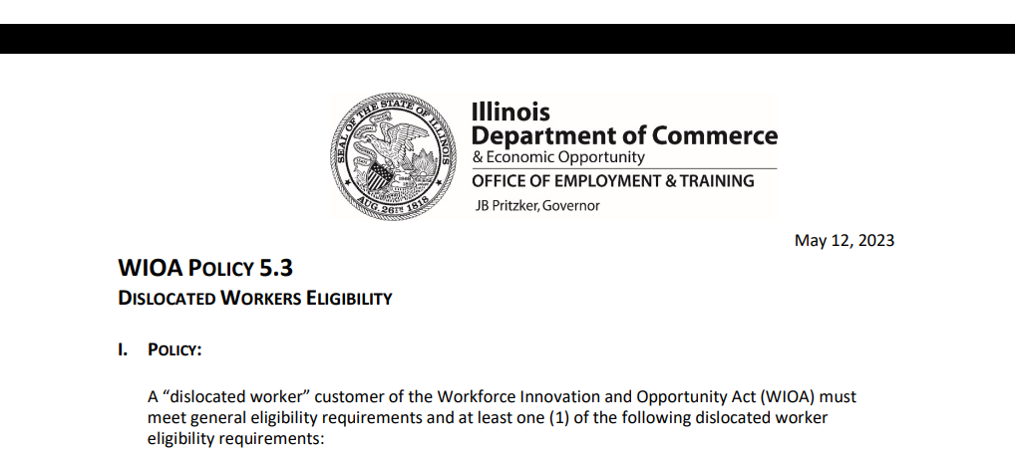
Traditional Dislocated Worker Eligibility Criteria
DCEO Dislocated Worker Policy was updated/new policy was issued on May 12th, 2023:

Slide 14
Dislocated Worker Eligibility
WIOA ePolicy Chapter 5.3 Dislocated Worker Eligibility:
Unlikely to Return to Previous Industry or Occupation
Plant Closure or Substantial Layoff
UI Profilee
No Longer Self-Employed
Displaced Homemaker
Spouse of a member of the Armed Forces on active duty

Slide 15
Broadening Substantial Layoff Criteria
Some key items that I wanted to pass on regarding this updated Dislocated Worker Eligibility guidance, is the broadening of the definition on what could be considered a “Substantial Layoff”.
Under WIOA ePolicy Chapter 5.3 Dislocated Worker Eligibility Policy, for additional guidance about “Substantial Layoff” under paragraphs I.2.a.1)a)i)ii)iii) states:
Substantial layoff includes, but is not limited to, the following:
Any layoffs resulting from Federal, State, or local disasters or emergencies (e.g., flood, tornado, fire, COVID, etc.);
Documented State or Local Rapid Response layoff in the Illinois Employment Business System (IEBS); or
Layoffs from sectors and occupations that are substantial or significant to the regional or local workforce or economy as identified by the local workforce innovation board (LWIB).

Slide 16
Broadening Substantial Layoff Criteria
Under WIOA ePolicy Chapter 5.3 Dislocated Worker Eligibility Policy, for additional guidance about “Substantial Layoff” under paragraphs I.2.a.1)a)i)ii)iii) states:
Substantial layoff includes, but is not limited to, the following:
Any layoffs resulting from Federal, State, or local disasters or emergencies (e.g., flood, tornado, fire, COVID, etc.);
This allows any dislocation job that can be tied to a disaster or emergency, can be considered a “Substantial Layoff”. Meaning, if the individual meets WIOA General Eligibility around Authorized to Work in the U.S. and compliant with Selective Service the individual would be eligible under traditional Dislocated Worker Eligibility of Substantial Layoff criteria.

Slide 17
Broadening Substantial Layoff Criteria
In layman’s terms, IF the dislocation for any individual can be tied to either COVID; Flood; Tornado; Fire; etc., then when recording the “Layoff Reason”, the appropriate response would be either “Substantial Layoff” or “Plant Closure” (whichever is correct.)
To clarify, even if the layoff was just one or two persons, if the layoff can be tied to any Local, State or National Emergency, (which COVID does meet criteria of a National Emergency), then it is correct to record the layoff reason as “Substantial Layoff”.

Slide 18
Broadening Substantial Layoff Criteria
In the updated Dislocated Worker Policy for “Substantial Layoff”, under bullet “iii”, the question of what does, “Layoffs from sectors and occupations that are substantial or significant to the regional or local workforce or economy as identified by the local workforce innovation board (LWIB).” mean was posed to the OET Regional Program Managers?

Slide 19
Feedback from Regional Managers
Response from Regional Program Managers for DCEO OET:
“Substantial sectors and occupations should come from the Local and Regional Plan documents. If the occupation/sector is not listed in the local plan, but there are other extenuating factors that the board believes will impact the local economy, they can determine as circumstances warrant, to include those layoffs as significant to the local economy. The circumstances should be defined in the local policy along with a statement from the LWIB as supporting documentation for eligibility purposes.”

Slide 20
Example Provided
A company closes or has a mass layoff, and it impacts other employers that do business with that company:
Fiat Chrysler had a layoff of their second shift, which impacted five other employers who were Tier 1 suppliers in the region.
A recent Owens-Brockway Glass Containers layoff event in Streator IL is a manufacturing layoff impacting 161 people.
Manufacturing is included in the local plan, but the number of layoffs at Owens is significant enough for the local economy, that there may be a ripple effect into nearby local businesses that may be in sectors not included in the local plan, but still considered part of a “significant event” for the local economy.

Slide 21
Each LWIA Tailors Local Policy
If it has not been done so yet, it is highly encouraged that each LWIA work with their LWIB to develop a tailored Local Dislocated Worker Eligibility Policy that identifies key sectors and occupations that are substantial or significant to the regional or local workforce as identified by the local workforce innovation board (LWIB).

Slide 22
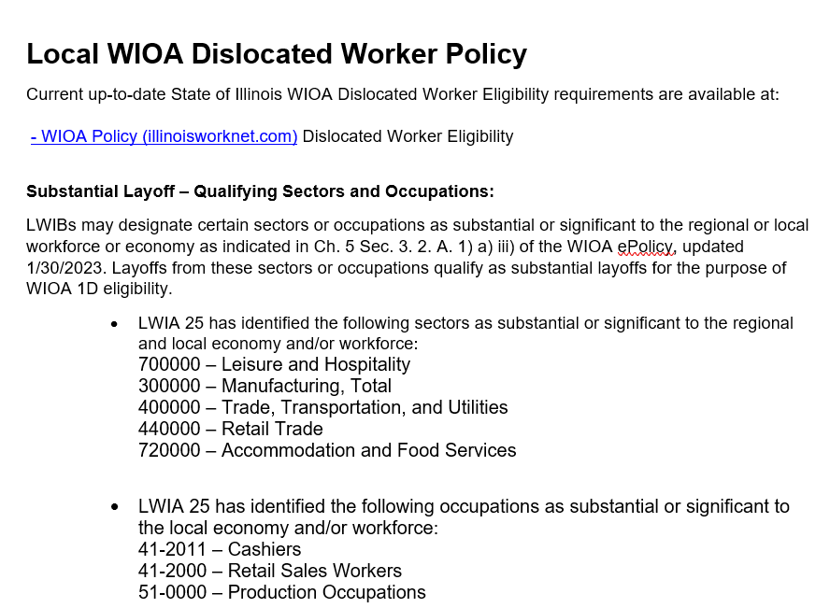
Example of LWIA 25 Local Policy
LWIA 25 has been very proactive and developed Local Policy Guidance around identifying substantial or significant sectors or occupations.

Slide 23
Details about LWIA 25 Example
To tie this together, the LWIA 25 Policy allows any individual who had been dislocated from those industries and/or occupations identified in their Local Policy, to characterize the Dislocation Job as a “Substantial Layoff”.
So even in cases where the dislocation from the specific industry and/or occupation would not meet traditional criteria around “Substantial Layoff” due to the approved Local Policy, it would meet the criteria.
However, this is only allowed if an LWIA creates a similar Local Policy as was demonstrated in the previous slide, and then the LWIB approves the Local Policy.

Slide 24
Local Dislocated Worker Policy
As mentioned earlier, the intent of the State’s guidance was for each LWIA to examine their own Local Policy on WIOA Dislocated Worker, and then work with the LWIB to identify those sectors and occupations that are substantial or significant to the regional or local workforce or economy as identified by the local workforce innovation board (LWIB).”
It is my understanding that besides LWIA 25, both LWIA 1 and LWIA 26 have also worked with their LWIB to develop local policy guidance identifying their local sectors and occupations that are substantial or significant to their regional or local workforce or economy.

Slide 25
UI Profilee
The Dislocated Worker Eligibility Policy guidance around UI Profilee states:
The individual is profiled and referred Unemployment Insurance (UI) claimant whose UI profile date is within the past calendar year of the WIOA application date;
The state has determined as allowed per 680.130(b)(3) of the WIOA legislation, that UI profiles are eligible dislocated workers with the definition of dislocated worker in WIOA Section 3(15).
In such instances, no further documentation will be needed to establish the “Unlikely to Return to a Previous Industry or Occupation” criteria of WIOA section 3(15)(A)(iii).
As a result, acceptance of UI Profiling data to prove eligibility for meeting the requirements of 3(15) is the only standard. General eligibility will still apply.

Slide 26
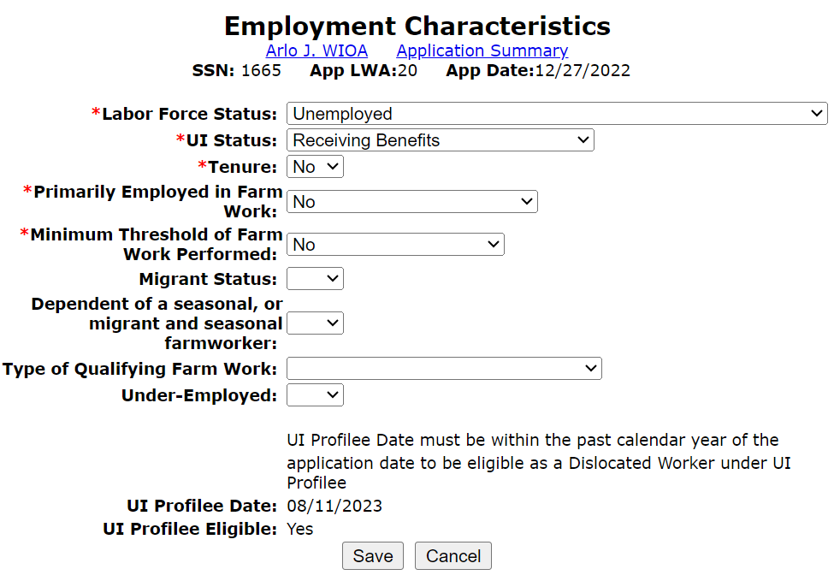
UI Profilee Example
Within IWDS, when an individual puts in their WIOA application; on the “Employment Characteristics” screen of the electronic application in IWDS (towards the bottom of the screen), IF the individual had been profiled by IDES, those details will appear as demonstrated in the adjacent screen print:

Slide 27
UI Profilee in IWDS
As previously stated, the individual must have been profiled within one year of the date of their WIOA application and then the UI Profilee eligibility certification would need to be completed within one year of the profile date.
Some other details include, a dislocation job is not required to be populated for a client who is having their Dislocated Worker eligibility determined due to being a “UI Profilee”.
As a side note, currently for those who work in LWIA 7, the Career Connect system does not capture “UI Profilee”, but any individual that has been profiled, should meet traditional Dislocated Worker under Category 1 – Unlikely to Return to Previous Industry or Occupation due to UI status within Career Connect.

Slide 28
UI Profilee Report
In the IWDS Reporting Menu, under the “Participant” reports, there is a “UI Profilee” report that can be run by LWIA and by specific date ranges.
Keep in mind that any individual profiled by IDES within one year of their WIOA application date would be eligible as a Dislocated Worker under UI Profilee.
However, when an individual has already obtained full-time, self-sustaining employment, WIOA Dislocated Worker services would not be appropriate nor the best use of your Dislocated Worker funds.

Slide 29
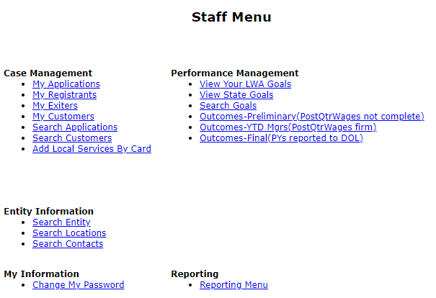
UI Profilee Report in IWDS
To run a “UI Profilee Report” the staff member must have been given reports rights and roles by the local systems administrator.
If you have those report rights, you will see from the “Staff Menu”, a section called “Reporting”.

Slide 30
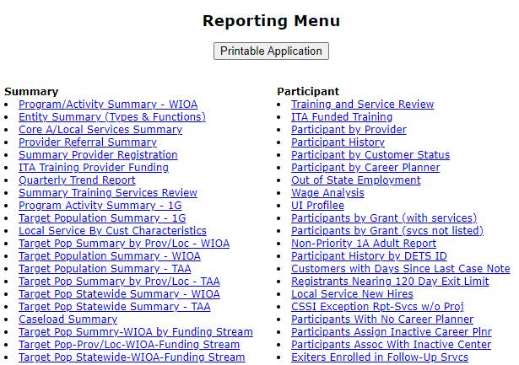
UI Profilee Report in IWDS
On the reporting menu, under “Participant” reports is the “UI Profilee” report.
Simply click on “UI Profilee”.

Slide 31
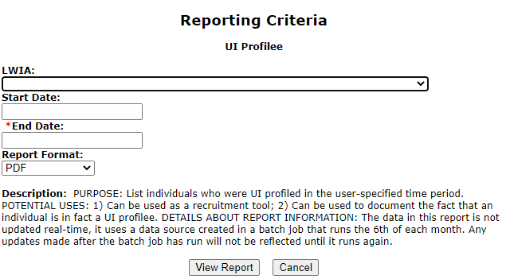
UI Profilee Report in IWDS
Then populate the various criteria for the UI Profilee you wish to run by your own LWIA and the start and end date.
There is data lag, meaning if the end date is populated today, the last time individuals might have been profiled could have been up to one month ago.

Slide 32
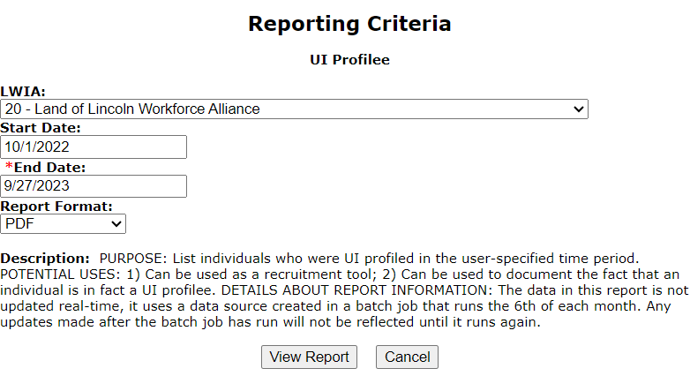
UI Profilee Report in IWDS
Below is the example for a recent report I ran for the UI Profilee at LWIA 20:

Slide 33
UI Profilee Report in IWDS
This example report, was being ran in production IWDS with “real” information about individuals, and below demonstrates the different columns of information that was recorded on 379 potential LWIA 20 Dislocated Worker clients who would be eligible under UI Profilee:

Slide 34
Total Numeric Results of UI Profilee Reports from date range of 10-1-22 through 9-27-23 by LWIA
LWIA 1 – 602
LWIA 2 – 302
LWIA 3 – 565
LWIA 4 – 1,215
LWIA 5 – 814
LWIA 6 – 467
LWIA 7 – 5,995
LWIA 10 – 864
LWIA 11 – 522
LWIA 13 – 752
LWIA 14 – 433
LWIA 15 – 1,393
LWIA 17 – 712
LWIA 18 – 288
LWIA 19 – 709
LWIA 20 – 379
LWIA 21 – 367
LWIA 22 – 275
LWIA 23 – 542
LWIA 24 – 442
LWIA 25 – 566
LWIA 26 – 305
TOTAL UI Profilee’s State-wide -18,473

Slide 35
UI Profilee Report and Data Lag
It is recommended that your LWIA’s UI Profilee report be run by someone approximately every two weeks as there is data lag on when individuals appear on the report as compared to when they had been a UI Profilee.
Typically, the clients that will appear on the UI Profilee report are approximately one month to two months from the date of being profiled as compared to the end date of the report.
For example, if you run a report with the end date of 9/27/2023 on September 27th, 2023, the last clients that had been profiled might be 7/24/2023 or earlier and not up to 9/27/2023 due to the data lag.

Slide 36
UI Profilee in IWDS
As mentioned previously, this new standalone Dislocated Worker criteria of UI Profilee is a subset of the criteria of Unlikely to Return to Previous Industry or Occupation.
However, for an individual who has been a UI Profilee within one year of their WIOA application, the Career Planner is not required to record a Dislocation job, and the eligibility documentation used to support the client was profiled, is the “auto populated” information that is populated on the clients “Employment Characteristics” screen of their IWDS electronic record.

Slide 37
Traditional Dislocated Worker Eligibility
WIOA ePolicy Chapter 5.3 Dislocated Worker Eligibility
Unlikely to Return to Previous Industry or Occupation
Plant Closure or Substantial Layoff
UI Profilee
No Longer Self-Employed
Displaced Homemaker
Spouse of a member of the Armed Forces on active duty

Slide 38
Details on Alternative Emergencies and Disasters Criteria
In instances where an individual does not meet any of the traditional Dislocated Worker criteria, then there is alternative Emergencies and Disaster Criteria.
The alternative Emergencies and Disaster criteria are captured within Illinois Workforce Development System (IWDS) on the Dislocated Worker Characteristics screen, in the middle of that screen is where the alternative eligibility criteria for an individual who does not meet any traditional Dislocated Worker criteria.

Slide 39
Emergency and Disaster Criteria
Within Illinois Workforce Development System (IWDS) on the Dislocated Worker Characteristics screen, in the middle of that screen is where the alternative eligibility criteria for an individual who does not meet any traditional Dislocated Worker criteria.
If the individual who does not meet traditional Dislocated Worker eligibility, meets any one of the alternative criteria questions, they would be eligible to certified under Emergencies and Disasters DWG criteria.
Reiterate, for an individual who does not meet any traditional Dislocated Worker eligibility criteria, only need to choose one (1) of the alternative criteria, to be determined eligible.

Slide 40
Dislocated Worker Characteristics Screen

Slide 41
Emergency and Disaster Criteria

Slide 42
Emergency and Disaster Criteria
IMPORTANT – for any individual who meets traditional WIOA Dislocated Worker (DW) criteria, the client should be certified under the traditional WIOA DW eligibility criteria.
Again, only use the seven (7) alternative eligibility questions that have been added in the middle of Dislocated Worker Characteristics screen in IWDS when the individual would not meet any traditional Dislocated Worker Eligibility criteria.
In situations where an individual does not meet traditional Dislocated Worker but meets one or more of the alternative criteria questions they could be served only under the Emergency and Disaster Grant.

Slide 43
Emergency and Disaster Criteria
1st alternative question is:
An individual that has never held a job before; a “Yes” response to this question and the client will be determined eligible under 1N – National Dislocated Worker Grant 1N – DWG Emergencies and Disasters Career Services.
The documentation to support the “Yes” would simply be the client's self-attestation that they have never worked before.

Slide 44
Emergency and Disaster Criteria
2nd alternative question is:
A “Yes” response to this question and the client will be determined eligible under 1N – National Dislocated Worker Grant 1N – DWG Emergencies and Disasters Career Services.
Examples of this criteria could include but are not limited to people who work in the landscaping business; or with a temp agency; or someone who is a day worker.
The documentation to support the “Yes” could be the client’s work history or self-attestation of their employment circumstances.

Slide 45
Emergency and Disaster Criteria
3rd alternative question is:
For this criteria, it could have been by the client’s choice, or by the employer’s choice.
A “Yes” response to this question and the client will be determined eligible under 1N – National Dislocated Worker Grant 1N – DWG Emergencies and Disasters Career Services.
The documentation to support the “Yes” could be the client’s work history or self-attestation of their employment circumstances.

Slide 46
Emergency and Disaster Criteria
4th alternative question is:
As stated, in the past 13 weeks, has the client been unemployed at least six (6) weeks? This could be due to the client’s choice, or by the employer’s choice.
OR, if client had not met the criteria for at least six or the past 13 weeks, but the client is unemployed and has an employment barrier(see next slide for detail about State defined barriers to employment.)
A “Yes” response to this question and the client will be determined eligible under 1N – National Dislocated Worker Grant 1N – DWG Emergencies and Disasters Career Services.
The documentation to support the “Yes” could be the client’s work history or self-attestation of their employment circumstances.

Slide 47
Barriers to Employment
criteria under question #4
Displaced homemakers; low-income individuals; Indian, Alaska Native, and Native Hawaiian individuals; individuals with a disability; older individuals (age 55 or over); justice-involved individuals; homeless individuals; individuals who are in or have aged out of the foster care system; individuals who are English language learners, have low levels of literacy, or face substantial cultural barriers; eligible migrant and seasonal farmworkers; individuals within 2 years of exhausting TANF lifetime eligibility; single parents (including single pregnant women); long-term unemployed individuals (at least 27 consecutive weeks per BLS definition); individuals who reside in a Qualified Census Tract (QCT) or a Disproportionately Impacted Area (DIA); and individuals who are basic skills deficient.

Slide 48
Facing a Substantial Cultural Barrier
“An individual who faces a substantial cultural barrier” is an individual that perceives him or herself as possessing attitudes, beliefs, customs or practices that influence a way of thinking, acting or working that may serve as a hindrance to employment.”

Slide 49
Emergency and Disaster Criteria
5th alternative question is:
See next slide for the definition for Underemployed;
In addition, if someone is working multiple jobs, they would meet this criteria, and if someone is working at employment earning less than $15 an hour, they would meet this criteria.
A “Yes” response to this question and the client will be determined eligible under 1N – National Dislocated Worker Grant 1N – DWG Emergencies and Disasters Career Services.
The documentation to support the “Yes” could be the client’s work history or self-attestation of their employment circumstances.

Slide 50
Underemployed Definition
An individual who is working part-time but desires full-time employment; who is working in employment not commensurate with the individual's demonstrated level of educational and/or skill achievement; who is employed and meets the definition of a low-income individual as defined in WIOA Sec. 3(36); who is employed but their current earnings are not sufficient compared to their previous job’s earnings from their previous employment; or who is employed in a job lacking employer-provided health care benefits.

Slide 51
Emergency and Disaster Criteria
6th alternative question is:
This criteria is meant to assist any individuals who left employment due to circumstances around a disaster/emergency - see the next slide for examples of individuals who could meet this criteria.
A “Yes” response to this question and the client will be determined eligible under 1N – National Dislocated Worker Grant 1N – DWG Emergencies and Disasters Career Services.
The documentation to support the “Yes” could be the client’s work history or self-attestation of their employment circumstances.

Slide 52
Emergency and Disaster Criteria
Examples of layoffs resulting from the COVID-19 disaster/emergency include, but are not limited to, individuals who: contracted or were exposed to COVID and stayed home to quarantine/isolate or to care for a COVID-impacted individual or a child schooling at home; were in an at-risk health category; lacked access to adequate daycare; no longer felt safe in their job/career, in their work environment, or during their work commute due to COVID; experienced a change in work hours or shifts due to reduced schedule of business operations; were impacted by compliance with Federal/State/local COVID requirements (e.g., required vaccinations, quarantine/isolation, testing, masking, etc.).

Slide 53
Emergency and Disaster Criteria
7th alternative question is:
This criteria is meant to assist any individuals who own their business, but due to the current circumstances their business has declined where they are no longer considered full-time employed. Circumstances could include but are not limited to someone whose business has steadily declined since COVID occurred.
A “Yes” response to this question and the client will be determined eligible under 1N – National Dislocated Worker Grant 1N – DWG Emergencies and Disasters Career Services.
The documentation to support the “Yes” could be the client’s work history or self-attestation of their employment circumstances.

Slide 54
Documentation Supporting Alternative Criteria
Last year there were several questions about the documentation to support the alternative eligibility for the DWG Emergencies and Disasters criteria:
Key to understand for any “Yes” to the seven (7) different alternative eligibility question, there needs to be an independent documentation explaining how the client met the specific criteria.
We recommend having the client choose only one (1) of the seven (7) different criteria, and it should be the one that is easiest to support.
Another point from last year, if multiples questions are answered with a “Yes” response, then no one question that has a “Yes” response should not contradict another “Yes” response.
As an example, last year we had instances where a record had “No Work History” checked “Yes” and then also had another “Yes” to the question about “In the last 24 months, employment ended more than once”; ?

Slide 55
Emergency and Disaster Criteria
As mentioned previously, any client who has been certified under any traditional Dislocated Worker (DW) title, the client will be eligible for services under the QUEST Disaster DWG.
You only need to use the alternative criteria that will be added to IWDS for individuals who do not meet traditional DW criteria that you want to serve under your QUEST Disaster DWG.

Slide 56
Underserved and Historically Marginalized
Regardless if the client is going to be served under the QUEST Disaster DWG due to meeting traditional WIOA Dislocated Worker Eligibility criteria, or if the client had met the alternative DWG eligibility criteria, the client must also have an initial case note recording how the client met the criteria of “Underserved and Historically Marginalized”.

Slide 57
Tracking QUEST Disaster Participants
Under monthly reporting/tracking, clients that will be served under your QUEST Disaster DWG will be reported by the number of clients who met traditional Dislocated Worker criteria, as compared to the number of clients who have will use the alternative Emergencies and Disaster criteria for their eligibility.
More details about the monthly reporting requirements/details will be provided by Jill Meseke.

Slide 58
IWDS for Alternative Eligibility
Over the next several slides will demonstrate/discuss details for any an individual who would not meet traditional Dislocated Worker eligibility criteria, but you wish to serve the individual under your LWIA’s QUEST Disaster DWG using the alternative Emergencies and Disasters eligibility criteria that has been discussed in the PowerPoint up to this point.
This PowerPoint is being created out of the “Training” platform of IWDS; in “Training” IWDS the grants and provider/entity relationships are housed under LWIA 20 so that is where the “example” client will appear in this PowerPoint.

Slide 59
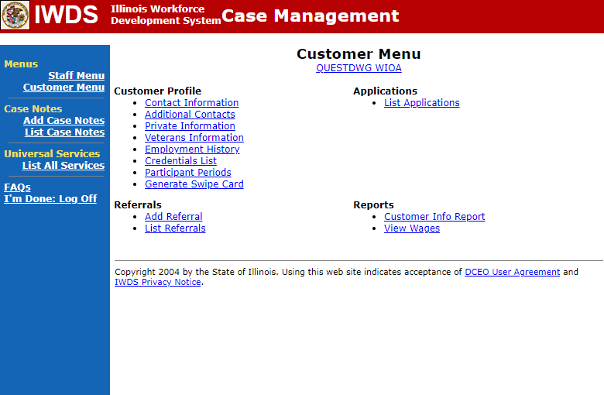
Create an Application
Once an individual is created as a “Customer” level record in IWDS, on right side under “Applications”, is “List Applications”, click on that to begin creating an application.

Slide 60
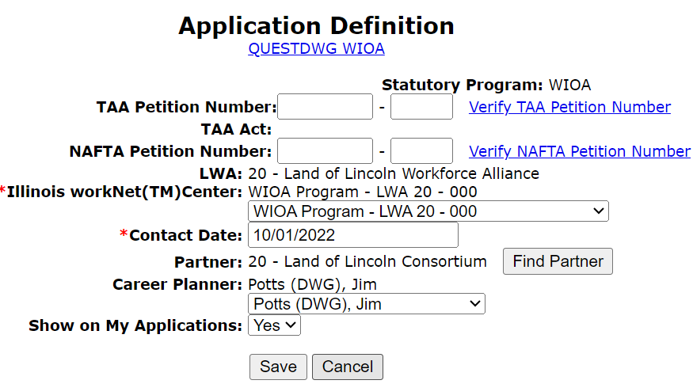
Contact Date of Application
If using the alternative eligibility, the changes in IWDS will be effective as of 10/1/2022;
IMPORTANT: The contact date for any application that will use the alternative criteria, must be dated 10/1/2022 or later to capture the updated alternative criteria.

Slide 61
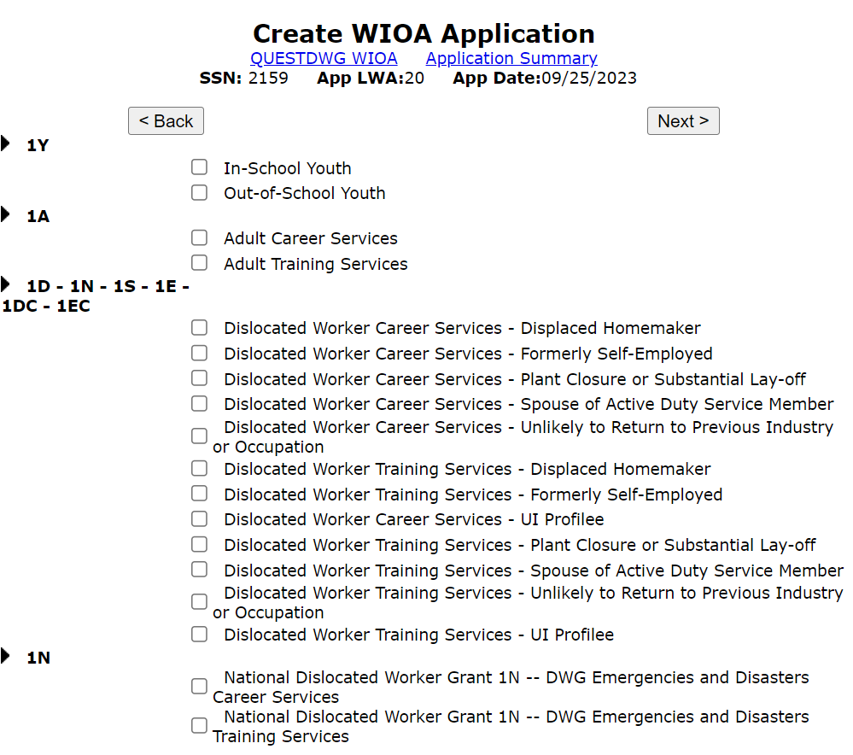
Guided Application
Guided application has all the various traditional Dislocated Worker titles as well as the guided application for the National Dislocated Worker Grant 1N – DWG Emergencies and Disasters.

Slide 62
Guided Application
In IWDS, if the client does not meet any traditional Dislocated Worker criteria, and you are attempting to qualify the client under the alternative criteria the correct guided application for QUEST Disaster DWG grants would be:
National Dislocated Worker 1N - DWG Emergencies and Disasters Career Services
National Dislocated Worker 1N - DWG Emergencies and Disasters Training Services

Slide 63
Guided Application

Slide 64
Details about Guided Application
In the example on the previous slide, I chose to complete both the Career and Training Services guided application; if you know the client you are going to serve under your QUEST Disaster DWG is only planning to receive Career Services and/or Disaster Recovery Services level services, then you could choose to just complete the “Career Services” guided application

Slide 65
Emergencies and Disaster Guided Application Screens
Contact Information;
Additional Contacts;
Private Information;
Veterans Information;
Concurrent Programs;
Tests;
Characteristics and Barriers;
Education Status;
Dislocated Worker Characteristics;
List Work History;
Public Assistance;
Family Characteristics;
WIOA Training Criteria.

Slide 66
Details about Guided Application
From the Emergencies and Disaster Guided Application screens only the Private Information screen (Authorized to Work in the U.S. & Selective Service) and the Dislocated Worker Characteristics screen (the seven alternative eligibility questions) have eligibility criteria under the Emergencies and Disaster certification.
All the information captured on the other screens in the guided application are tied to Federal Reporting requirements, and/or details about the client’s circumstances.

Slide 67
Assessment Test Requirements
For a client who is being certified under the Emergencies and Disasters Alternative criteria, if the client is going into Career Services only and/or Disaster Recovery Level services only, they would not be required to take assessment tests.
If under the Emergencies and Disasters Alternative criteria client is planning to go into WIOA funded training services, then prior to recording the training services, the internal logic within IWDS will require a Math and Reading test be recorded on or prior to the date the training service will begin.

Slide 68
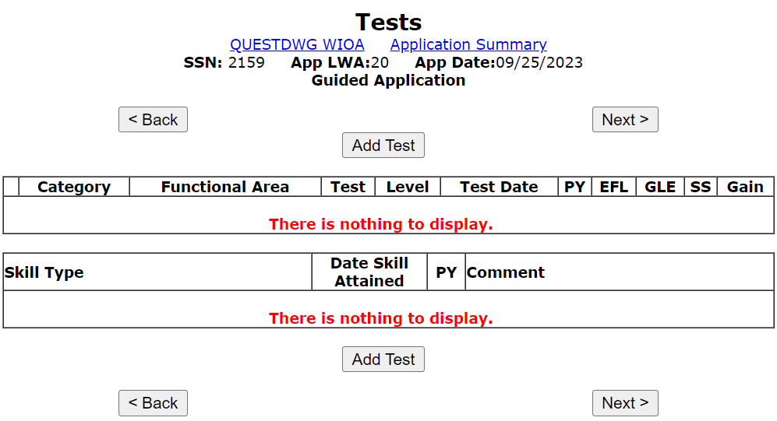
Assessment Tests
As previously mentioned, unless going into WIOA funded training services, the Emergencies and Disasters eligibility certification does not require the client to take Math and Reading Assessment tests.

Slide 69
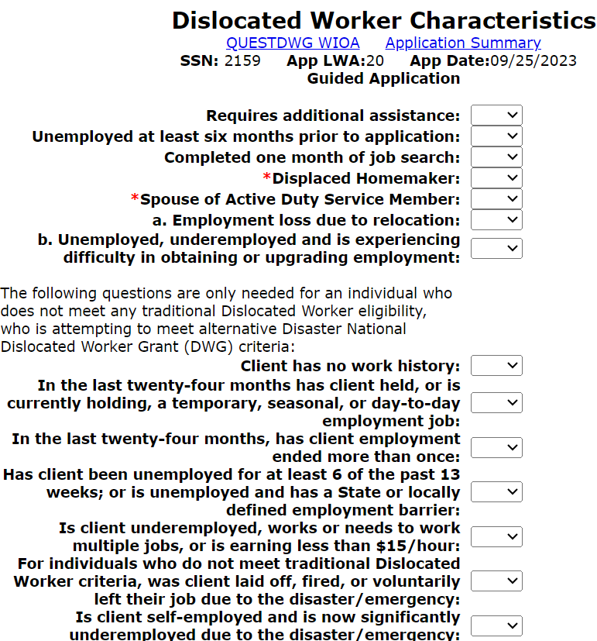
Dislocated worker Characteristics
This is the screen that has the “Emergencies and Disasters” alternative eligibility criteria.
The seven questions in the bottom of the adjacent screen print are the alternative criteria as previously discussed.

Slide 70
Emergencies and Disaster Criteria
Below are the seven (7) total alternative eligibility questions, any “Yes” response = eligible.
Client has no work history?
In the last twenty-four months has client held, or is currently holding, a temporary, seasonal, or day-to-day employment job?
In the last twenty-four months has client’s employment ended more than once?
Has client been unemployed for at least 6 of the past 13 weeks; or is unemployed and has a State or locally defined employment barrier?
Is client underemployed, works or needs to work multiple jobs, or is earning less than $15/hour?
For individuals who do not meet traditional Dislocated Worker criteria, was client laid off, fired, or voluntarily left their job due to the disaster/emergency?
Is client self-employed and is now significantly underemployed due to the disaster/emergency?
Documentation to support any “Yes” response to one or more of the questions above at certification will be the clients “Work History” or an “Applicant Statement” explaining how the client met the circumstances of the question.

Slide 71
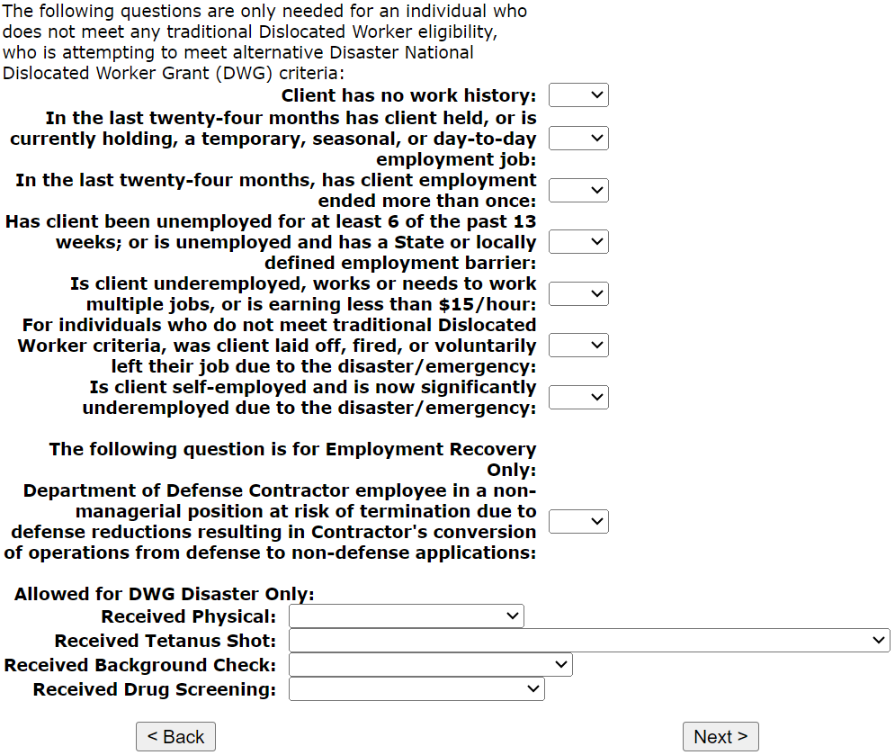
Bottom of Dislocated Worker Characteristics Screen
Toward the bottom of the Dislocated Worker Characteristics screen are four questions that will require responses for any client that will be receive “Disaster Recovery Level” of Disaster Relief Employment services where a client might be required to have Physical, or Tetanus shot, or Background Check; or Drug Screening.

Slide 72
Required and Allowed for DWG Disaster Only Questions
These questions are not needed for certification under either Emergencies and Disasters alternative eligibility criteria or under traditional Dislocated Worker eligibility.
The “Required and Allowed for DWG Disaster Only” questions must be completed for any client that will be enrolled in “Disaster Recovery Level” services, which include Disaster Relief Employment, Disaster Relief Safety Training, and Disaster Relief Employment Supportive Services.

Slide 73
Required and Allowed for DWG Disaster Only Questions
“Received Physical” is tied to any planned Disaster Relief Employment.
This question only needs to have a response if the client is going into any “Disaster Recovery Level” services, such as Disaster Relief Employment.

Slide 74
Required and Allowed for DWG Disaster Only Questions
“Received Tetanus Shot” is tied to any planned Disaster Relief Employment.
This question only needs to have a response if the client is going into any “Disaster Recovery Level” services, such as Disaster Relief Employment.

Slide 75
Required and Allowed for DWG Disaster Only Questions
“Received Background Check” is tied to any planned Disaster Relief Employment.
This question only needs to have a response if the client is going into any “Disaster Recovery Level” services, such as Disaster Relief Employment.

Slide 76
Required and Allowed for DWG Disaster Only Questions
“Received Drug Screening” is tied to any planned Disaster Relief Employment.
This question only needs to have a response if the client is going into any “Disaster Recovery Level” services, such as Disaster Relief Employment.

Slide 77
Required and Allowed for DWG Disaster Only Questions
As mentioned previously, these questions are not needed for certification under either Emergencies and Disasters alternative eligibility criteria or under traditional Dislocated Worker eligibility.
Even after certification, those four question could be populated and will be required if you attempt to enroll the client in any “Disaster Recovery Level” services:

Slide 78
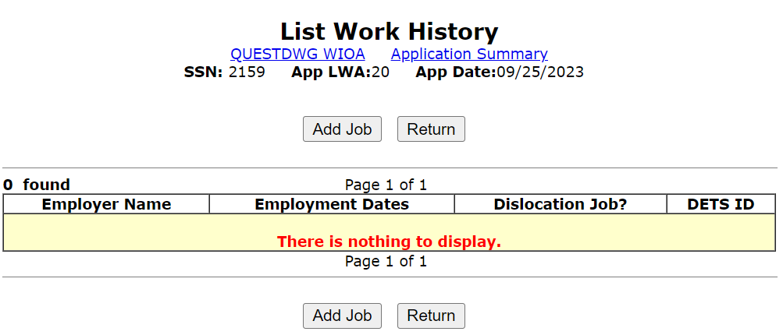
List Work History
Under the Emergencies and Disasters alternative eligibility criteria, there is no need to record a Dislocation job, as the eligibility is based on the responses to those seven (7) questions that will on the updated “Dislocated Worker Characteristics” screen discussed previously in this presentation.

Slide 79
Details about List History Screen
From the previous screen, if the client has a Dislocation job, then they should meet traditional Dislocated Worker eligibility and the alternative Emergencies and Disasters criteria should not be used.
If you are not sure if an individual would meet traditional Dislocated Worker eligibility criteria, please feel free to reach out to James (Jim) Potts at james.potts@illinois.gov

Slide 80
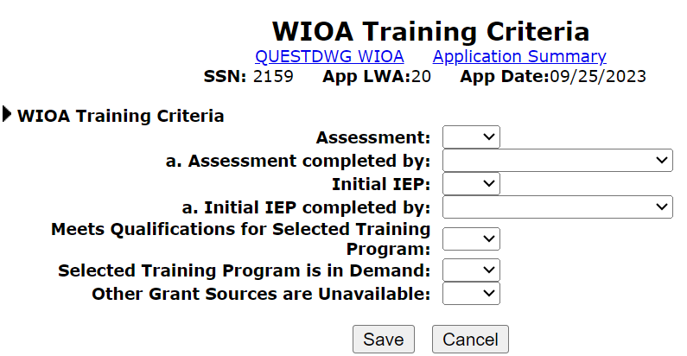
WIOA Training Criteria Screen
At the beginning of the guided application in this PowerPoint both Career and Training Services were checked; for the Training Services the only extra screen is the WIOA Training Criteria screen.
All the same IWDS logic for the answers to these questions are the same for traditional Adult and/or Dislocated Worker certification up to the “Training Services” level is needed.

Slide 81
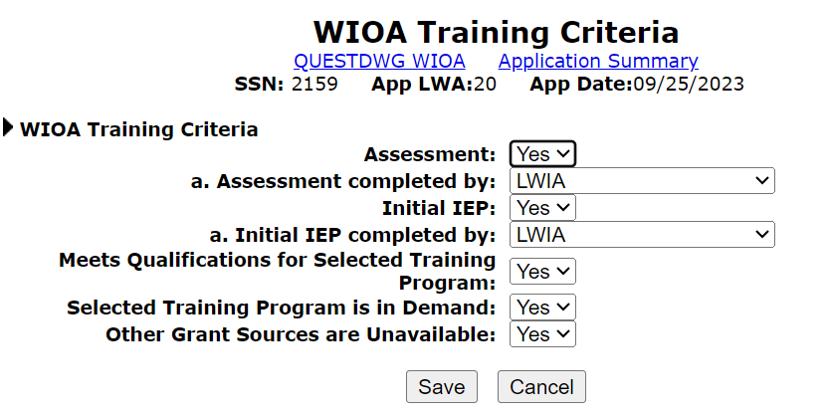
WIOA Training Criteria Screen
For this “example” client, the WIOA Training Criteria was completed as shown below:

Slide 82
Emergencies and Disaster Criteria
As mentioned previously, only the Private Information screen (Authorized to Work in the U.S. & Selective Service) and the Dislocated Worker Characteristics screen (the seven alternative eligibility questions) have eligibility criteria under the Emergencies and Disasters alternative criteria; the information captured on the other screens in the guided application are tied to Federal Reporting requirements, and/or basic details about the client’s circumstances.

Slide 83
Eligibility Determination Screen

Slide 84
Application Date Details
The Application date can be on or after any date from the original application contact date.
For this client, application date must be any date on or after 10/01/2022.

Slide 85
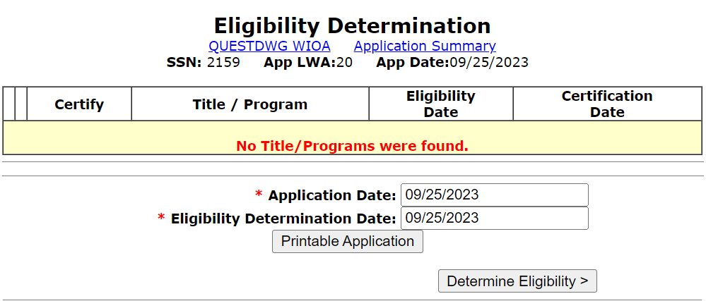
Application Date and Eligibility Date
Your application date and eligibility determination date are not required to be on the same date.
For most WIOA titles, internal IWDS logic requires eligibility determination date must be within 30 days of the application date.

Slide 86
Eligibility Determination
When we click on “Determine Eligibility” IWDS logic will take the responses we put in the application and display which titles the client might be eligible under WIOA.
Keep in mind, a client might be eligible under several WIOA titles, but your 1N QUEST Disaster DWG can only be utilized for individuals who either meet any traditional WIOA Dislocated Worker Eligibility or 1N Emergencies and Disasters Eligibility.

Slide 87
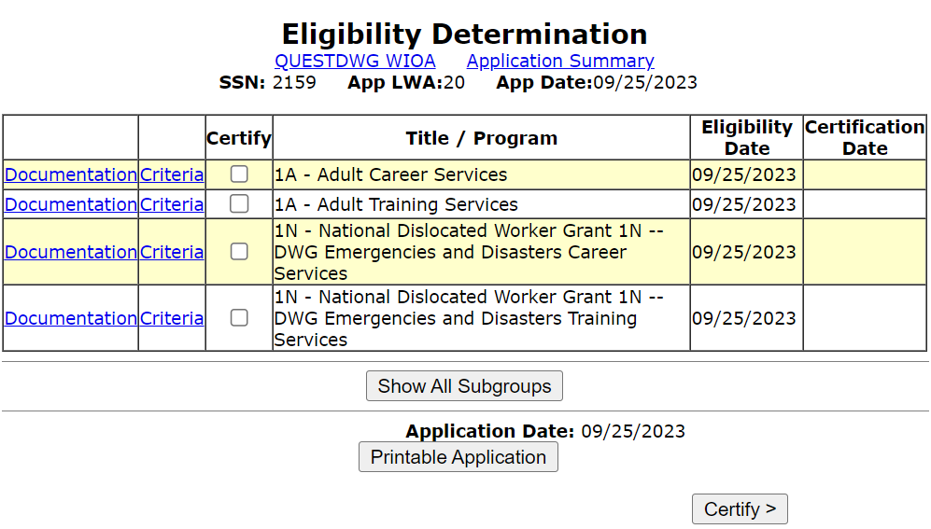
Eligibility Determination
Based on the information recorded in the completed guided application, this client is eligible under the Adult title and the alternative Emergencies and Disaster Career and Training Services.

Slide 88
Eligibility Certification
For this client, we are not interested in certifying under the Adult title.
This client does not meet any traditional WIOA Dislocated Worker title eligibility, so we would want to certify under the 1N Emergency and Disaster criteria.
The1N National Dislocated Worker - Emergency and Disaster criteria would be what we would certify this client under if we are wanting to serve the client under the QUEST Grant.

Slide 89
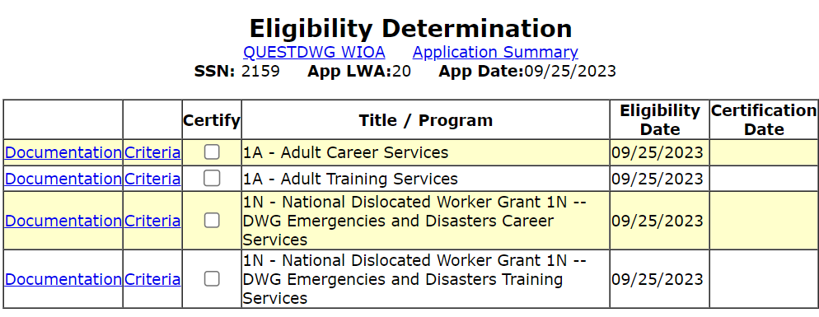
Alternative DWG Criteria Certification
In this situation, since this client did not meet any traditional dislocated worker criteria, and we are going to serve the client under the QUEST Disaster DWG, so we will certify under National Dislocated Worker Grant 1N – DWG Emergencies and Disasters Career Services.

Slide 90
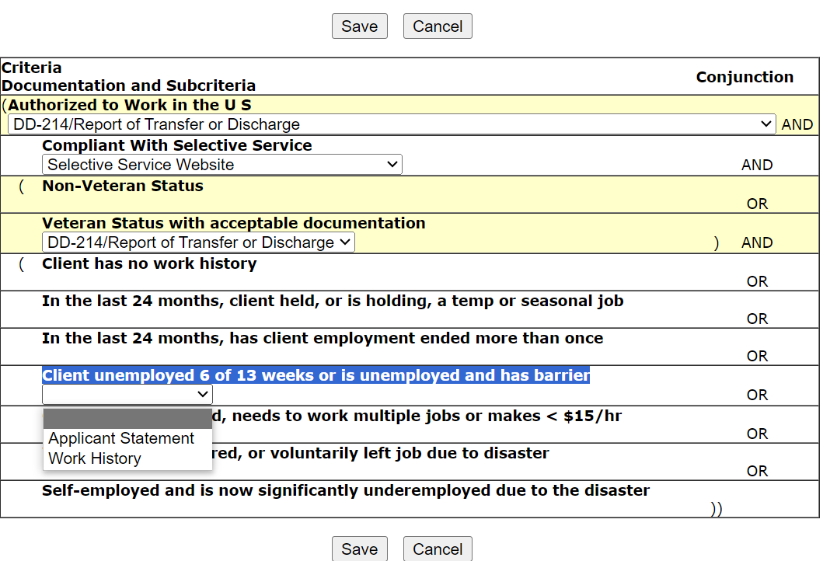
Alternative DWG Criteria Certification
All clients must support Authorized to Work in the U.S. and if born male, on or after 1/1/1960 must be compliant with Selective Service.
Then documentation to support the alternative criteria.

Slide 91
Documentation Supporting Alternative Criteria
Last year there was a lot of questions about the documentation to support the alternative eligibility for the DWG Emergencies and Disasters criteria:
Key to understand for any “Yes” to the seven (7) different alternative eligibility question, there needs to be an independent documentation explaining how the client met the specific criteria.
We recommend having the client choose only one (1) of the seven (7) different criteria, and it should be the one that is easiest to support.
Another point from last year, if multiples questions are answered with a “Yes” response, then the particular question should not contradict one of the other “Yes” responses.
As an example, last year we had instances where a record had “No Work History” checked “Yes” and then also had another “Yes” to the question about “In the last 24 months, employment ended more than once”.

Slide 92
Alternative DWG Criteria Certification
Often for these alternative criteria, the documentation might be a combination of both work history and the applicant statement to tie the criteria together, even though only one choice could be selected.

Slide 93
Alternative DWG Criteria Certification

Slide 94
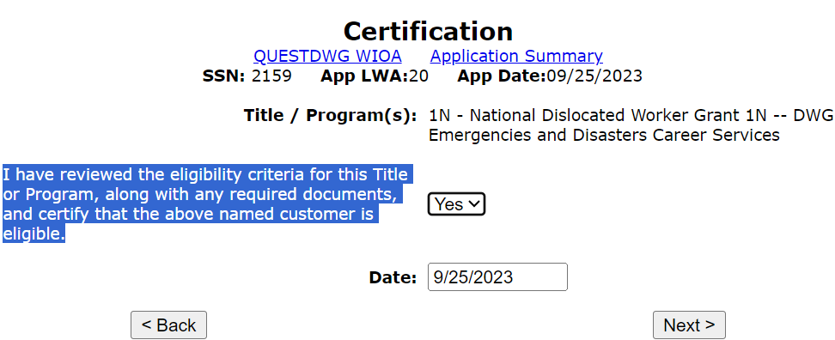
Alternative DWG Criteria Certification

Slide 95
Enrollment in Services

Slide 96
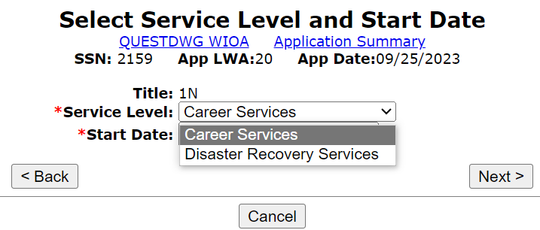
Enrollment in Services

Slide 97
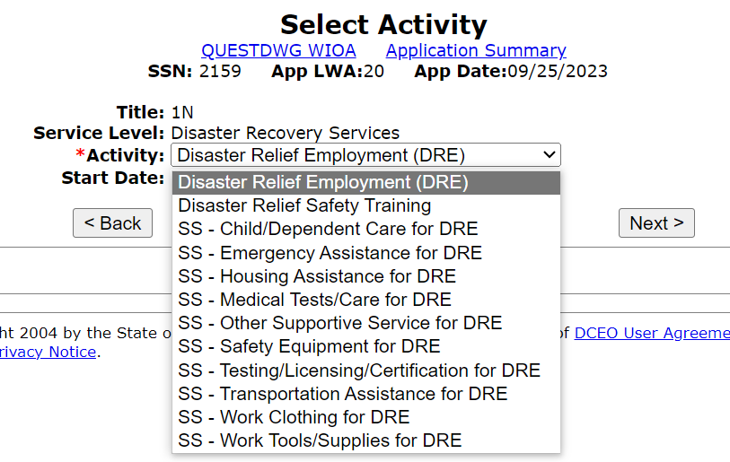
Enrollment in Services
If enrollment in the Disaster Recovery Services, such as Disaster Relief Safety Training or Disaster Relief Employment (DRE) and/or Supportive Services under Disaster Relief (DR):

Slide 98
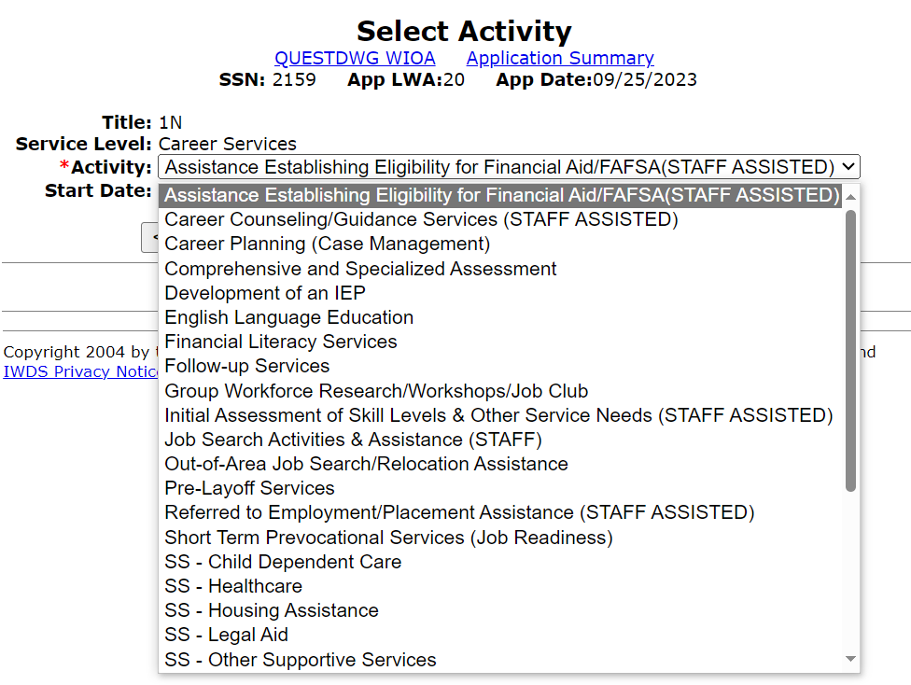
Enrollment in Services
Or if the client will be enrolled in traditional Career Services?

Slide 99
So Far You Have Seen
We had a discussion of the QUEST Disaster National Dislocated Worker (DWG).
We discussed how any client who meets traditional Dislocated Worker criteria, or any client who will meet the alternative Emergencies and Disasters Services will be able to get served under the QUEST Disaster DWG.
We discussed details around the new/updated traditional Dislocated Worker Eligibility criteria specifically addressing the broadened criteria under “Substantial Layoff” and the stand-alone “UI Profilee” criteria.
We discussed and demonstrated the alternative eligibility questions that are in IWDS for the 1N Emergency and Disaster alternative eligibility.
We discussed and demonstrated details about the 1N Emergency and Disaster application eligibility and certification within IWDS.

Slide 100
Current WIOA Adult or Youth Registrant
With the PY22 QUEST Disaster DWG, there were questions about could a current WIOA Adult or Youth Registrant be co-enrolled under the QUEST Disaster DWG if they met the alternative Emergencies and Disaster criteria.
That is allowable but the current WIOA Adult or Youth Registrant client enrolled, must meet criteria of being an “Under-served and historically marginalized individual” and would meet one or more of the alternative criteria and the individual could be co-enrolled.
The next several slides explain how this is accomplished in IWDS.

Slide 101
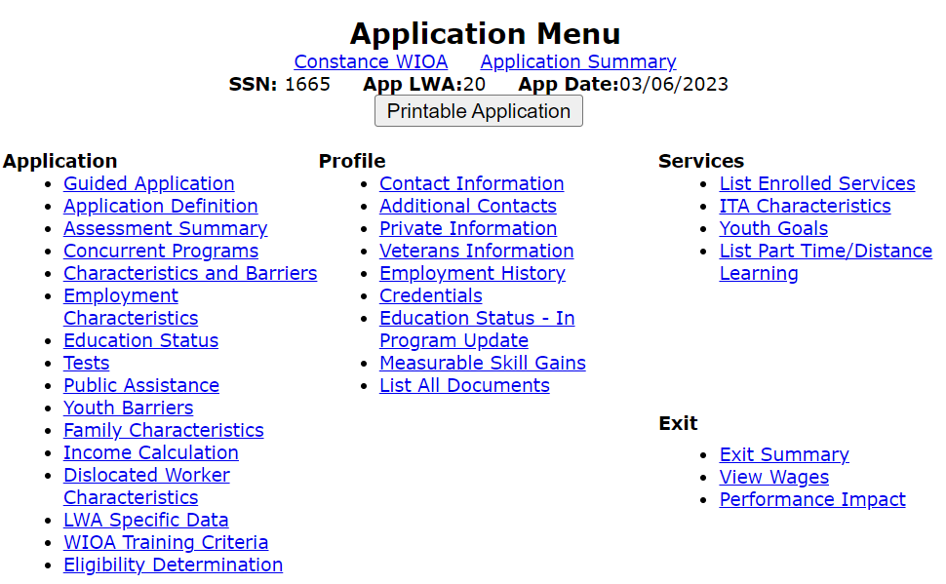
Current Registrant – Co-Enroll
Go into the Application Menu of any current WIOA Adult or Youth in IWDS who is a good candidate to co-enroll under your 1N QUEST Disaster DWG; then you will click on “Dislocated Worker Characteristics” screen.

Slide 102
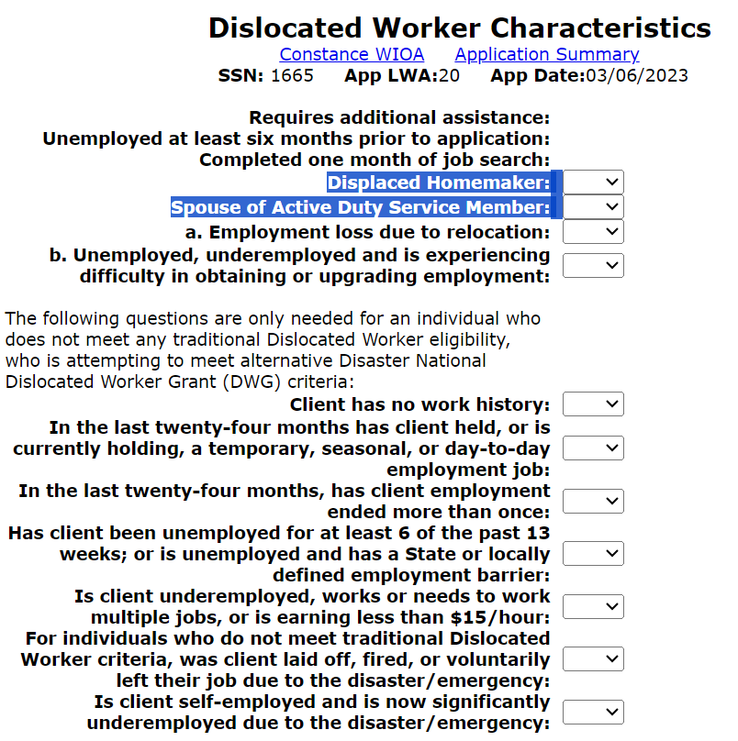
Current Registrant – Co-Enroll
Internal logic within IWDS will require that you populate the questions of “Displaced Homemaker” and “Spouse of Active-Duty Service Member”.
Both questions should be “No”; if either would be “Yes” the client would meet traditional Dislocated Worker criteria.
Leave the two questions a. & b., below “Spouse of Active-Duty Service Member” blank as shown in the bottom screen print on the adjacent screen print.

Slide 103
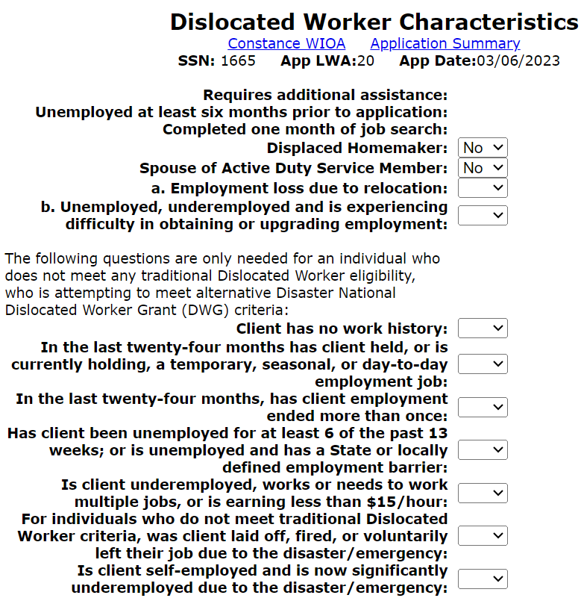
Current Registrant – Co-Enroll
Then update the alternative criteria that the client meets:
You only need to populate one of the alternative criteria; if you populate multiple alternative criteria, it does not make your client “extra” qualified.
For each alternative criteria you put a “Yes”, you must have addressed how the client would meet that criteria.

Slide 104
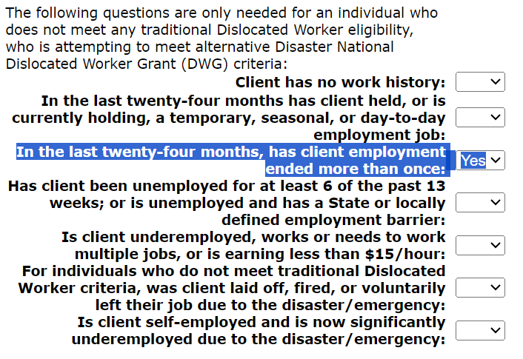
Current Registrant – Co-Enroll
In this example, I populated that in the last twenty-four months, client employment ended more than once.
Next step, record a detailed case note explaining how the client meets criteria of “Under-served and historically marginalized individual”.
On the next slide is the definition of “under-served and historically marginalized individual.

Slide 105
Underserved and Historically Marginalized
LWIAs will identify underserved and historically marginalized populations and communities based on their local assessment of community need and service gaps, utilizing partnership and community data. Such populations of underserved and historically marginalized individuals include, but are not limited to: Veterans; individuals with disabilities; persons of color; women; justice-involved individuals; immigrants; refugees; homeless individuals and those at risk of homelessness; low-income individuals; individuals in or aged-out of Foster Care; GED candidates and recipients; public assistance recipients; individuals who are basic skills deficient; UI Profilees; individuals unemployed for an extended period; individuals age 55 and over; lower-wage workers; child-care-challenged workers; high-unemployment-area residents; rural residents; individuals residing in a Qualified Census Tract (QSI) or a Disproportionately Impacted Area (DIA); individuals who have exhausted their unemployment insurance benefit; and individuals with other employment barriers.

Slide 106
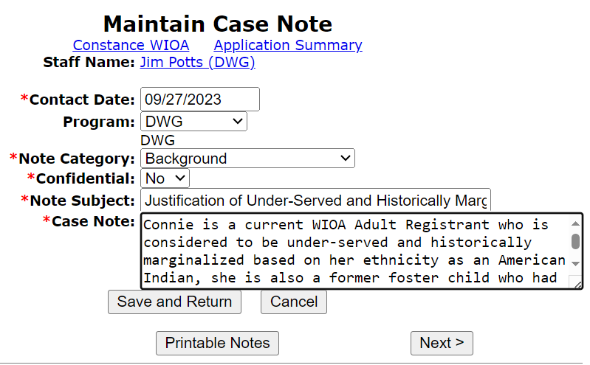
Current Registrant – Co-Enroll
Detailed case note explaining how the client meets criteria as an “Under-served and historically marginalized individual”.
This type of note is needed for each client that will be enrolled in your 1N QUEST Disaster DWG.

Slide 107
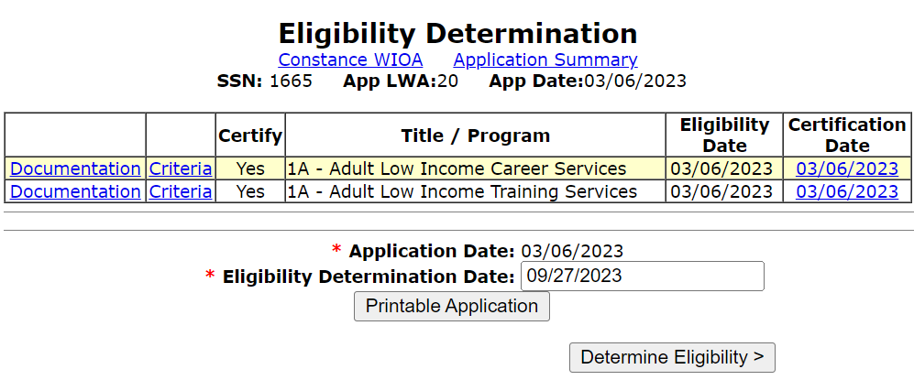
Current Registrant – Co-Enroll
Conduct the WIOA Eligibility determination after the new criteria has been recorded.
Eligibility determination date should be on or after the date of the case note supporting enrollment, so in this case 9/27/2023.

Slide 108
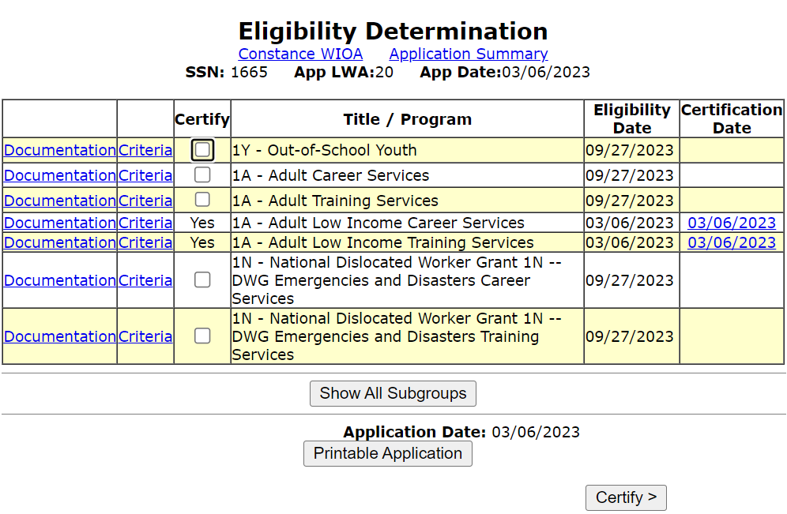
Current Registrant – Co-Enroll
As shown on the adjacent screen print, the client is now eligible under the N – National Dislocated Worker Grant 1N – DWG Emergencies and Disasters Career Services and Training Services.
This will be accomplished by following the same steps shown previously on slides 93-98 of this PowerPoint.

Slide 109
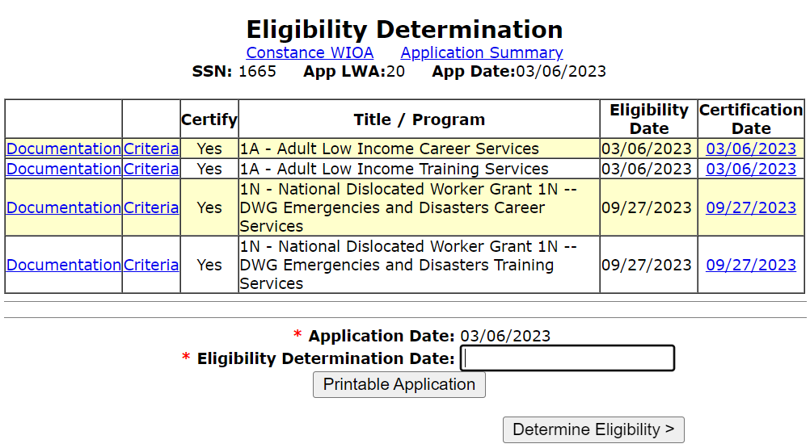
Current Registrant – Co-enrolled
Client was certified under the DWG Emergencies and Disasters Career and Training Services on 9/27/2023.
The steps that were taken to certify were previously shown on slides 93-98 of this PowerPoint.

Slide 110
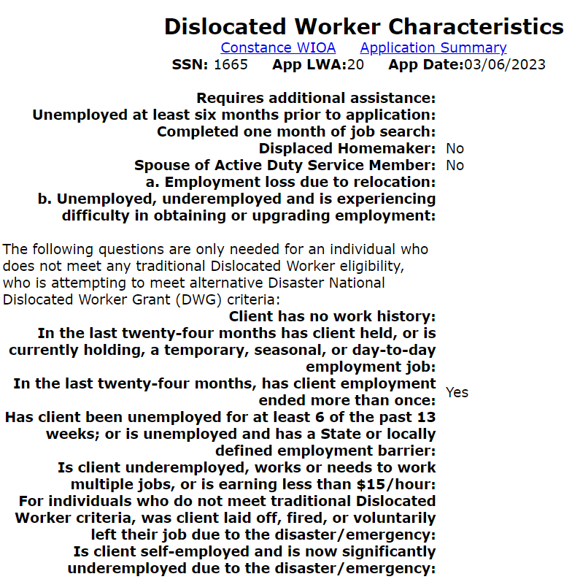
Current Registrant – Co-Enroll
Previously certified Adult client is now co-enrolled and the alternative eligibility criteria used to support the new 1N – National Dislocated Worker Grant 1N – DWG Emergencies and Disasters Career Services you will see that alternative criteria has been locked.

Slide 111
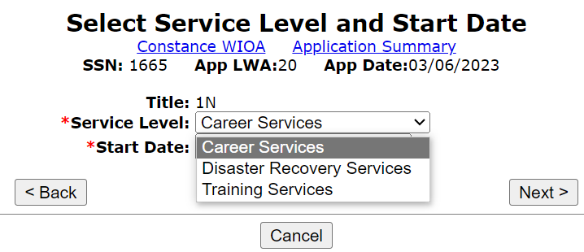
Current Registrant – Co-Enroll
Now the 1N title is available for enrollment in 1N – QUEST Disaster DWG services as shown on the adjacent screen.

Slide 112
Case Note for all QUEST Disaster DWG Clients
To reiterate, for every client that will be served under the 1N – QUEST Disaster DWG, staff must be a detailed case note explaining how the client meets the criteria of “Under-served and historically marginalized individual”.
The next slide demonstrates the complete case note on this “example” client on how this client met the criteria of “Under-served and historically marginalized individual”.

Slide 113
Case Note on How Meets Priority
Entire example case note for QUEST Disaster DWG “mock” client:

Slide 114
Current Registrant – Co-Enroll Wrap up
This portion of the PowerPoint demonstrated the steps needed for taking a current WIOA Adult client who would like to be co-enrolled under the 1N National Dislocated Worker – Emergencies and Disasters eligibility; then this PowerPoint discussed and demonstrated the requirements around recording a case note for the 1N QUEST Disaster DWG client explaining how they met the criteria of “Under-served and historically marginalized individual”.

Slide 115
In conclusion
We had a discussion of the QUEST Disaster National Dislocated Worker (DWG).
We discussed how any client who meets traditional Dislocated Worker criteria, or any client who will meet the alternative Emergencies and Disasters Services will be able to get served under the QUEST Disaster DWG.
We discussed details around the new/updated traditional Dislocated Worker Eligibility criteria around “Substantial Layoff” and “UI Profilee”.
We discussed and demonstrated the alternative eligibility questions that are in IWDS for the 1N Emergency and Disaster alternative eligibility.
We discussed and demonstrated details about the 1N Emergency and Disaster application eligibility and certification within IWDS.

Slide 116
Questions
If you have questions about anything in this PowerPoint, please reach out to James (Jim) Potts at james.potts@Illinois.gov or call him at (217) 416-7097 OR,
You can contact Jill Meseke who provides oversight of the National Disaster Worker Recovery Grants, and she can be reached at mesekejill@gmail.com or call her at (217) 553-4243.

