Slide 1
WIOA Mandated Follow-up Requirements
June 22nd, 2023

Slide 2
Today’s Objectives
Discuss the Federal and State requirements tied to Workforce Innovation and Opportunity Act (WOIA) legislatively mandated Follow-up Services for clients who were served under WIOA.
Understand the guidance and rules for providing follow-up activities for WIOA Title IB Adults, Dislocated Workers and Youth.
Demonstrate recording Follow-up services within Illinois Workforce Development System (IWDS).

Slide 3
Federal Guidance
Workforce Innovation and Opportunity Act of 2014
Training and Employment Guidance Letter (TEGL) 19-16 – Guidance on Services Provided through Adult and Dislocated Worker under WIOA – dated March 1st, 2017.
TEGL 21-16 – Third WIOA Title I Youth Formula Guidance – dated March 2nd, 2017
TEGL 09-22 – Third WIOA Title I Youth Formula Guidance – dated March 2nd, 2023

Slide 4
State Guidance
DCEO Office of Employment & Training (OET) Policy Chapter 4 Section 3 - Follow-Up Services – effective 5/11/2023.
DCEO OET Policy Chapter 4 Section 3.1 – Adult and Dislocated Workers Programs Follow-Up Services – effective 5/11/2023.
DCEO OET Policy Chapter 4 Section 3.2 – Optional Adult and Dislocated Worker Follow-up Services – effective 5/11/2023.
DCEO OET Policy Chapter 4 Section 3.3 – Youth Program Follow-Up Services – effective 5/11/2023.
Note: DCEO OET Policy Unit is in the process of updating the Adult and Dislocated Worker Follow-up Policy 4.3.2, please be on the lookout for this updated guidance in the next few weeks.

Slide 5
Follow-up Guidance
Federal guidance requires states and local areas to set policy on Follow-Up Services:
OET Policy Chapter 4: Section 3 - Follow-Up Services – provides overall guidance for Adult, Dislocated Worker and Youth follow-up related to two-way communication; including telephone conversations, in person or via e-mail (or other social media) could be considered two-way communication as part of follow-up.
This policy guidance states that sending a letter or leaving a voicemail for a client is not an acceptable two-way communication to be recorded as follow-up.

Slide 6
Follow-up Guidance
Other guidance in OET Policy Chapter 4: Section 3 - Follow-Up Services:
It is the responsibility of the Career Planner to determine, in conjunction with the Participant, which follow-up services after exit would best suit the individual’s circumstances.
Follow-up Services and information obtained may directly impact Federal Performance Reporting and Outcomes.
POST Exit Supplemental Employment/Wages, Secondary and Post Exit Education and Credentials/Certificates will positively impact performance outcomes ONLY when they are documented during follow-up.
Supplemental Employment Information (and education status counts for YOUTH) in the 2nd and 4th Quarter POST exit count as positives ONLY when they are documented in Follow-up.

Slide 7
Follow-up Guidance
Other guidance in OET Policy Chapter 4: Section 3 - Follow-Up Services:
Guidance is given that follow-up should be as often as necessary throughout the required twelve (12) months.
At a minimum, it should occur at least every thirty (30) days for the first three (3) months and then must occur at least once a quarter for the remainder of the twelve (12) month period.
This aligns with quarterly post-exit reporting requirements.

Slide 8
Follow-up Guidance
Other guidance in OET Policy Chapter 4: Section 3 - Follow-Up Services:
The follow-up service activity must be recorded in Illinois Workforce Development System (IWDS) throughout the required twelve (12) months.
Follow-Up is opened with a start date, but the actual follow-up activities are recorded within the Case Note section or on the exit control panel of the client’s record.
Notes:
Future Update - See SLIDE 34 of the IA/ID Session 3 Part 2 Service Matrix PPT.

Slide 9
Adult and Dislocated Worker
Federal requirements for Follow-up for Adult and Dislocated Workers in “Unsubsidized Employment”.
Follow-up services must be provided for Adult and Dislocated Worker clients up to twelve (12) months after the first date of employment for Adults and Dislocated Workers who obtain “Unsubsidized Employment” and are exited.

Slide 10
Adult and Dislocated Worker
From Recent US DOL Monitoring: Finding - Improper Program Exits:
The regulations require that exits must be service-based. WIOA Section 677.150 (c) states:
As defined for the purpose of performance calculations, Exit is the point after which a participant who has received services through any program meets the following criteria: (1) For the adult, dislocated worker, and youth programs authorized under WIOA title I, the AEFLA program authorized under WIOA title II, and the Employment Service program authorized under the Wagner-Peyser Act, as amended by WIOA title III, exit date is the last date of service. (i) The last day of service cannot be determined until at least 90 days have elapsed since the participant last received services; services do not include selfservice, information-only services or activities, or follow-up services. This also requires that there are no plans to provide the participant with future services.
Note: Guidance under Section 677.150 (c)(1)(i) indicates that follow-up services do not extend the date of exit, and Section 116 of WIOA requires states to ensure data submitted and reported to the Department is valid and reliable.

Slide 11
IA/ID Follow-Up Services
Career Services versus Follow-Up Activities –
During monitoring DOL sited:
“Four participants were exited on the day they received a follow up call verifying employment rather than the last day a service was provided.”
“Additionally, DCEO erroneously instructed staff and did not correct anomalies with exit dates. DCEO incorrectly determined that employment verification is a service to participants and instructed the local area staff to use the date of employment verification as the exit date.”

Slide 12
IA/ID Follow-Up Services
Career Services versus Follow-Up Activities –
Staff documented career services and/or “same day” episodes on dates when only employment verification occurred.
Employment verification is not considered a program service that extends participation or exit.
Exit dates are not tied to follow-up via “information only” correspondence like employment verification.
Result/Finding: Programs were not properly determining and reporting the dates on which participants’ last “active” career service occurred. Therefore, their exit dates aligned with follow-up activities instead of last active services.

Slide 13
IA/ID Follow-Up Services
Career Services versus Follow-Up Activities -
Refer to Individual Employment Plan (IEP).
Identify differences between enrolling (active) career services and follow-up activities.
Identify and document date of last enrolling service to determine when to begin documenting follow-up via case notes.
NOTE: Closely examine details of career services definitions versus the follow-up activities in the Services Matrix.

Slide 14
IA/ID Follow-Up (Post Exit) Application:
“Career” Service – During Participation
“Job Search Activities and Assistance”
Career planner who matches a current WIOA participant with employers and existing job openings.
Placement and activities occur during program participation.
Examples:
Staff research and analysis of participant’s prior job experience, career goals, and occupational interests for job placement.
Employment research may be focused on training program the individual has completed.
Staff may provide supportive service to assist in acquiring the employment or starting work.
Follow-Up Service–Post-Exit
Activities may include:
Assistance with maintaining the job/employment a former WIOA “participant” gained during the program may include:
Career planner working with both the employer and client;
Assistance with work related problems;
Contact to secure better paying jobs
Additional career planning and counseling.
Identified in IEP.
Occur after last active service and date of exit is determined
Supportive Services, such as transportation, are not allowed for IA/ID in Follow-Up.
Notes:
Compare real-life examples of a career service occurred versus follow-up activities.

Slide 15
Question about Adult or DW Client
Both Federal and State guidance states Follow-up services must be provided for Adult and Dislocated Worker clients up to twelve (12) months after the first date of employment for Adults and Dislocated Workers who obtain “Unsubsidized Employment”.
QUESTION: If a client is currently receiving WIOA enrolling services when they obtain “Unsubsidized Employment”, IWDS will not allow opening the follow-up service. How could we meet the follow-up requirements when a client is still receiving WIOA services and IWDS will not allow follow-up service to be opened/recorded?

Slide 16
Answer about Adult or DW Client
QUESTION: If a client is currently receiving WIOA enrolling services when they obtain “Unsubsidized Employment”, IWDS will not allow opening the follow-up service. How could we meet the follow-up requirements when a client is still receiving WIOA services and IWDS will not allow follow-up service to be opened/recorded?
ANSWER: In instances when the client enters “unsubsidized employment” while still enrolled in traditional WIOA services, the follow-up should be included and recorded by the Career Planner as part of the routine, two-way communication with the client that must occur at least every 30 days.

Slide 17
Adult and Dislocated Worker
OET Policy Chapter 4: Section 3.1 provides specific feedback on Adult and Dislocated Worker Programs Follow-Up Service.
When all WIOA services have been completed, then the activity of Follow-up should be opened.
All two-way communication completed as part of follow-up, should be recorded under the “Case Note” feature within IWDS and/or on the exit control panel of the client’s record.
Outcomes that impact performance should be documented and recorded in corresponding POST EXIT Quarter Section on the exit control panel of the client’s record in IWDS.

Slide 18
Adult/Dislocated Worker who obtains Unsubsidized Employment
In instances where either an Adult or Dislocated Worker client obtain unsubsidized employment while still enrolled in WIOA services, it is not possible to open the service of Follow-up; in those situations, Follow-up is conducted during normal two-way communication and recorded in the client’s case notes.
Make sure to detail the case note so it is clear that beginning Follow-up due to the client has obtained Unsubsidized Employment.
The next slide demonstrates an example case note.

Slide 19
Adult/Dislocated Worker who obtains Unsubsidized Employment

Slide 20
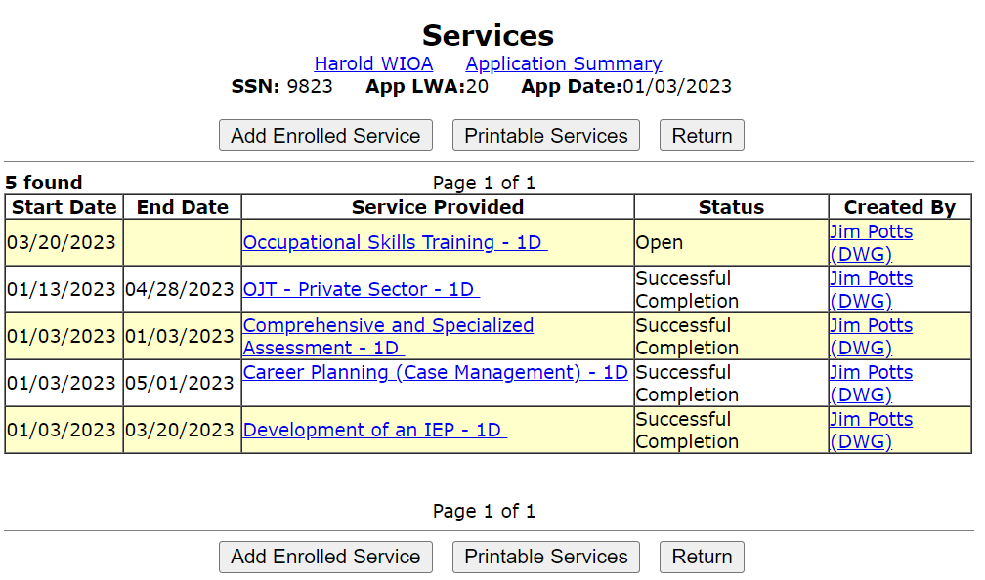
Adult/Dislocated Worker who obtains Unsubsidized Employment
This client was hired into unsubsidized employment following a WIOA funded OJT, however, the client still has a WIOA Training Service open so traditional Follow-up cannot be opened until all WIOA Services are completed.

Slide 21
Adult and Dislocated Worker
OET Policy Chapter 4: Section 3.1 provides specific feedback on Adult and Dislocated Worker Programs Follow-Up Service.
For those Adult and Dislocated Worker clients who obtain unsubsidized employment, the follow-up services are designed to help individuals retain employment, earn wage gains, or advance within their occupation.
Supportive Services cannot be provided for Adult and Dislocated Worker clients who are enrolled in Follow-up
Note: Supportive Services are allowed for Youth clients who are enrolled Follow-up if justified/supported in the client’s Individual Service Strategy (ISS).

Slide 22
Adult and Dislocated Worker
Follow-Up services must be provided as appropriate related to counseling regarding the workplace to improve/assist with retention of employment.
Below are a list of activities offered, but is not limited to the following:
Counseling individuals about the workplace;
Contacting individuals or employers to verify employment;
Contacting individuals or employers to help secure better paying jobs;
Assisting individuals and employers in resolving work-related problems;
Connecting individuals to peer support groups;
Providing individuals with information about additional educational or employment opportunities; and
Providing individuals with referrals to other community resources.

Slide 23
Question about Adult or DW Client
QUESTION: In instances where an Exited Adult or Dislocated Worker client is enrolled in Follow-up; could a supportive service be provided ?

Slide 24
Answer about Adult or DW Client
QUESTION: In instances where an Exited Adult or Dislocated Worker client is enrolled in Follow-up; could a supportive service be provided ?
ANSWER: The only way to provide a supportive service for an exited Adult or Dislocated Worker would be if the client has not been exited more than 90 days, then the exit would need to be removed, and the client could resume being served. If this is done, the exit date would then change to the new last date of service.

Slide 25
Adult and Dislocated Worker
According to OET Policy Chapter 4: Section 3.1
After ninety (90) days following exit, if a participant is not responsive, cannot be located, or refuses to provide information, the Career Planner may close follow-up services.
When that is done, case notes and the Individual Employment Plan (IEP) must document the reason for discontinuation of the follow-up services.

Slide 26
Adult and Dislocated Worker
In instances where an Adult or Dislocated Worker Participant does not obtain unsubsidized employment upon completion of traditional WIOA Services, follow-up services should be made available.
Understanding the client is still being tracked for Federal Reporting and Performance outcomes for 12 months post exit, it makes perfect sense to stay engaged with the client to assist with gaining self-sustaining employment.
If individuals who do not obtain unsubsidized employment and decline follow-up services, policy Chapter 4 Section 3.1 states it must be documented in the Case Notes and the IEP.

Slide 27
Youth Guidance
Follow-Up for all Youth – OET Policy Chapter 4: Section 3.2
Follow-up services are critical services provided following a participant’s completion of WIOA services to help ensure their success in employment and/or postsecondary education and training.
The goal of follow-up services for youth is to enable participants to continue life-long learning and achieve a level of self-sufficiency to ensure job retention, wage gains, and postsecondary education and training progress.

Slide 28
Youth Follow-up Guidance
Follow-Up for all Youth – Chapter: 4 Section 3.2
Follow-up services for all Youth must be made available to all WIOA Youth for a minimum of twelve (12) months from the exit.

Slide 29
Youth Follow-up Guidance
Youth follow-up may include, but are not limited to the following program elements:
Supportive Services – if funding is available and the need for supportive services are supported in the Individual Service Strategy (ISS) for the client;
Adult Mentoring;
Financial Literacy education;
Services that provide labor market and employment information;
Activities that help youth prepare for and transition to postsecondary education and training;
Other services necessary to ensure the success of the youth in employment and/or postsecondary education.

Slide 30
Youth Follow-up Guidance
You might notice from the previous slide, along within Youth TEGL 21-16 (specifically on page 19), that many of the allowable activities for a Youth as part of follow-up, include but are not limited to to “Adult Mentoring”; “Financial Literacy Education”; “Labor Market Information”; as well as “Supportive Services”, which are all enrolling Youth activities.
QUESTION: How would those activities be recorded in IWDS when the client would receive one or more of those activities as part of the Follow-up?

Slide 31
Youth Follow-up Guidance
QUESTION: How would those activities be recorded in IWDS when the client would receive one or more of those activities as part of the Follow-up?
ANSWER: When any of those Youth activities that are considered enrolling Youth elements are needed as part of a Youth clients follow-up; first the “Individual Service Strategy” should be updated to include details about what was needed and provided in regards to those Youth activities being provided as part of Follow-up. The actions are then recorded in the case notes of the client.

Slide 32
Youth Follow-up Guidance
As mentioned on the previous slide, IF any of those Youth activities that are part of actually enrolling services are provided during Follow-up, after updating the ISS with details on why those were needed, the actions/information are simply recorded under the case notes describing actually what was provided;
No actual service element would be recorded. It is not considered an “enrolling” Youth element and doest not extend exit.
Does not reset/extend the clients required twelve (12) months of follow-up.

Slide 33
Adult Mentoring During Follow-up
In TEGL 09-22, WIOA Title I Youth Guidance issued on March 2nd, 2023 the policy specifically lists “Adult Mentoring” occurring as part of Youth Follow-up is something that they (DOL) are tracking and it appears on a national basis, they believe “Mentoring” is something that should be utilized more than it is currently being recorded.
Let us examine the “Adult Mentoring” definition (see next slide) and discuss ideas to utilize this activity not only during participation but also while a Youth client is enrolled in Follow-up.

Slide 34
Adult Mentoring Definition

Slide 35
Youth in Follow-up – Receiving Adult Mentoring
Receiving “Adult Mentoring” in Follow-up – example case note recording this allowable activity during follow-up:

Slide 36
Supportive Services Provided as Part of Youth Follow-Up
First you must review your local policy related to supportive services to see if they are an allowable expense for Youth who are in follow-up.
Next, the supportive services provided during follow-up for a Youth, are typically when something out of the ordinary occurs, and any supportive services provided during follow-up would then be spelled out in the Individual Service Strategy and detailed in the post exit follow-up case notes. (See next slide for an example out of the training platform of IWDS.)

Slide 37
Example Case Note to Support Post Exit Supportive Service

Slide 38
Youth Guidance
Opting Out of the twelve (12) month follow-up period may occur at any point in time. The request to opt-out or discontinue follow-up services must be clearly documented in the case notes.
Final Regulation and rules under WIOA allow for youth to decline follow-up services altogether, however, when that occurs it should be the exception and not the rule.
You spend a lot of time helping a Youth client getting aimed towards the right direction in life through WIOA Youth services/activities.
If all attempts and efforts to contact the youth occur and are documented in the case notes, then “Unable to Locate” could be used and follow-up would not be provided.
Career Planners should encourage all youth to participation in follow-up activities“ and avoid them “opting” out.

Slide 39
Transition from WIOA Enrolling Services into WIOA Follow-up
QUESTION: When does a WIOA client transition from being enrolled in WIOA services into having their WIOA follow-up services opened up in IWDS?

Slide 40
Transition from WIOA Enrolling Services into WIOA Follow-up
QUESTION: When does a WIOA client transition from being enrolled in WIOA services into having their WIOA follow-up services opened up in IWDS?
ANSWER: The Individual Service Strategy (ISS) for a Youth and the Individual Employment Plan (IEP) for an Adult and/or Dislocated Worker; once all objectives and the overall goal laid out in the clients ISS/IEP have been met, and all WIOA services are closed and no further WIOA services are planned is when the client should have their WIOA Follow-up Service opened.

Slide 41
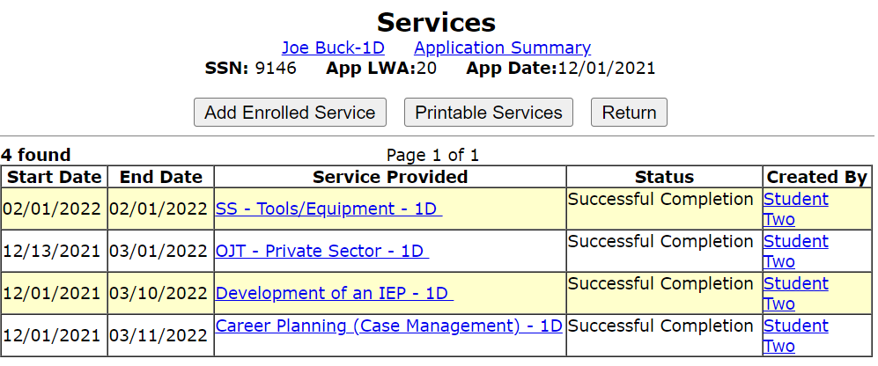
When to Open Follow-Up
For the example client below, the last enrolling service was closed on 3/11/2022. This client has met all requirements laid out in the IEP and no other services are planned, so now the Service of Follow-up should be opened.

Slide 42
Documenting the Service of Follow-up
For the example client on the previous slide, the final WIOA service(s) were recorded/closed on 3/11/2022.
On the next slide, it will demonstrate opening the actual “Follow-Up Service” in the IWDS record.
The Follow-up Service will begin on 3/11/2022, which is the same date the final WIOA service(s) were completed.
The actual start date of follow-up could be recorded on the same date the last enrolling service ended, or you could open the follow-up service on the day after the last enrolling service had ended; either one is acceptable.

Slide 43
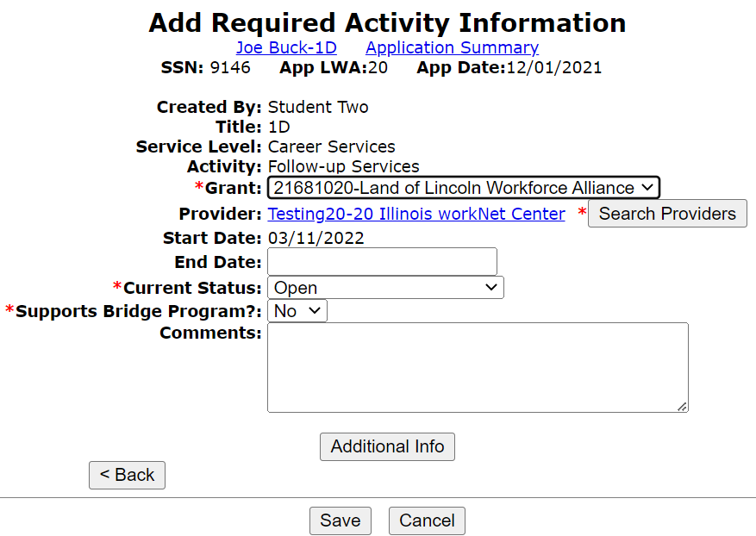
Documenting the Service of Follow-up
For this example, follow-up began on the same date the last enrolling service ended on 3/11/2022.

Slide 44
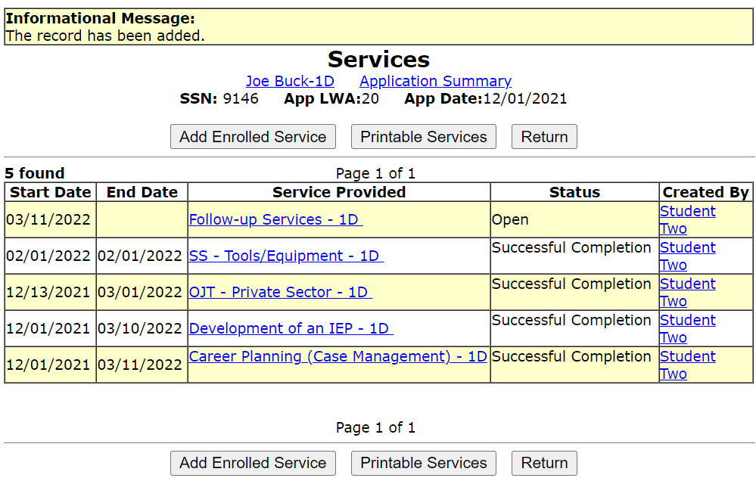
Documenting the Service of Follow-up
A clients actual service of follow-up remains open until all follow-up has been completed.
The actions taken as part of follow-up are recorded in the case notes and/or on the exit control panel.

Slide 45
Documenting the Service of Follow-up
As mentioned, the interactions between the client and the Career Planner as well as all related actions that are part of follow-up are recorded in the case notes and when appropriate, within IWDS screens such as the exit control panel.
The next slide provides an example case note for the date that follow-up began.

Slide 46
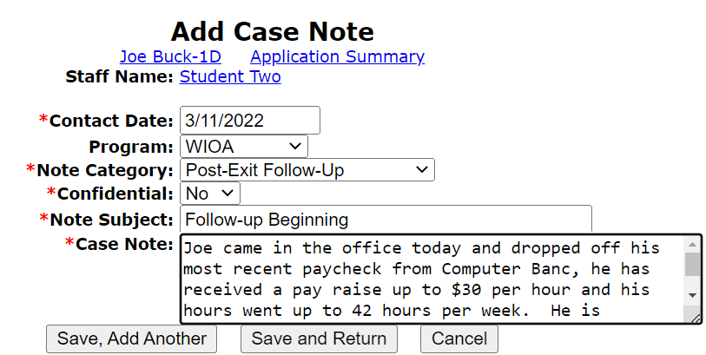
Documenting the Service of Follow-up
Case notes should explain what has occurred during follow-up:

Slide 47
Documenting the Service of Follow-up
Besides recording the follow-up actions in the client's case notes, each quarter the post exit control panel should be examined and when appropriate recorded with the most current information on the client.
For those clients who wages are not reported to IDES, when learning a client is in supplemental employment (i.e. self-employed), it is vital wages earned are documented.
This is especially important for Youth who enter post-secondary training which counts towards performance outcomes.
Additionally, if the client’s post exit employment is not reported through traditional Illinois Department of Employment Security (IDES), but will be recorded via “Supplemental Wages”, it is essential that the information get recorded on the exit control panel.

Slide 48
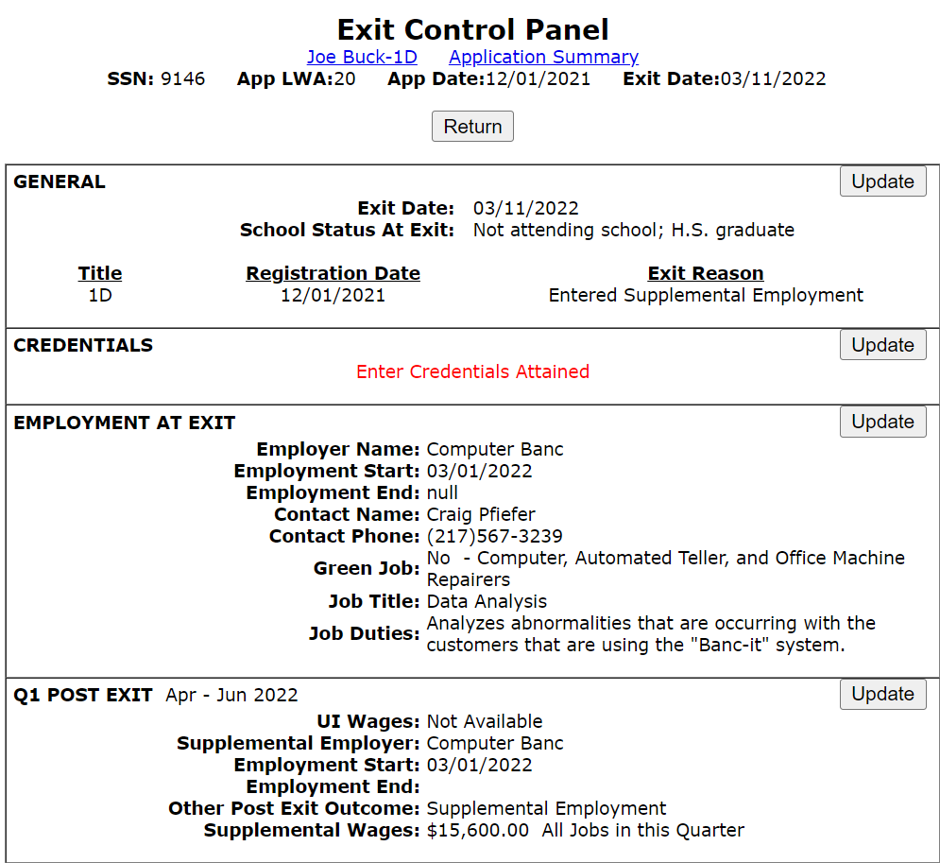
Exit Control Panel
On the adjacent screen print is an example of the exit control pane.
Each Quarter should record updates as appropriate for the client.

Slide 49
UI Wages VS Supplemental Wages
It is important to understand, for most clients they will have their post employment wages populated into IWDS through the interface that Commerce has with Illinois Department of Employment Security (IDES)
For those clients who do not work at employment where the wages are reported to IDES, it is very important that when appropriate, for the Career Planner to record any Supplemental Wages and individual might have earned during post exit follow-up.

Slide 50
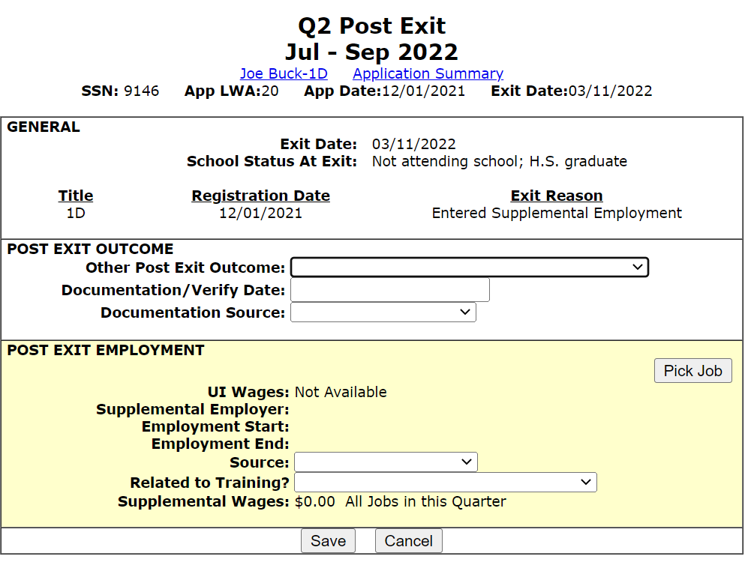
Updating Exit Control Panel
In this example, we are going to update Q2 Post Exit for Supplemental Employment/Wages.
Update all appropriate post exit outcomes.
This is an Adult client who was exited with Supplemental Employment and still has the same employment in Q2 Post Exit:

Slide 51
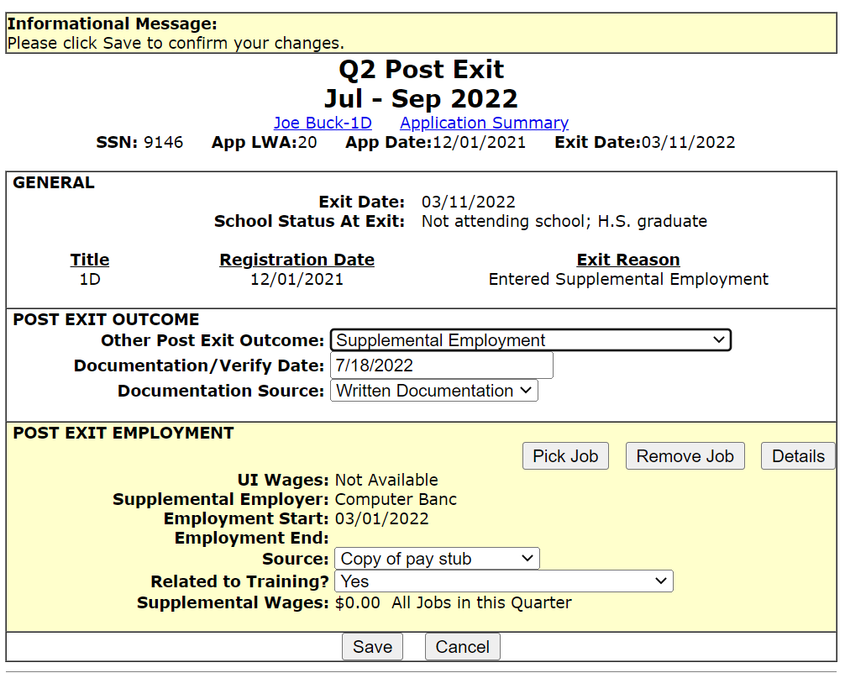
Updating Exit Control Panel
Client has supplemental employment with the same employer as time of exit.
The supplemental wage amount will be configured based on how the exit employment wage is recorded on the IWDS employment screen.

Slide 52
2nd and 4th Quarter Post Exit
During the 2nd and 4th Quarter post exit, employment and wages are critical times for reporting performance outcomes.
Record supplemental employment in the 4th Quarter post exit as the client received a pay increase this year and his hours are up to 50 hours per week.

Slide 53
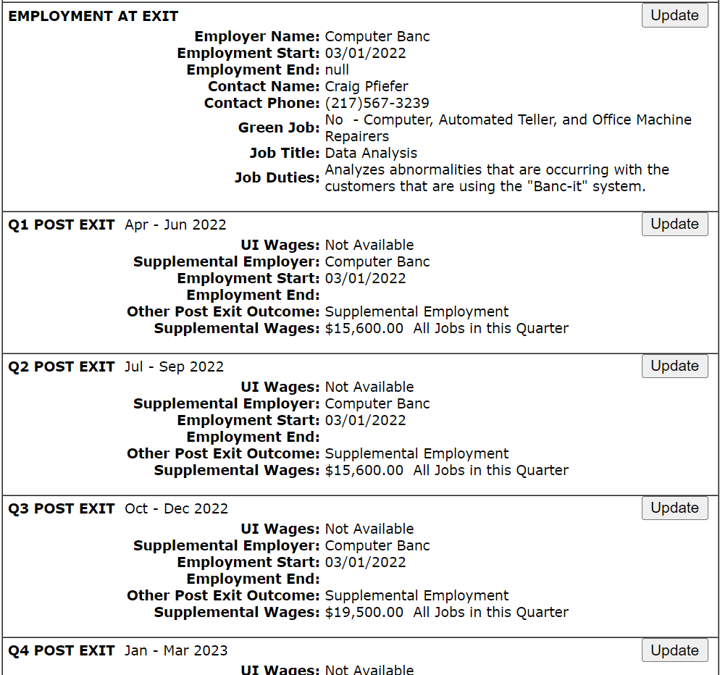
Exit Control Panel
4th Quarter post exit update:
This quarter, the client received a pay increase to $32.50 per/hr. Since October 2022, his hours increased to 50 hours per week.
Next several slides will demonstrate updating pay rate and hours.

Slide 54
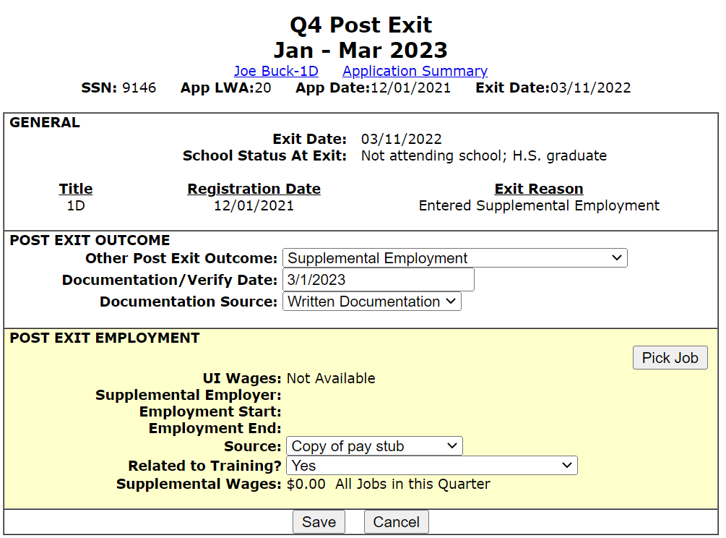
4th Quarter Post Exit
In this example, we are going to update Q4 Post Exit using Supplemental Employment.
Client did receive pay increase so need to go into the actual job to update the pay rate, select “Pick Job”.

Slide 55
Steps to Update Wage Info
Client had a pay increase from $30 per hour to $32.50 per hour.
Pay increase was effective on 1/2/2023.
To record, “Pick” the job, in this case it was “Computer Banc” job.

Slide 56
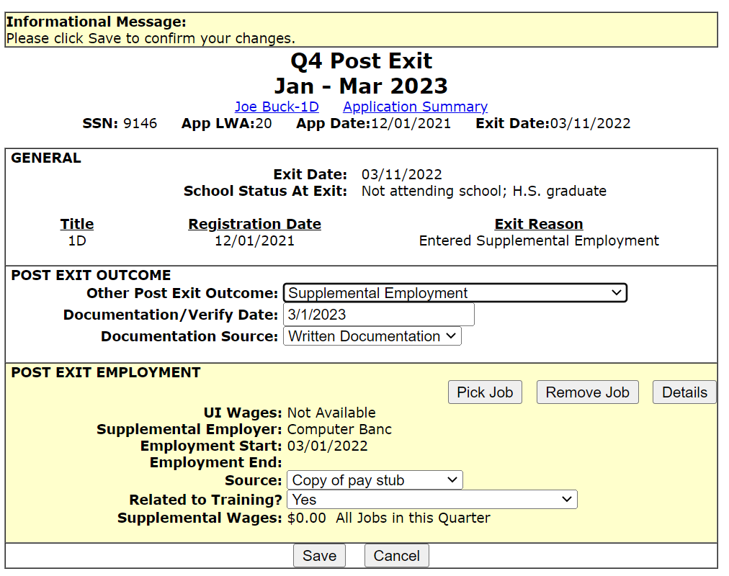
Steps to Update Wage Info
After the exit screen comes up, next click on “Details” which will open the actual job selected to be “Edited”.

Slide 57
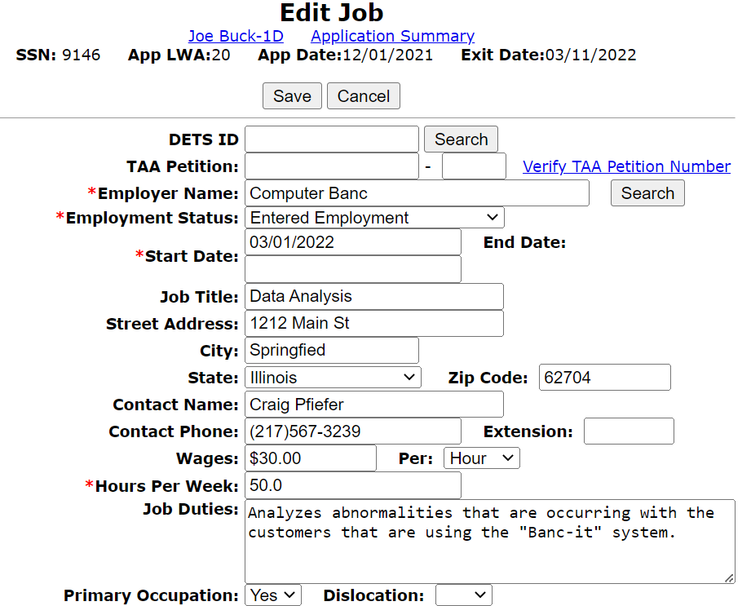
Updating Wage Information
Go to the “Wages” block that is currently showing $30.00 per hour.
Update to the new hourly wage information, which is $32.50 per hour.
If hours increase, you would update accordingly. Note, for this client the hours had increased in October 2022.

Slide 58
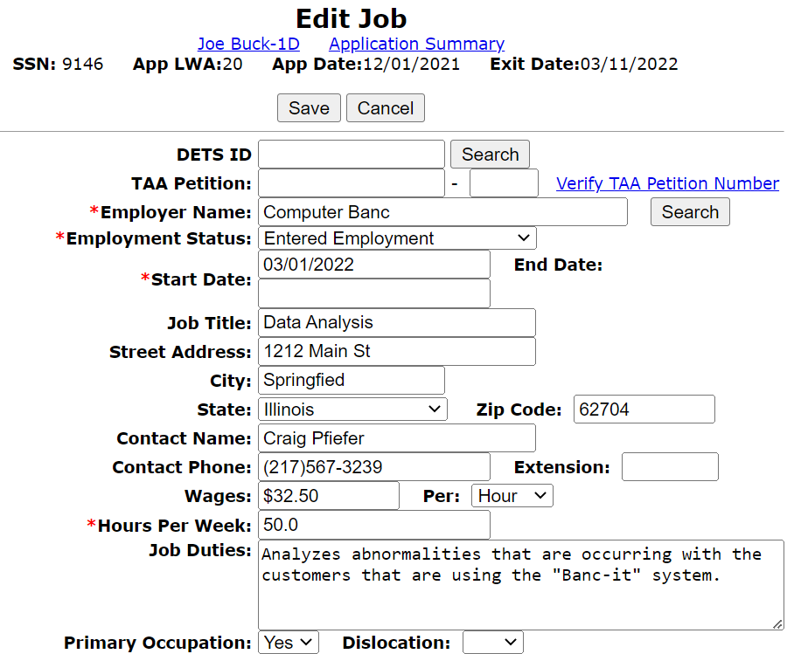
Updating Wage Information
As shown, increase wage to $32.50 and also verifying hours are correct at 50 hours per week.
Then click “Save” to lock those updates in for that job.

Slide 59
Updating 4th Quarter Post Exit
Now it will bring back to the original Q4 Post Exit follow-up and hit “Save”.
That will complete the update to the exit control pane for all four (4) quarters post exit.

Slide 60
Completed Exit Control Panel
Complete exit control panel for a client that had supplemental employment through all four (4) quarters during post exit follow-up.
Notice how in the Q3 that overall wage had went up, and that was due to client hours increasing to 50 hours per week since October 2022.
Then under Q4 another increase due to a pay increase that we had demonstrated being updated by editing the original exit job record.

Slide 61
Follow-up Actions
Follow-Up Guidance Reminder:
The guidance on the frequency of conducting follow-up is addressed in OET Policy Chapter 4: Section 3 - Follow-Up Services:
Guidance is given that follow-up should be as often as necessary throughout the required twelve (12) months.
At a minimum follow-up should occur at least every thirty (30) days for the first three (3) months and then must occur once a quarter for the remainder of the twelve (12) month period.
This aligns with quarterly post-exit reporting requirements.

Slide 62
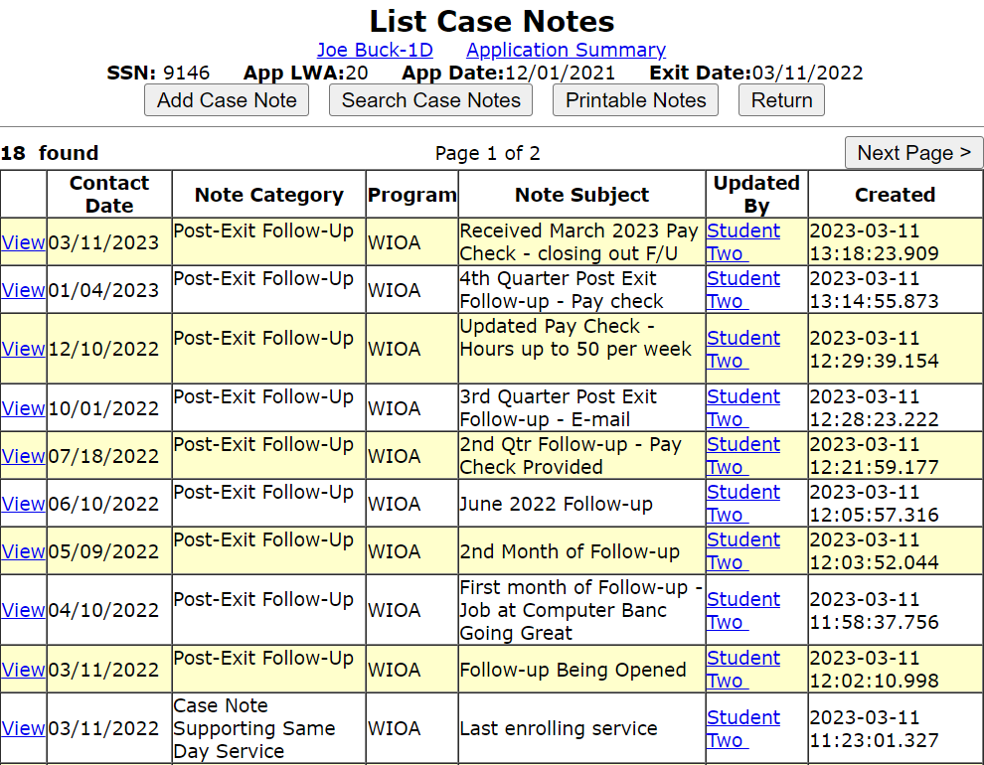
Verify Case Notes are Caught Up
Review/update case notes to ensure all are accurate and up to date.
In this case, the last note verified the details about the clients pay raise and detailed Q4 post exit follow-up.

Slide 63
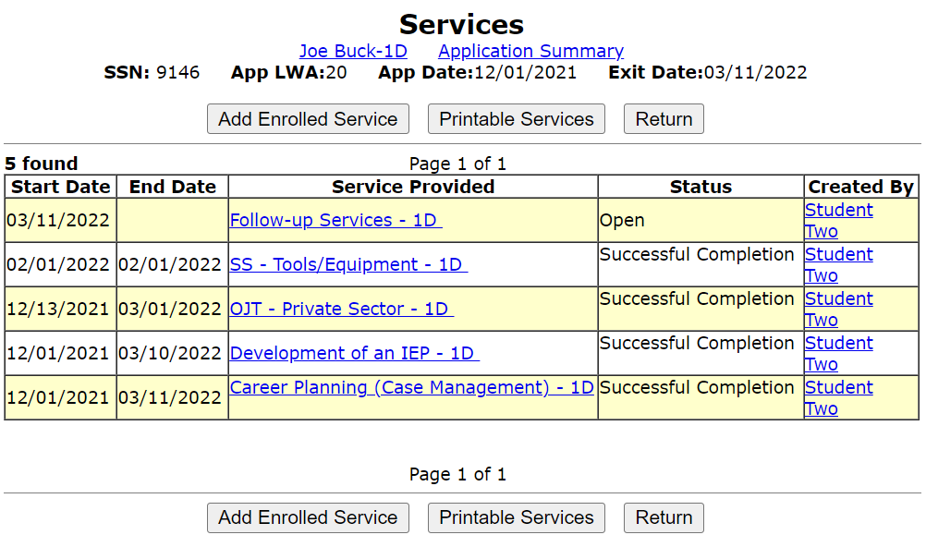
Closing Follow-up
Go back into services screen and take action to close the “Follow-up” Service that was opened back on 3/11/2022.
This can be accomplished by clicking into the original Follow-up Service.

Slide 64
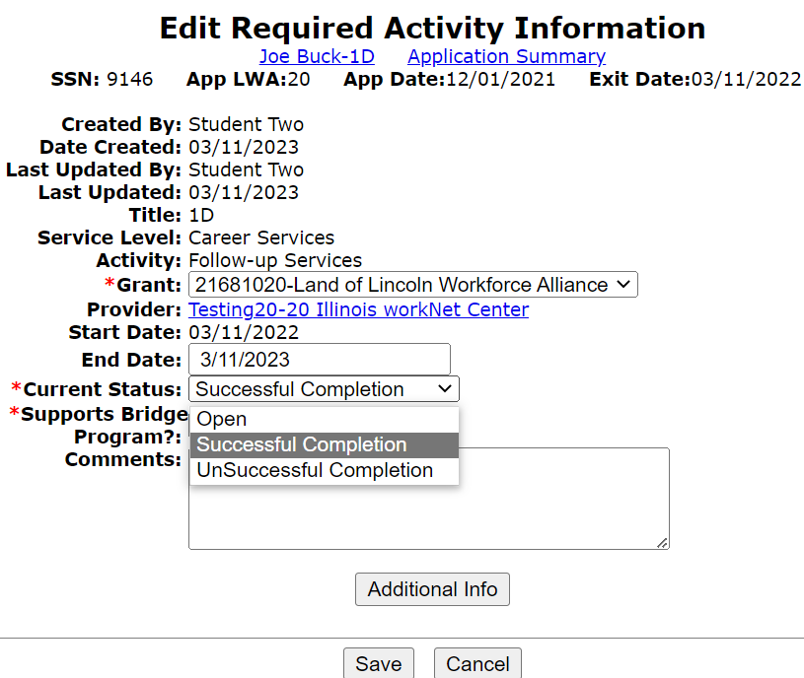
Closing Follow-up
Once the original “Follow-up” Service is brought up, populate the “End Date” and update the “Current Status” to “Successful Completion”.
The end date should match the last case note about follow-up.

Slide 65
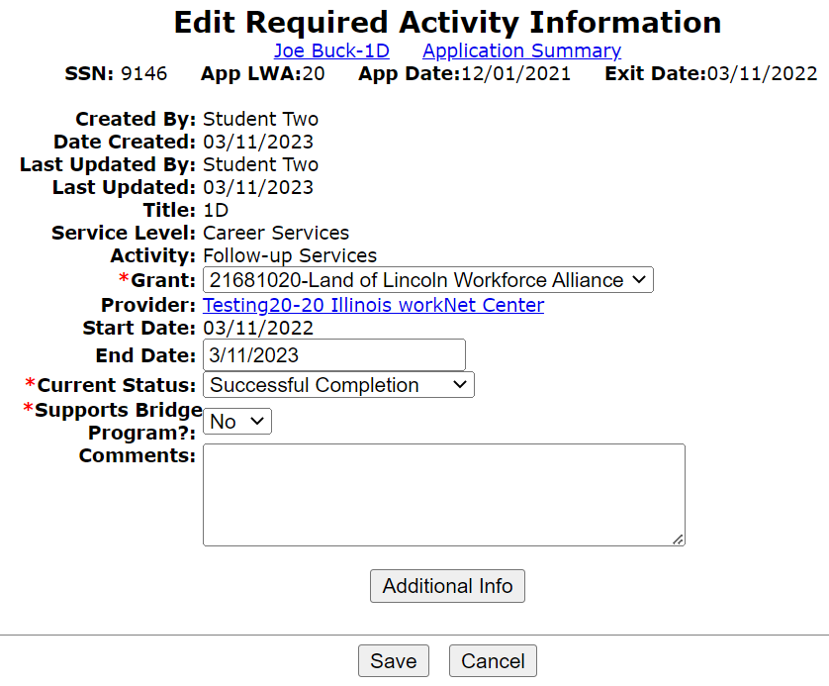
Closing Follow-up
For this example client, the Follow-up Service that was opened back on 3/11/2022 will end on 3/11/2023.
The “Current Status” is switched from “Open” to “Successful Completion” and then click on “Save”.

Slide 66
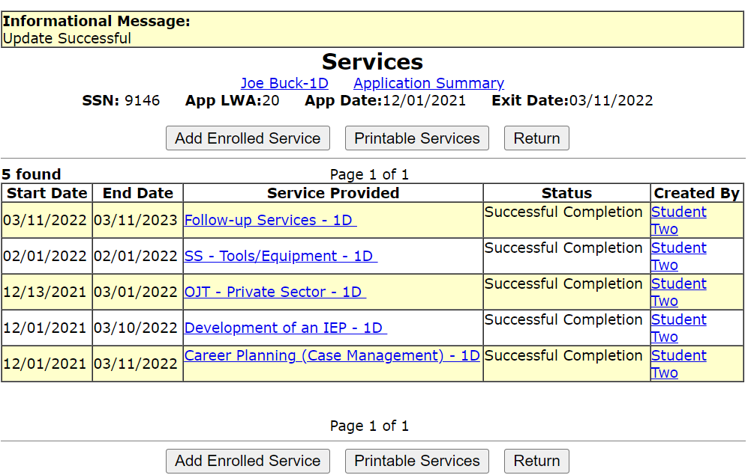
Closing Follow-up
Lastly, a quick review of the services screen to verify the “Follow-up” service is portrayed with the correct end date.

Slide 67
Concludes this PowerPoint
This power point discussed the WIOA legislatively mandated Follow-Up, and demonstrated the steps required to record the service of follow-up within IWDS.
If you have questions related to Follow-Up or recording the follow-up services in IWDS, feel free to contact James (Jim) Potts at james.potts@Illinois.gov or call him at (217) 416-7097.

