Slide 1
WIOA Dislocated Worker Eligibility Tailored for LWIA 26
June 22nd, 2023

Slide 2
Objective
The primary objective of this presentation is to inform the audience about the intricate details around the Updated Workforce Innovation and Opportunity Act (WIOA) Dislocated Worker Eligibility Policy Chapter 5 Section 3.

Slide 3
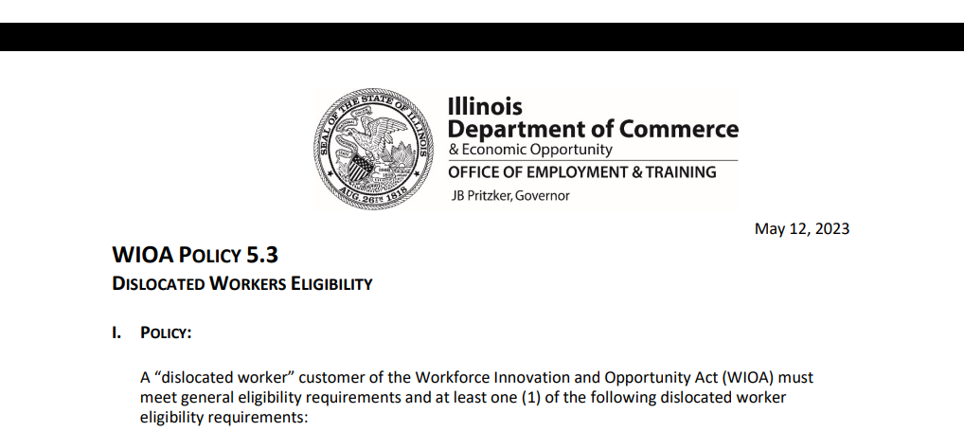
WIOA Policy 5.3 – Dislocated Worker Eligibility
This updated/new policy was issued on May 12th, 2023:

Slide 4
WIOA Dislocated Worker Eligibility
WIOA Title 1 Authority
Workforce Innovation and Opportunity Act of 2014
Training and Employment Guidance Letter (TEGL)19-16 – Guidance on Services Provided through Adult and Dislocated Worker under WIOA – dated March 2nd, 2017
WIOA ePolicy Chapter 5.1 – General Eligibility
WIOA ePolicy Chapter 5.1.1 – Selective Service updated August 2021
WIOA ePolicy Chapter 5.3 – Dislocated Worker Eligibility updated May 12th, 2023

Slide 5
WIOA General Eligibility
DCEO ePolicy – WIOA General Eligibility Policy 5.1
All clients must be authorized to work in the U.S. before they meet WIOA General Eligibility.
All clients born male, who have turned 18 and were born on or after January 1, 1960, must comply with Selective Service before they meet WIOA General eligibility.

Slide 6
Dislocated Worker Eligibility
WIOA ePolicy Chapter 5.3 Dislocated Worker Eligibility:
Unlikely to Return to Previous Industry or Occupation
Plant Closure or Substantial Layoff
UI Profilee
No Longer Self-Employed
Displaced Homemaker
Spouse of a member of the Armed Forces on active duty

Slide 7
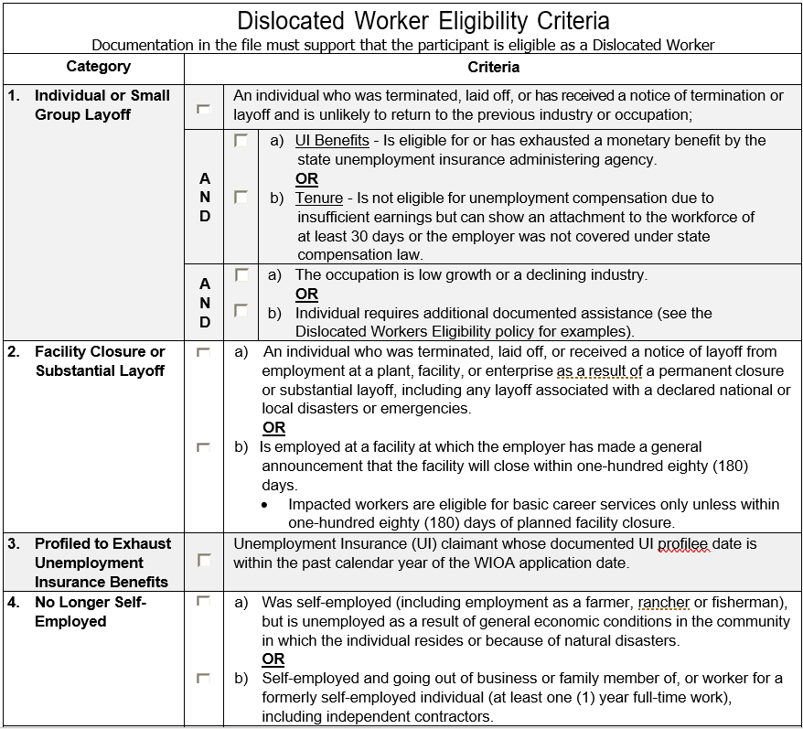
Dislocated Worker Eligibility Checklist
As part of the Dislocated Worker Eligibility Policy, under Attachment “C”, a Dislocated Worker Eligibility checklist was added. This checklist breaks down in a truncated wording the six (6) different Dislocated Worker eligibility criteria.

Slide 8
WIOA Dislocated Worker in IWDS
For this presentation, we will be discussing the updated WIOA Dislocated Worker Eligibility Policy Chapter 5 Section 3 that was issued in May 2023.
Much of this presentation will be demonstrating how the clients are portrayed within IWDS, as IWDS correlates directly with how the Dislocated Worker criteria are associated with the current WIOA Policy Chapter 5 Section 3 – WIOA Dislocated Worker Eligibility.

Slide 9
Dislocated Worker Eligibility
Key terms that must be understood related to Dislocated Worker Eligibility:
Under-Employed
Self-Sustaining Employment
Intervening Employment

Slide 10
Under-Employed
You will notice that the term Under-Employed is included as part of various WIOA Dislocated Worker Eligibility criteria.
Under WIOA, Under-Employed is defined as an individual who is working part-time but desires full-time employment, or who is working in employment not commensurate with the individual’s demonstrated level of educational attainment.

Slide 11
Under-Employed
TEGL 19-16 - Guidance on Services Provided through Adult and Dislocated Worker Programs also states that if an individual is working full-time but is on public assistance (Food Stamps, Cash Welfare, Medical Card, etc.), then they should also be considered under-employed.

Slide 12
Under Employed
TEGL 19-16 – provided additional criteria for Under-employed:
Individuals who meet WIOA Low-Income criteria but are working full-time are considered under-employed.
Individuals who are employed, but whose current job’s earnings are not sufficient compared to their previous job’s earnings from their previous employment.
Similar, LWIA’s local policy on self-sufficiency criteria for a Dislocated Worker (DW) Client can be based on the individual finding employment equal to or greater than a percentage of a client’s dislocation lay-off wage.

Slide 13
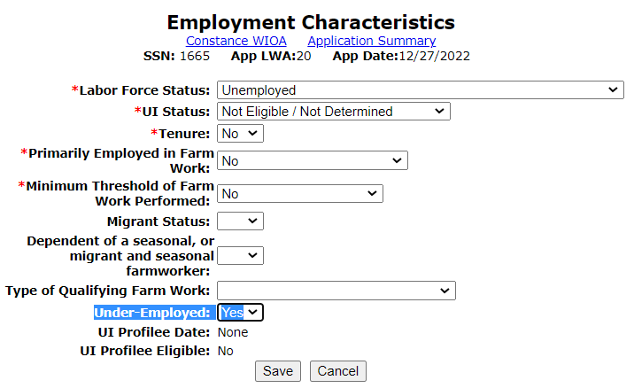
Under-Employed within IWDS
Within the Dislocated Worker application within IWDS, on the “Employment Characteristics” screen, is the question of “Under-Employed”; the response should be answered with a “Yes” if the client meets the criteria of “Under-Employed”.

Slide 14
Self-Sustaining Employment
Self-Sustaining Employment is a job, that meets a LWIA’s definition for self-sufficiency.
Under the Dislocated Worker title, as mentioned previously in this presentation, each LWIA has the latitude to define self-sufficient employment based on a percentage of a dislocation wage.

Slide 15
LWIA 26 Self-Sufficiency Criteria
As of June 22nd, 2023 – LWIA 26 defined self-sufficiency for a Dislocated Worker as:
DISLOCATED WORKER SELF-SUFFICIENCY REQUIREMENTS The Southern 14 Workforce Investment Board, for the purposes of dislocated worker eligibility, sets criteria of 85% of the dislocated hourly wage for determining whether employment leads to self-sufficiency or income that does not exceed 250% of the current Income Guidelines for Determination of Low Income (LLSIL) as applicable for LWIA #26.

Slide 16
Intervening Employment
Using the example on the previous slide, for any Dislocated Worker client that would be from LWIA 26, where the self-sufficiency criteria for a Dislocated Worker is set at 85% of the dislocation wage; if a client would have been making $50,000 per year at dislocation, if that individual was hired into a job making less than $42,500 of their Dislocation Wage (which is 85% of dislocation wage of $50,000), then that new employment would be considered “intervening employment”.

Slide 17
Taking those things into Consideration
To tie everything together on these topics; if a client had “intervening employment”, they would also be considered “under-unemployed”.
The client could still be considered for eligibility under the Dislocated Worker program using the original Dislocation Job, while working at the “intervening employment” due to being “under-employed”.
Lastly, a client would be working in “intervening employment” at any job until they obtain “self-sustaining employment”.

Slide 18
Dislocated Worker Eligibility
Now that we have those terms covered, let us get into the specifics of WIOA Dislocated Worker eligibility.
As mentioned earlier, an individual could meet WIOA Dislocated Worker eligibility under six different categories, and each category has different eligibility criteria with significantly different documentation requirements.

Slide 19
Dislocated Worker Eligibility
Under the new Dislocated Worker Policy Chapter 5 Section 3, there are six (6) different ways an individual could meet WIOA Dislocated Worker eligibility and each criteria is significantly different:
Unlikely to Return to Previous Industry or Occupation
Plant Closure or Substantial Layoff
UI Profilee
No Longer Self-Employed
Displaced Homemaker
Spouse of a member of the Armed Forces on active duty

Slide 20
Dislocated Worker Eligibility
Out of the six different ways an individual could be determined eligible under Dislocated Worker criteria, by far, the most complex criteria is under “Unlikely to Return to Previous Industry or Occupation” – We will just call this “Unlikely to Return”.
“Unlikely to Return” has layered eligibility criteria, meaning there are several factors that will determine if an individual meets this criteria. The next several slides will cover this very layered criteria.

Slide 21
Unlikely To Return
First as listed in WIOA ePolicy Chapter 5.3 Dislocated Worker Eligibility - paragraph I.1.a.1) - The individual: 1) Has been terminated or laid off or has received notice of employment termination or layoff; this would include an individual who has separated from or has an impending separation from the Armed Forces; and

Slide 22
Unlikely To Return
This individual that has been terminated, laid off, or has received notice of employment termination or layoff; must as listed in WIOA ePolicy Chapter 5.3 Dislocated Worker Eligibility - paragraph I.1.a.2).a):
Is eligible for or has exhausted entitlement to unemployment compensation as documented in one of the following ways; Unemployment Insurance Benefits:
The classification of persons as eligible for unemployment compensation is limited to those who have been determined eligible to receive a monetary benefit by the state unemployment insurance administering agency, or who have been determined by the state unemployment administering agency to have exhausted their benefits; OR

Slide 23
Unlikely To Return
In layman’s terms, to meet this portion of the criteria under “Unlikely to Return,” an individual who had worked at a job where the employer had paid into Unemployment Insurance (UI) on behalf of the client, the client must be eligible to draw a monetary UI benefit or has exhausted the UI benefit.

Slide 24
Unemployment Insurance (UI)
Traditional UI payments are received when an individual loses their job, where the employer of record had been paying into the UI system on behalf of the individual.
When an individual applies for UI, if the employer does not dispute the UI claim, the individual can draw the UI benefit while looking for new employment.

Slide 25
Unemployment Insurance (UI)
In the past, there was a lot of information about the different UI payments.
Pandemic Unemployment Assistance (PUA) program was a program during the COVID-19 Crisis, which provided UI benefits for many individuals who had been determined ineligible for traditional unemployment benefits.
Self-employed and independent contractor employees are probably the two most well-known groups of individuals who received PUA.

Slide 26
Unemployment Insurance (UI)
Regardless if an individual receives or has received traditional UI benefits or PUA benefits, is receiving or eligible to receive a monetary benefit but is not currently drawing, or has exhausted either traditional UI or PUA, they will meet the criteria tied to UI under the eligibility for “Unlikely to Return” criteria.

Slide 27
Additional Feedback on UI
Additionally, regardless if the individual was fired, quit, or laid off, if determined eligible to draw a monetary UI benefit (either traditional or PUA) or has exhausted their monetary UI benefit (either traditional or PUA), the criteria tied to being terminated or laid off is met, and the criteria tied to UI would be met.

Slide 28
PUA Ended in September 2021
In September 2021, Pandemic Unemployment Assistance (PUA) ended. There were questions about how a client on PUA when the program ended should be recorded in their WIOA application regarding UI Status.
Based on communication with our Policy Unit, after coordination with Illinois Department of Employment Security (IDES), based on UI Law, if an individual was drawing PUA when the program ended, (even if that individual still had a balance remaining when the PUA program ended,) the individual should be considered to have “Exhausted” their UI benefits.

Slide 29
Link to OET COVID-19 Q&A
Within Illinois workNet (IwN) the Office of Employment and Training (OET) maintains a COVID-19 Question and Answers (Q&A).
IwN COVID Page: https://www.illinoisworknet.com/WIOA/Resources/Pages/Advisory-Group-FAQ.aspx

Slide 30
OET WIOA COVID Q&A

Slide 31
PUA Guidance from OET

Slide 32
Recent Inquiry – Notified of Impending Layoff and UI
In a recent virtual training on WIOA Dislocated Worker Eligibility, there was an excellent question about an individual who had recently been notified of a lay-off (that was not part of a closure or substantial layoff), for an individual that is working at a job where the employer had paid into Unemployment Insurance on behalf of the individual, how could that individual meet the criteria that states:
Is eligible for or has exhausted entitlement to unemployment compensation as documented in one of the following ways; Unemployment Insurance Benefits:
The classification of persons as eligible for unemployment compensation is limited to those who have been determined eligible to receive a monetary benefit by the state unemployment insurance administering agency, or who have been determined by the state unemployment administering agency to have exhausted their benefits; OR

Slide 33
Guidance on Notified of Impending Lay-off and UI
Working with our OET Policy Unit and Illinois Department of Employment Security (IDES) staff, the following guidance will be included in an update to the OET WIOA Dislocated Worker Policy Chapter 5 Section 3:
For those who have been notified of an upcoming layoff and will not have applied for UI benefits, to meet the criteria around UI, the individual must have earned at least $2,000 in at least two (2) of the last four (4) calendar quarters which should be supported by either an IBIS document or the client’s pay records. In those instances, the correct response to the IWDS application question of “UI Status:” would be “Eligible, But Not Receiving Benefits”.

Slide 34
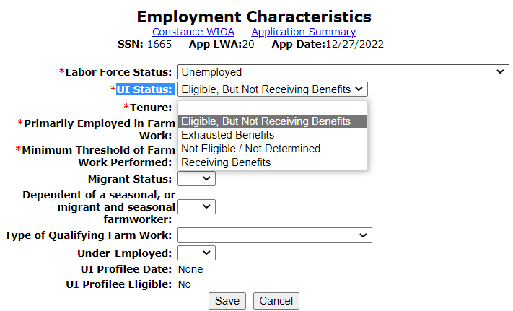
Dislocated Worker Eligibility
To meet this first criteria under “Unlikely to Return”, or those who use IWDS, regardless if the prospective WIOA client is receiving traditional UI or PUA, if the client has any response to the UI Status question other than “Not Eligible/Not Determined” they will have met the first eligibility criteria of eligible for or exhausted UI:

Slide 35
Unlikely to Return
To recap, the initial eligibility for “Unlikely to Return to Previous Industry or Occupation” requires the client to be eligible to draw a monetary UI benefit (either traditional UI or PUA) or exhausted UI (either traditional UI or PUA), that was covered in the previous slides.
In addition, there is an alternative to UI for individuals who worked for an employer who had not paid into UI on their behalf; this is known as “Tenure”.
The details around “Tenure” will be covered on the next several slides.

Slide 36
Unlikely to Return
This individual that has been terminated or laid off or has received notice of employment termination or layoff; and as listed WIOA ePolicy Chapter 5.3 Dislocated Worker Eligibility - paragraphs I.1.a.2.b)
Tenure = has been employed for a duration sufficient to demonstrate attachment to the workforce (meaning the individual must have at least thirty (30) days of employment in the industry or occupation from which he/she was dislocated) but is not eligible for unemployment compensation due to insufficient earnings or having performed services for an employer that were not covered under a state unemployment compensation law;
NOTE: In the previous WIOA Dislocated Worker Eligibility Policy, the time to meet the “Tenure” criteria had been six (6) months in the industry or occupation, and that time frame has now been shrunken down to thirty (30) days in the 5-13-23 policy.

Slide 37
Tenure Alternative to UI
“Tenure” is for an individual who worked at a job (or in the industry) for at least 30 days, where the employer did not pay into the UI system on behalf of the employee.
OR “Tenure” is for an individual who worked full-time at their dislocation job (or in the industry) for at least 30 days and had insufficient wages to draw a monetary UI benefit.

Slide 38
Further Details about Tenure
Based on recent guidance provided by IDES to our Policy Unit, for an individual to be eligible to draw a monetary UI benefit, the person must have earned at least $2,000 in at least two (2) of the last four (4) calendar quarters which should be supported by either an IBIS document or the client's pay records.
If an individual has worked full-time at their dislocation job for at least 30 days but does not meet the above criteria (due to insufficient earnings), then that individual would meet the alternative criteria to UI known as “Tenure”.

Slide 39
Tenure – Military Separation
Often people who separate from the armed forces after their enlistment (discharged from active duty) are not eligible for UI. If that is the case with someone you are working with, Illinois Department of Employment Security has given guidance that those individuals would meet “Tenure” if they had served at least 30 days in the armed forces and are not eligible for UI.

Slide 40
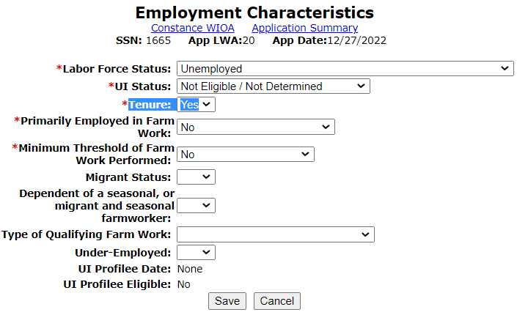
Employment Characteristics Screen
For the “example” client on the adjacent screen, the individual met “Tenure” as he was medically separated from the Air Force and with his Veterans benefits, he was not eligible for UI benefit.

Slide 41
Examples of “Tenure” Jobs
Some examples of jobs not covered under the state unemployment compensation law:
Church or religious organization
Railroad
Insurance agent
Agricultural labor
Domestic Service
Family Business
Many of these jobs did receive PUA benefits during COVID. But from my knowledge the PUA ended in September 2021.

Slide 42
Unlikely to Return Criteria
It is very important to understand that under the criteria of “Unlikely to Return”, if an individual is laid off (or fired, quit, etc.) from a job where the employer had paid into the UI system on behalf of the individual, and the individual is/has been denied UI benefits, (both traditional UI and PUA) the individual cannot be determined eligible under the Dislocated Worker criteria of “Unlikely to Return”.
There is no exception to the above paragraph.

Slide 43
Unlikely to Return Criteria
If a client has met the first part of the Unlikely to Return criteria of being eligible for or exhausted UI (either traditional UI or PUA) or they met the alternative to UI called “Tenure”; the next layer is:
WIOA ePolicy Chapter 5.3 Dislocated Worker Eligibility - paragraphs I.1.a.3.)a)i):
This individual has been laid off or terminated from a low growth industry, defined by a North American Industrial Classification System (NAICS) code category with less than the statewide average growth rate; and/or

Slide 44
Unlikely to Return Criteria
Or, if the client was not from a declining industry, they could also be determined “Unlikely to Return” if the dislocation job was from a “Low Growth Occupation”. Below is the wording from the Policy:
WIOA ePolicy Chapter 5.3 Dislocated Worker Eligibility - paragraph I.1.a.3.)a)ii)
This individual has been laid off or terminated from a low growth occupation, defined as any O*Net Codes category with an average annual employment growth rate of less than the statewide average growth rate for all occupations;

Slide 45
Dislocation Job
The declining industry and/or the low growth occupation would be recorded on the clients “Dislocation Job” in IWDS.
Below is an example of a client whose “Dislocation Job” was from both a “Declining Industry” and from a “Low Growth Occupation”. Only one would be required to have a “Y”, but this just demonstrates a client that met both criteria.

Slide 46
Unlikely to Return Criteria
In instances where a client’s dislocation job was not from a declining industry, nor was the dislocation job from a low growth occupation; if the Career Planner can justify in their assessment why an individual is unable to obtain employment in their previous industry or occupation, then it would be appropriate to check “Yes” to the question of “Require Additional Assistance”.
It is important to understand the details of this criteria as explained in the next slides.

Slide 47
Unlikely to Return Criteria
See the criteria outlined in WIOA ePolicy Chapter 5.3 Dislocated Worker Eligibility - paragraph I.1.a.3)b) – “Require Additional Assistance” can be used to support the remaining criteria of “Unlikely to Return”
Really should only be concerned with “Require Additional Assistance” if the dislocation job is not from a low growth occupation and/or a declining industry;
The individual requires additional assistance. After an assessment of education, skills, and work experience has been determined by the Title IB entity to “Require Additional Assistance” to qualify for any available openings in the industry or occupation from which the person was laid off, or to obtain employment in another occupation. Such determination must be documented in the person’s case file.

Slide 48
Requires Additional Assistance
Examples of requiring additional assistance laid out in Dislocated Worker Policy under section I.1.a.3)b)i) - include, but are not limited to, the following:
An individual who meets the long-term unemployed criteria (unemployed for twenty-seven (27) or more consecutive weeks);
The individual is a separating or separated member of the U.S. Armed Forces;
The individual has a history of involvement at any stage with the criminal justice system (justice-touched individual);
The individual is likely to enter a new job that is different structurally or organizationally than their previous job;
The individual is likely to enter a new job with lower seniority compared to their previous position;
The individual has a gap in employment that decreases their chances of returning to the same level of occupation or type of job, including justice-touched individuals;
There are limited employment opportunities in the occupation or industry within the local area;
There is an excess number of workers with similar skill sets and experience in the local area;
The individual has out-of-date or inadequate skills;
The individual has adequate skills, but lacks a credential required by most employers;
The individual has a barrier to employment such as a disability, medical condition, or legal issues that could prevent a return to employment in the same industry or occupation; or
An unsuccessful job search suggests the individual is unlikely to regain employment in their previous occupation or industry.

Slide 49
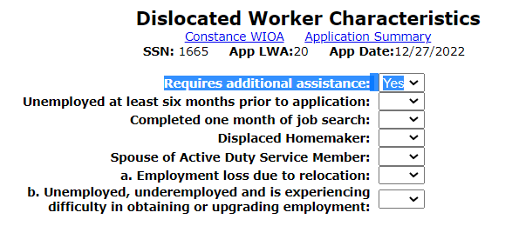
Requires Additional Assistance
The eligibility criteria is captured on the Dislocated Worker Characteristics screen. The question “Require Additional Assistance” can only be justified in the assessment by the grantee staff explaining why the individual “Requires additional assistance” to regain full-time, self-sustaining employment.

Slide 50
Unlikely to Return Criteria
It is important to understand this alternative criteria under “Unlikely to Return” is related to the questions of “Required additional assistance to regain employment,” would only be needed if the client’s dislocation job is not from a declining industry or low growth occupation.
Most dislocation jobs are from either a declining industry, low growth occupation, or both.

Slide 51
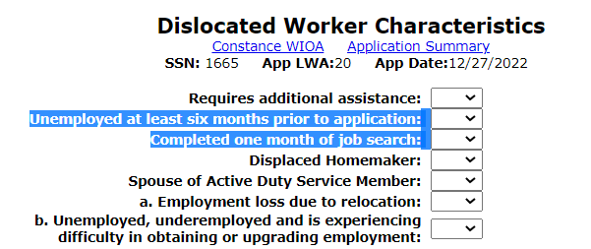
Change under New/Updated Policy
With the updated Policy Chapter 5 Section 3 under Unlikely to Return to Previous Industry or Occupation, the criteria that had been tied to the two (2) questions highlighted in blue directly below have been removed:

Slide 52
Unlikely to Return Criteria
To recap, for any client to meet dislocated worker eligibility criteria for “Unlikely to Return” they must first be eligible to draw a monetary UI benefit or exhausted UI or meet the alternative to UI called “Tenure”. Then the individual must also meet one or more of the following:
Dislocation job must be from a declining industry or a low growth occupation.
The client “Requires Additional Assistance”, which must be justified in the case note as to why the client was laid off from a job that was not from a declining industry or a low growth occupation.
The updated Dislocated Worker Policy Chapter 5 Section 3., lists many great examples that have been added.

Slide 53
Change under New/Updated Policy
So even though those two questions are still appearing in IWDS, they are no longer part of the criteria in the Policy under Unlikely to Return to Previous Industry or Occupation.
In their place, to capture any client who would meet this criteria would now be captured under the “Required Additional Assistance” criteria on slides 46 – 50 of this presentation.
As an example, slide 48 provides a detailed list of example situations/criteria for “Required Additional Assistance” including but not limited to: :
An individual who meets the long-term unemployed criteria (unemployed for twenty-seven (27) or more consecutive weeks);

Slide 54
Unlikely to Return Criteria
This wraps up the dislocated worker eligibility criteria for “Unlikely to Return to Previous Industry or Occupation”.
If you understand the in’s and out’s of “Unlikely to Return” eligibility, the rest of WIOA Dislocated Worker Eligibility should be easy.

Slide 55
WIOA Dislocated Worker Eligibility
Plant Closure or Substantial Lay-off criteria outlined in WIOA ePolicy Chapter 5.3 Dislocated Worker Eligibility paragraphs I.2.a.1)2)3).

Slide 56
Plant Closure or Substantial Layoff
An individual must have been terminated or laid off, or has received notice of termination or layoff from employment due to a permanent closure of, or a substantial layoff at a plant, facility or enterprise; OR

Slide 57
Guidance on Substantial Lay-off
One of the most exciting updates in the DCEO OET Policy Chapter 5 Section 3 – Dislocated Worker Eligibility that was issued on updated policy guidance is around the broadening of what can be considered a “Substantial Lay-off”!
I feel this updated guidance is a true game changer and can assist in instances where in the past, someone might not have been eligible as a Dislocated Worker, but if an individual meets this updated guidance, it will make them eligible as a Dislocated Worker under “Substantial Layoff”.

Slide 58
Substantial Layoff Guidance
Under WIOA ePolicy Chapter 5.3 Dislocated Worker Eligibility Policy, for additional guidance about “Substantial Layoff” under paragraphs I.2.a.1)a)i)ii)iii) states:
Substantial layoff includes, but is not limited to, the following:
Any layoffs resulting from Federal, State, or local disasters or emergencies (e.g., flood, tornado, fire, COVID, etc.);
Documented State or Local Rapid Response layoff in the Illinois Employment Business System (IEBS); or
Layoffs from sectors and occupations that are substantial or significant to the regional or local workforce or economy as identified by the local workforce innovation board (LWIB).

Slide 59
Looking More In-depth
Under WIOA ePolicy Chapter 5.3 Dislocated Worker Eligibility Policy, for additional guidance about “Substantial Layoff” under paragraphs I.2.a.1)a)i)ii)iii) states:
Substantial layoff includes, but is not limited to, the following:
Any layoffs resulting from Federal, State, or local disasters or emergencies (e.g., flood, tornado, fire, COVID, etc.);

Slide 60
Updated Substantial Layoff Guidance
In layman’s terms, IF the dislocation for any individual can be tied to either COVID; Flood; Tornado; Fire; etc., then when recording the “Layoff Reason”, the appropriate response would be either “Substantial Layoff” or “Plant Closure” (whichever is correct.)
To clarify, even if the layoff was just one or two persons, if the layoff can be tied to any Local, State or National Emergency, (which COVID does meet criteria of a National Emergency), then it is correct to record the layoff reason as “Substantial Layoff”.

Slide 61
What Does Bullet “iii” Really Mean ?
In the updated Dislocated Worker Policy, as shown on the previous slide under bullet “iii”, what does, “Layoffs from sectors and occupations that are substantial or significant to the regional or local workforce or economy as identified by the local workforce innovation board (LWIB).” mean?

Slide 62
Feedback from Regional Managers
Response from Regional Program Managers for DCEO OET: Substantial sectors and occupations should come from the Local and Regional Plan documents. If the occupation/sector is not listed in the local plan, but there are other extenuating factors that the board believes will impact the local economy, they can determine as circumstances warrant, to include those layoffs as significant to the local economy. The circumstances should be defined in the local policy along with a statement from the LWIB as supporting documentation for eligibility purposes.

Slide 63
Example Provided
A company closes or has a mass layoff, and it impacts other employers that do business with that company
FCA/Stellant’s elimination of their second shift impacted five other employers who were Tier 1 suppliers in the region.
A recent Owens layoff event in Streator is a manufacturing layoff impacting 161 people. Manufacturing is included in the local plan, but the number of layoffs at Owens is significant enough for the local economy, that there may be a ripple effect into nearby local businesses that may be in sectors not included in the local plan, but still considered part of a “significant event” for the local economy.

Slide 64
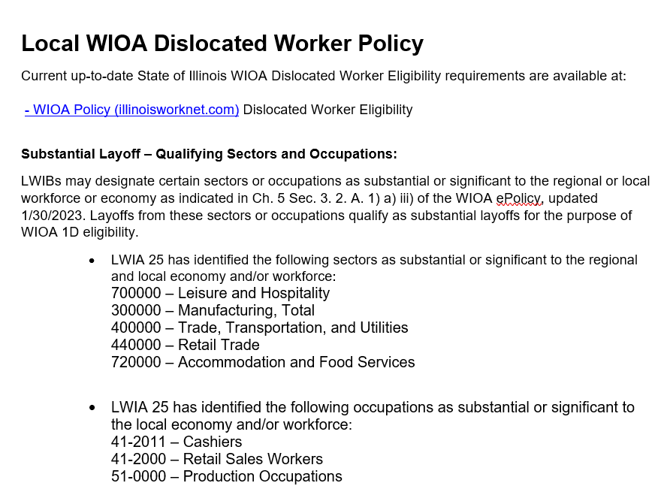
Example LWIA 25 Guidance
LWIA 25 has been very proactive and developed Local Policy Guidance around identifying substantial or significant sectors or occupations.

Slide 65
Substantial Layoff Guidance (cont.)
Often there are questions about what is a “Substantial Layoff”?
As discussed, the Dislocated Worker Policy provided some updated guidance that broadened criteria around “substantial layoff”.
In addition, a “substantial layoff” could be tied to 50% of employees but could be broadened depending on the situation.
As an example, if a company was running three shifts, but closed an entire shift, that might only equal 1/3 of employees but could easily be justified as a “Substantial Layoff”.
Or, say a company has a small sales force of six sales staff, and they layoff three of the sales staff, that would be half of the sales force and could be considered a “substantial layoff”.
If you have questions about whether a client meets the criteria as a “Substantial Layoff”, reach out to your supervisor or OET Rapid Response team.

Slide 66
LWIA 25 Local Policy
To tie this together, the LWIA 25 Policy allows any individual who had been dislocated from those industries and/or occupations identified in their Local Policy, to characterize the Dislocation Job as a “Substantial Layoff”.
So even in cases where the dislocation from the specific industry and/or occupation would not meet traditional criteria around “Substantial Layoff” due to the approved Local Policy, it would meet the criteria.
However, this is only allowed if an LWIA creates a similar Local Policy as was demonstrated in the previous slide, and then the LWIB approves the Local Policy.

Slide 67
Plant Closure or Substantial Layoff
Within IWDS, the logic for determining if a client meets the criteria as a Dislocated Worker under Plant Closure or Substantial Layoff – is based on the dislocation job from the “Edit Job” screen:
Specifically determined based on how the “Lay-off Reason” is populated.
If either “Plant Closure” or “Substantial Layoff” is the “Lay-off Reason”, IWDS logic will make the client eligible as a Dislocated Worker under Plant Closure or Substantial Layoff.

Slide 68
Plant Closure

Slide 69
Substantial Layoff

Slide 70
Plant Closure or Substantial Layoff
An individual must have been terminated or laid off, or has received notice of termination or layoff from employment due to a permanent closure of, or a substantial layoff at a plant, facility or enterprise; OR
Is employed at a facility in which the employer has made a general announcement that the facility will close within 180 days;

Slide 71
Plant Closure or Substantial Layoff
Something to understand about Plant Closure/Substantial Layoff, there is no additional criteria tied to UI status or “Tenure” criteria; nor is there any criteria tied to if the dislocation job is from a declining industry or low growth occupation; or if the individual requires additional assistance to regain employment.

Slide 72
Plant Closure or Substantial Layoff
One of the easiest ways to qualify your clients is under the Dislocated Worker criteria of Plant Closure or Substantial Layoff and should be used any time the client meets the criteria.

Slide 73
WIOA Dislocated Worker Eligibility
Profiled to Exhaust Unemployment Insurance Benefits criteria outlined in WIOA ePolicy Chapter 5.3 Dislocated Worker Eligibility paragraphs I.3.a.1)2)3).
This is the newest Dislocated Worker eligibility criteria that has been added and is also known as “UI Profilee”.
In this presentation, we are going to go much deeper in explaining details about the newest Dislocated Worker “UI Profilee” criteria.

Slide 74
UI Profilee
The Dislocated Worker Eligibility Policy guidance around UI Profilee states:
The individual is profiled and referred Unemployment Insurance (UI) claimant whose UI profile date is within the past calendar year of the WIOA application date;
The state has determined as allowed per 680.130(b)(3) of the WIOA legislation, that UI profiles are eligible dislocated workers with the definition of dislocated worker in WIOA Section 3(15).
In such instances, no further documentation will be needed to establish the “Unlikely to Return to a Previous Industry or Occupation” criteria of WIOA section 3(15)(A)(iii).
As a result, acceptance of UI Profiling data to prove eligibility for meeting the requirements of 3(15) is the only standard. General eligibility will still apply.

Slide 75
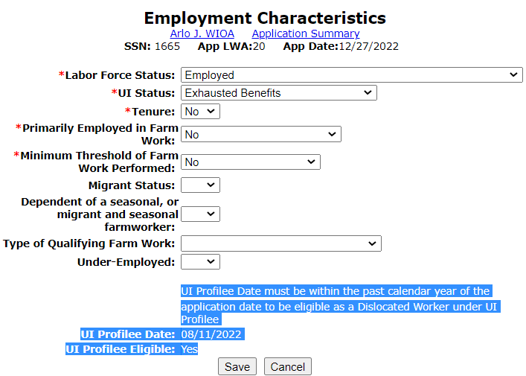
UI Profilee in IWDS
Within IWDS, when an individual puts in their WIOA application; on the “Employment Characteristics” screen of the electronic application in IWDS (towards the bottom of the screen), IF the individual had been profiled by IDES, those details will appear as demonstrated in the adjacent screen print:

Slide 76
UI Profilee in IWDS
As previously stated, the individual must have been profiled within one year of the date of their WIOA application and then the UI Profilee eligibility certification would need to be completed within one year of the profile date.
Some other details include, a dislocation job is not required to be populated for a client who is having their Dislocated Worker eligibility determined due to being a “UI Profilee”.
The next few slides demonstrate the details of when a UI Profilee client is certified.

Slide 77
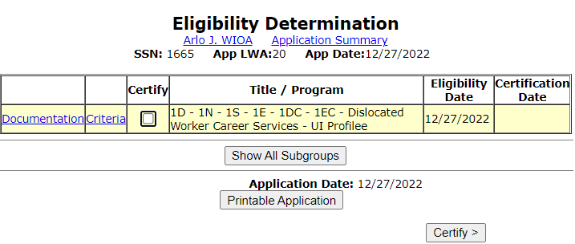
After WIOA Application is Completed
For any individual that gets profiled by IDES within one year of their WIOA application date; if the individual meets the General WIOA Eligibility criteria of Authorized to Work in the U.S. and the requirements around Selective Service, when their eligibility determination is completed in IWDS, the individual will meet “Dislocated Worker Career Services – UI Profilee”:

Slide 78
Criteria vs Documentation
Criteria explains the details on “why” the individual had met the eligibility.
Where the documentation will allow the specific documentation that will be used to support the different eligibility elements.

Slide 79
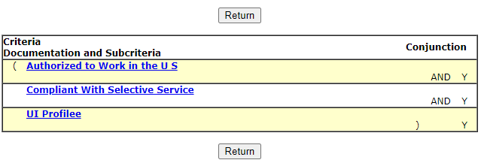
Criteria
When you click on “Criteria”, IWDS provides on the far right a “Y” for Yes or an “N” for No on if someone meets the various criteria elements; then if you click on the item, the system then gives additional details about that specific item:

Slide 80
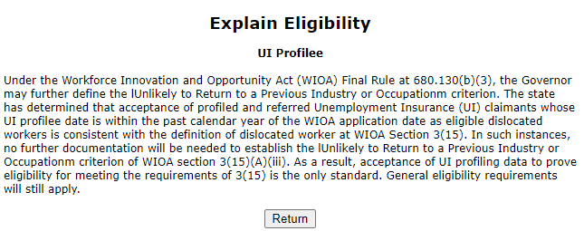
UI Profilee Criteria Details
In the example, click on “UI Profilee” and then in the screen print on the bottom demonstrates what that criteria means.

Slide 81
UI Profilee Documentation
Examine the specific documentation that could be used to support the different eligibility elements by clicking on the drop-down:

Slide 82
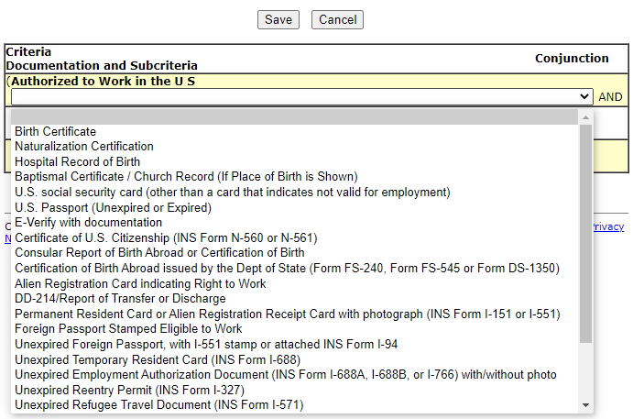
Documentation
Each of the criteria must have one of the acceptable documentation choices populated and that document selected would be expected to be retained in the hard copy file.

Slide 83
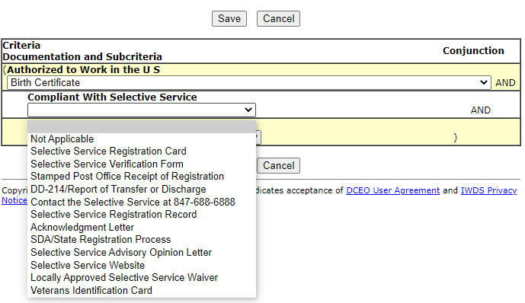
Selective Service Documentation
In this instance, the client was born female, so the appropriate response to Compliant with Selective Service would be “Not Applicable”.

Slide 84
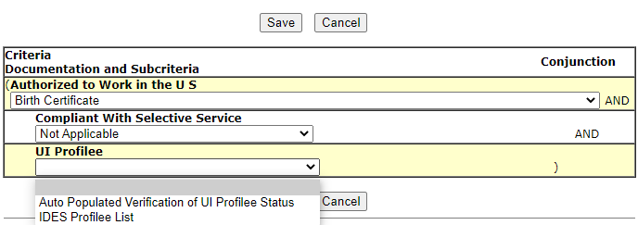
UI Profilee Documentation
Then for the documentation to support UI Profilee status; since the information has been auto populated on the Employment Characteristics screen, the most logical document to select would be “Auto Populated Verification of UI Profilee Status”.

Slide 85
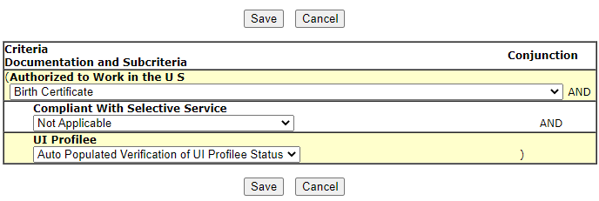
Completed Documentation Screen
Below is an example of a completed documentation screen for a client that had been born female and was a UI Profilee within one year of the WIOA application date.

Slide 86
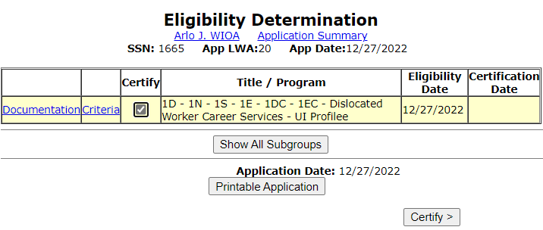
Certification of Eligibility
After the documentation has been populated, check the “Certify” box next to the word “Criteria” and then hit the “Certify” button near the bottom:

Slide 87
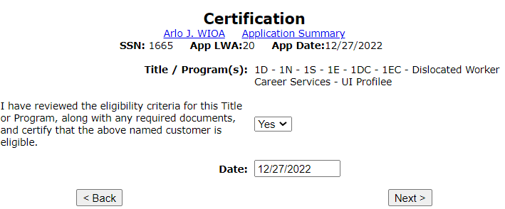
Certification Screen
The next screen is the “Certification” screen, you must change the response in the middle from “No” to “Yes” and then populate the certification date.

Slide 88
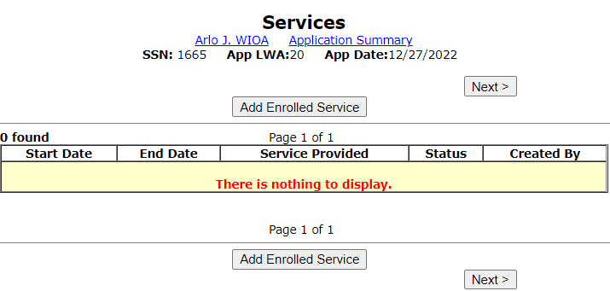
Certified and Ready for Enrollment
This client has now been certified under Dislocated Worker Career Services – UI Profilee and is ready to be enrolled in services under any 1D, 1E, 1N, 1S, 1DC, or 1EC grant:

Slide 89
UI Profilee Report
In the IWDS Reporting Menu, under the “Participant” reports, there is a “UI Profilee” report that can be run by LWIA and by specific date ranges.
Keep in mind that any individual profiled by IDES within one year of their WIOA application date would be eligible as a Dislocated Worker under UI Profilee.
However, when an individual has already obtained full-time, self-sustaining employment, WIOA Dislocated Worker services would not be appropriate nor the best use of your Dislocated Worker funds.

Slide 90
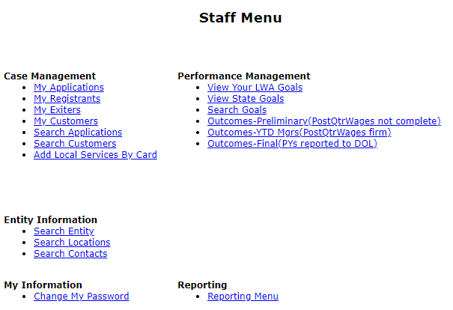
UI Profilee Report
To run a “UI Profilee Report” the staff member must have been given reports rights and roles by the local systems administrator.
If you have those report rights, you will see from the “Staff Menu”, a section called “Reporting”.

Slide 91
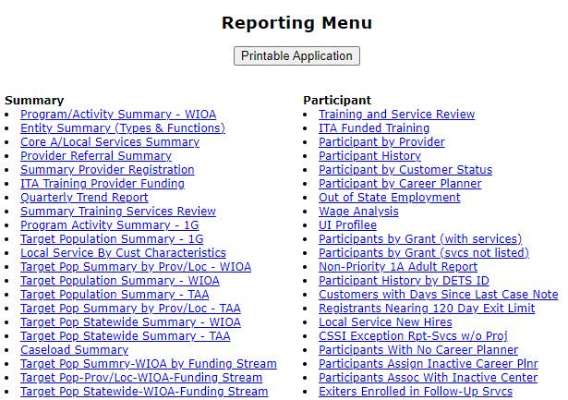
UI Profilee Report
On the reporting menu, under “Participant” reports is the “UI Profilee” report.
Simply click on “UI Profilee”.

Slide 92
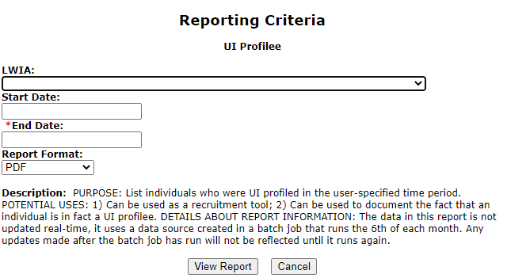
UI Profilee Report
Then populate the various criteria for the UI Profilee you wish to run by your own LWIA and the start and end date.
There is data lag, meaning if the end date is populated today, the last time individuals might have been profiled could have been up to one month ago.

Slide 93
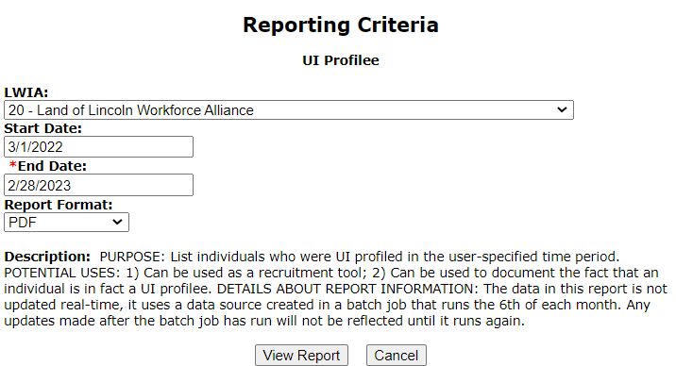
UI Profilee Report
In this example report, I am working in the “Training” platform of IWDS and there are not many UI Profilee mock clients in the “Training” platform of IWDS.

Slide 94
Example UI Profilee Report
In the “Training” platform there are only a few “mock” client records of individuals that have been a UI Profilee, and those mock records did not have an e-mail address associated with their record in the “Training” platform of IWDS.

Slide 95
UI Profilee Report Details
As mentioned in the previous slide which was an “example” report out of the “Training” platform of IWDS:
Your own LWIA’s “UI Profilee Report” in “Production” IWDS should have many individuals profiled and should include the phone number and e-mail address the client provided to IDES.
Once you run your report, it is an excellent resource to develop an outreach program to make those individuals aware of the Dislocated Worker program.

Slide 96
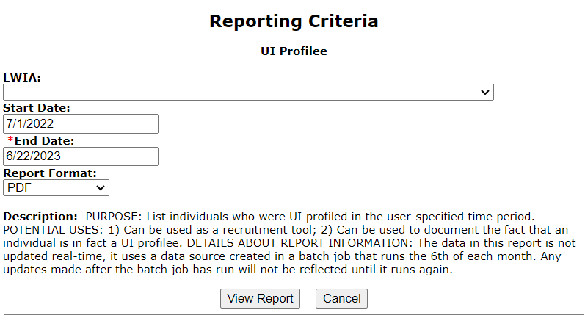
Current UI Profilee Reports
From the “real” production IWDS; I ran the UI Profilee Report for each LWIA using the date range of 7-1-22 thru 6-22-2023;
From data lag, the last date most LWIA’s had individuals profiled was 5/22/2023.

Slide 97
Total Numeric Results of UI Profilee Reports from date range of 7-1-22 through 6-22-23 by LWIA
LWIA 15 – 1,617
LWIA 17 – 735
LWIA 18 – 309
LWIA 19 – 753
LWIA 20 – 408
LWIA 21 – 368
LWIA 22 – 305
LWIA 23 – 592
LWIA 24 – 449
LWIA 25 – 619
LWIA 26 – 315
TOTAL UI Profilee’s State-wide -19,313
LWIA 1 – 651
LWIA 2 – 320
LWIA 3 – 551
LWIA 4 – 1,310
LWIA 5 – 845
LWIA 6 – 500
LWIA 7 – 6,054
LWIA 10 – 870
LWIA 11 – 506
LWIA 13 – 792
LWIA 14 – 484

Slide 98
UI Profilee Report Details
It is recommended that your LWIA’s UI Profilee report be run approximately every two weeks as there is data lag on when individuals appear on the report as compared to when they had been a UI Profilee.
Typically, the clients that will appear on the UI Profilee report are approximately one month from the date of being profiled as compared to the end date of the report.
For example, if you run a report with the end date of 6/22/2023 on June 22nd, 2023, the last clients that had been profiled might be 5/22/2023 or earlier and not up to 6/22/2023 due to the data lag.

Slide 99
UI Profilee Eligibility
As mentioned previously, this new standalone Dislocated Worker criteria of UI Profilee is a subset of the criteria of Unlikely to Return to Previous Industry or Occupation.
However, for an individual who has been a UI Profilee within one year of their WIOA application, the Career Planner is not required to record a Dislocation job, and the eligibility documentation used to support the client was profiled, is the “auto populated” information that is populated on the clients “Employment Characteristics” screen of their IWDS electronic record.

Slide 100
No Longer Self-Employed
Criteria for Formerly Self-Employed is outlined in WIOA ePolicy Chapter 5.3 Dislocated Worker Eligibility paragraphs I.4.a.1)2).
Must be the individual's primary job.
Formerly self-employed but no longer employed requires something showing the business closed or is closing due to:
General economic conditions
Flood or other natural disasters
Going out of business and has evidence of conditions to support business failure

Slide 101
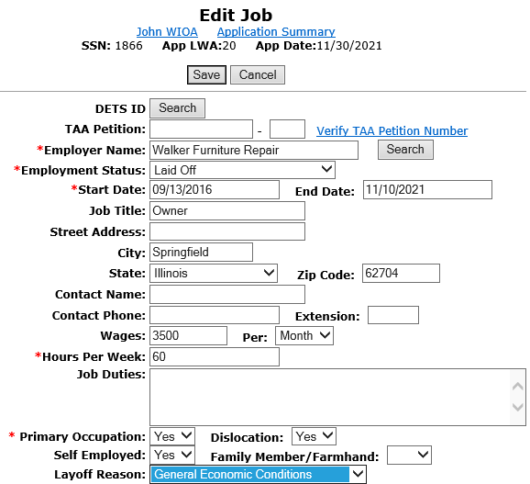
No Longer Self-Employed
Within IWDS on the “Edit Job” screen, the dislocation job must have “Yes” to the “Self-Employed” question.
Then layoff reason must be either “General Economic Conditions” or “Flood or Other Natural Disaster”.

Slide 102
No Longer Self-Employed

Slide 103
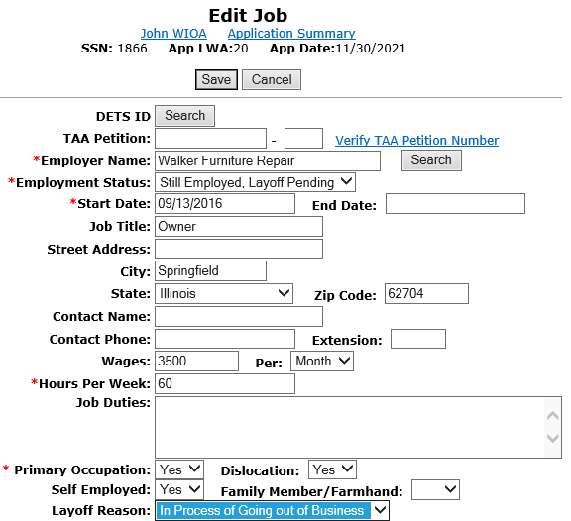
No Longer Self-Employed
OR for business that has not closed yet, “In Process of Going out of Business” – IWDS logic will determine the client as eligible under Dislocated Worker - Formerly Self-Employed, now Unemployed.

Slide 104
No Longer Self-Employed
Eligibility for this title could also be met if the individual worked at a Farm, Ranch, or Fish Hatchery where the business closed due to general economic conditions in the area or a natural disaster.
This is documented within IWDS on the “Edit Job” screen if the dislocation job has “Yes” to the “Self-Employed” question and “Yes” to the “Family Member/Farm Hand”.

Slide 105
No Longer Self-Employed

Slide 106
Displaced Homemaker
Criteria for Displaced Homemaker is addressed in WIOA ePolicy Chapter 5.3 Dislocated Worker Eligibility paragraphs I.5.a.b.

Slide 107
Displaced Homemaker
For an individual to meet the eligibility criteria under “Dislocated Worker - Displaced Homemaker” they must have been providing unpaid services to family members and who:
Has been dependent on the income of another family member but is no longer supported by that income; and
Is unemployed or is under-employed and having difficulty in obtaining or upgrading employment.

Slide 108
Displaced Homemaker
One point to note, under the new WIOA definition (see glossary of terms) for “Displaced Homemaker” there has been additional wording added to the definition of the “Displaced Homemaker” where it speaks about the dependent spouse of a member of the Armed Forces so that is available. However, the wording is a bit awkward and appears to duplicate the new criteria of Spouse of an Active-Duty Service Member.
I would utilize the new WIOA Dislocated Worker criteria of Spouse of Active-Duty Service that we will discuss in a few moments for those individuals.

Slide 109
Displaced Homemaker
The eligibility criteria is captured on the Dislocated Worker Characteristics screen. If the question “Displaced Homemaker” is populated with a “Yes, " then the internal logic within IWDS will make the client eligible under displaced homemaker criteria.

Slide 110
Displaced Homemaker Examples
Possible “Displaced Homemaker” eligibility criteria:
Unemployed or under-employed spouse who gets divorced/separated and cannot afford to get a divorce from the primary earner in the family.
Unemployed or under-employed whose spouse was the primary earner and passed away.
Unemployed or under-employed spouse where the primary earner in the family loses their job.

Slide 111
Displaced Homemaker
For the documentation to support the claim of “Displaced Homemaker” – it depends on which criteria of eligibility the client meets as a “Displaced Homemaker”:
Typically, you will need the client’s work history showing either unemployed or under-employed. Then based on the scenario, you would need either a court order, death certificate, self-attestation for marital status for those who cannot afford a divorce, or a layoff letter of the spouse.

Slide 112
Spouse of Active-Duty Service Member
Criteria for Spouse of a member of the Armed Forces on Active Duty is addressed in WIOA ePolicy Chapter 5.3 Dislocated Worker Eligibility paragraphs I.6.a.1).2)

Slide 113
Spouse of Active-Duty Service Member
For an individual to meet the eligibility criteria under “Dislocated Worker – Spouse of Active-Duty Service Member” they must meet one of the following criteria:
Has experienced a loss of employment as a direct result of relocation to accommodate a permanent change in duty station; OR,
Is unemployed or under-employed and experiencing difficulty in obtaining or upgrading employment.

Slide 114
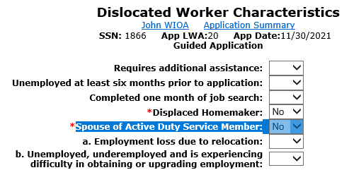
Spouse of Active-Duty Service Member
If the response to the questions of “Spouse of Active-Duty Service Member” is “No” - no other action needs to be taken as questions a. and b. are only available for eligibility for those that answer “Yes” to the “Spouse of Active-Duty Service Member”.

Slide 115
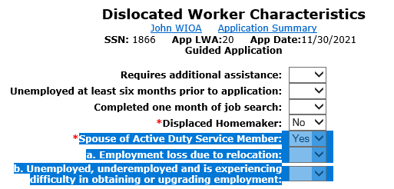
Spouse of Active-Duty Service Member
Within IWDS – logic is based on the “Dislocated Worker Characteristics” screen, if the question of “Spouse of Active-Duty Service Member” is populated with a “Yes”, then the client must have a “Yes” to one of the other questions for the client to meet criteria of “Spouse of Active-Duty Service Member:

Slide 116
Spouse of Active-Duty Service Member
To qualify as a Dislocated Worker – Spouse of Active-Duty Service member, then the spouse must have lost their job due to relocation from a transfer or duty station; or if the spouse is unemployed, underemployed and experiencing difficulty in obtaining or upgrading employment.

Slide 117
Spouse of Active-Duty Service Member
At a minimum, the documentation would include the military identification card showing the spouse of an activity duty service member, then if lost employment due to the spouse being transferred, the transfer orders along with the client’s work history. If eligibility were based on the spouse being unemployed, underemployed and experiencing difficulty in obtaining or upgrading employment, you would need the client’s military identification card showing the spouse of an active-duty service member and the client’s work history supporting unemployed or under-employed.

Slide 118
Dislocated Worker Eligibility
This concludes the various ways an individual could meet WIOA Dislocated Worker Eligibility criteria.
There are six different ways an individual could meet WIOA Dislocated Worker eligibility and each criteria is significantly different.

Slide 119
Overview of Dislocated Worker Eligibility
WIOA ePolicy Chapter 5.3 Dislocated Worker Eligibility
Unlikely to Return to Previous Industry or Occupation
Plant Closure or Substantial Layoff
UI Profilee
No Longer Self-Employed
Displaced Homemaker
Spouse of a member of the Armed Forces on active duty

Slide 120
Most Impactful Changes
Within the updated WIOA Dislocated Worker Eligibility Policy Chapter 5 Section 3 that was released on May 12th, 2023, there are two (2) changes that should hopefully have a significant impact in assisting in identifying and as well as finding new WIOA Dislocated Worker clients include, but are not limited to:
The updated/broadening of what could be considered a “Substantial Layoff”;
The new stand-alone WIOA Dislocated Worker Eligibility for those individuals who have been profiled by IDES within one year of the date they apply for WIOA, are automatically qualified (if they are not currently working full-time with self-sustaining employment).

Slide 121
Concludes this PowerPoint
This concludes the presentation on WIOA Dislocated Worker Eligibility.
If you have questions related to this presentation, feel free to contact me by email at James.potts@Illinois.gov or by phone at (217) 416-7097.

