Slide 1
WIOA Youth Eligibility
December 21st, 2023

Slide 2
Objective
The primary objective of this presentation is to inform the audience about the details around Workforce Innovation and Opportunity Act (WIOA) Youth Eligibility.

Slide 3
Federal Guidance
Workforce Innovation and Opportunity Act of 2014
Training and Employment Guidance Letter (TEGL) 21-16 – Third WIOA Title I Youth Formula Guidance – dated March 2nd, 2017
  Change 1 to TEGL 21-16 was issued July 30th, 2021 – Deals with the updated process for Determining Low Income for Youth Living in a High Poverty Area
TEGL 09-22 – WIOA Title I Youth Formula Guidance – dated March 2nd, 2023

Slide 4
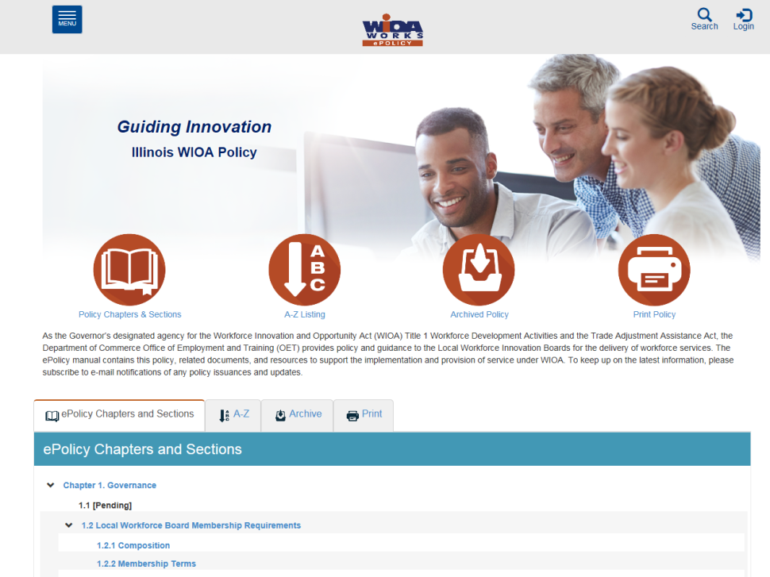
Understanding E-Policy Manual
The Illinois Department of Commerce and Economic Opportunity, Office of Employment and Training (OET) utilizes a WIOA ePolicy portal where all current and new guidance issued by the Illinois Workforce Innovation Board (IWIB) and OET is maintained.
Homepage: www.illinoisworknet.com/DCEOPolicies

Slide 5
State Guidance
WIOA ePolicy Chapter 5 - General Eligibility
WIOA ePolicy Chapter 5.1.1 – Selective Service updated August 2021
WIOA ePolicy Chapter 5.4 – General Youth Eligibility, 5/11/2023
WIOA ePolicy Chapter 5.4.1 – Out-of-School Youth, 5/11/2023
WIOA ePolicy Chapter 5.4.2 – In-School Youth, 5/11/2023
WIOA ePolicy Chapter 5.5 - Low-Income Individuals
WIOA ePolicy Chapter 5.9 Basic Skills Deficiency (BSD) Assessment Requirements, effective 5/17/2023

Slide 6
WIOA General Eligibility
DCEO ePolicy – WIOA General Eligibility Policy 5.1
  All clients must be authorized to work in the U.S. before they meet WIOA General Eligibility.
  All clients born male, who have turned age 18 and were born on or after January 1st, 1960 must comply with Selective Service before they meet WIOA General eligibility.

Slide 7
WIOA Youth Eligibility
Workforce Innovation and Opportunity Act of 2014
  In-School Youth is a separate category from Out-of-School Youth and the eligibility between these two are significantly different.
  School Status is determined at the time of application, not what the individual will be going into while in the WIOA program.
  Whatever the school status is at certification, remains the same school status for Federal Reporting all through WIOA Youth Services and until the client is exited.

Slide 8
WIOA Youth Eligibility
The Workforce Innovation and Opportunity Act (WIOA) legislation and Training and Employment Guidance Letter (TEGL) 21-16 – Third WIOA Title I Youth Formula Guidance – have mirror guidance on requirements for Youth client assessment.
That guidance states that any individual who is going to be served under the Youth title must have a complete assessment prior to the client being determined eligible and enrollment in WIOA Youth Services.

Slide 9
WIOA Youth Assessment Requirements
Section 129(b)(2)(c)(1)(A) of WIOA Legislation States:
Career Coach must provide an objective assessment of:
Academic levels
Skill levels
Service needs of each participant
Review of basic skills
Occupational Skills
Prior work experience
Employability
Interests
Aptitudes (including interests and aptitudes for nontraditional jobs)
Supportive service needs
Development needs of the participant
The assessments must also consider a youth’s strengths rather than just focusing on areas that need improvement

Slide 10
WIOA Youth Program
The results of the Youth assessment are used to support enrollment in the WIOA Youth program, and that assessment is used to create the Youth clients initial Individual Service Strategy (ISS) that is the basis to support the individual being brought into the WIOA Youth Program.

Slide 11
Individual Service Strategy (ISS)
The ISS is an agreement of objectives and goals decided between the WIOA Youth participant and WIOA Youth Career Coach that sets out a plan for the participant to make progress towards his/her educational and employment goals.

Slide 12
Guidance from TEGL 21-16
    For purposes of WIOA, providers of adult education under Title II of WIOA, YouthBuild programs, the Job Corps program, high school equivalency programs, and dropout re-engagement programs are not considered to be schools for the purposes of determining school status, with one exception:
      Youth attending high school equivalency (HSE) programs, including those considered to be dropout re-engagement programs, funded by the public K–12 school system that are classified by the school system as still enrolled in school are considered ISY.

Slide 13
Determining School Status in IWDS
In Illinois Workforce Development System (IWDS), on the “Education Status” screen within the application, is where the question to determine if an individual is an In-School Youth (ISY) or an Out-of-school Youth (OSY).
The “Attending School” question has the internal logic criteria and determines if a client will be considered an “In School Youth” (ISY) or an “Out-of-School Youth” (OSY) within IWDS.

Slide 14
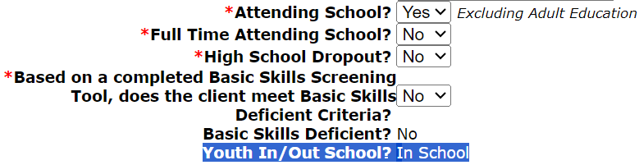
Determining In-School Youth
On the education status screen in the application within IWDS, if the question of “Attending School is populated with a “Yes”, the internal logic will determine the client as an In-School Youth:

Slide 15
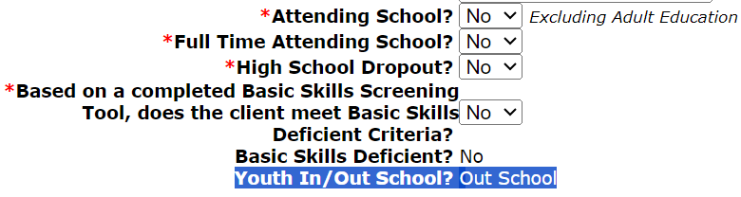
Determining Out-of-School Youth
On the education status screen in the application within IWDS, if the question of “Attending School is populated with a “No”, the internal logic will determine the client as an Out-of-School Youth:

Slide 16
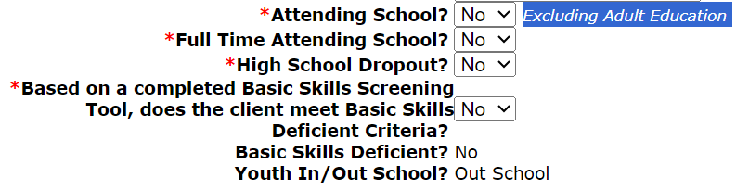
Excluding Adult Education
To reiterate, for the “Attending School” question in IWDS, if the individual applying for the WIOA Youth program is currently part of an Adult Education under Title II of WIOA, OR YouthBuild programs, OR the Job Corps program, the question of attending school should be recorded as a “No”.

Slide 17
WIOA In-School Youth
WIOA E-Policy Chapter 5.4.2 – In-School Youth:
    In-School Youth – Youth not younger than age 14 or older than age 21
      Attending school (as defined by state law)

Slide 18
WIOA In-School Youth
WIOA E-Policy Chapter 5.4.2 – In-School Youth:
  95% of the In-School Youth must meet low-income criteria (see WIOA E-Policy Chapter 5.5 - Low-Income Individuals)
As mentioned earlier, it is essential that you have viewed and understand the previous PowerPoint on WIOA Low Income, so you understand the eight different ways an In-School Youth client could meet WIOA Low-Income criteria.
Lastly, all In-School Youth clients must have one or more of the following barriers shown on the next slide.

Slide 19
WIOA In-School Youth Barriers
Basic Skills Deficient
An English Language Learner
An Offender
Homeless
Runaway
Foster Child or aged out of foster care
Pregnant or Parenting
An individual with a disability
An individual requiring additional assistance to enter or complete an educational program or to secure or hold employment.

Slide 20
Basic Skills Deficient Definition
Basic Skills Deficient – respect to an individual— (A) who is a youth, that the individual has English reading, writing, or computing skills at or below the 8th grade level on a generally accepted standardized test; or (B) who is a youth or adult, that the individual is unable to compute or solve problems, or read, write, or speak English, at a level necessary to function on the job, in the individual’s family, or in society.

Slide 21
Ways to be Basic Skills Deficient
As was covered in the separate presentation on Basic Skills Deficient (BSD), there are three different ways an individual could meet BSD criteria:
  Scoring at or below 8th Grade Level Equivalency (GLE) on their pre-assessment math or reading tests.
  Being determined BSD due to the Basic Skills Screening Tool.
  If a Youth Client is assessed as an English Language Learner (ELL), they are also considered BSD.

Slide 22
Basic Skills Deficient from Testing
A key internal logic item in IWDS to understand about BSD from assessment tests:
  The assessment test date must be, on or before the application date before the internal logic within IWDS is going to pick up the client as BSD due to the assessment test:
    Example, if a client has an application date of 10/1/2023, but was given the assessment test(s) on a date after 10/1/2023, even if the client scores at or below 8th Grade Level on the assessment test(s), the internal IWDS logic would not determine the individual BSD based on the assessment test.

Slide 23
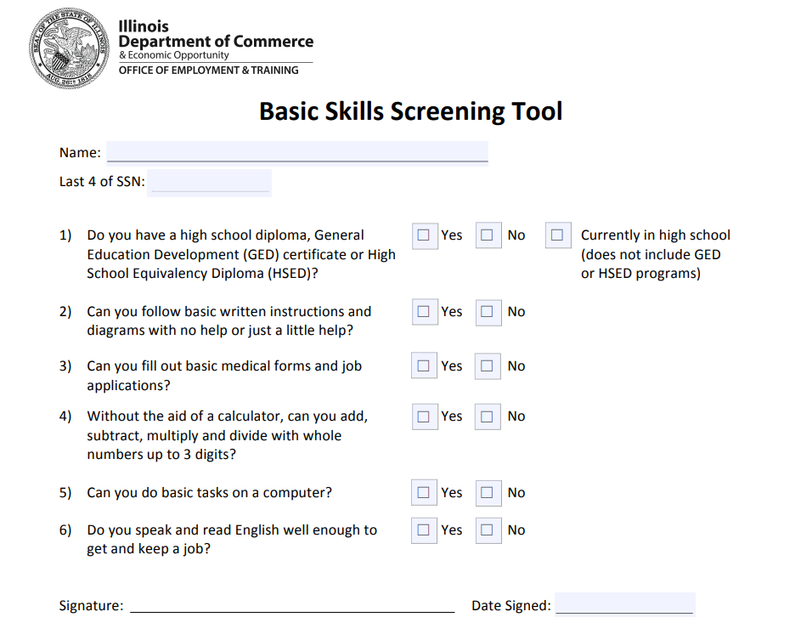
Basic Skills Screening Tool
If an individual replies “No” to any of the following questions on the screening tool, they can be determined BSD:

Slide 24
Basic Skills Screening Tool
Within IWDS, on the “Education Status” screen within the application, is where the question has been added when a client is being determined BSD due to the new screening tool.
If any question on the screening tool is answered “No” by the client, then the question related to the BSD screening tool on the “Education Status” screen should be answered “Yes”; (see example on next slide).

Slide 25
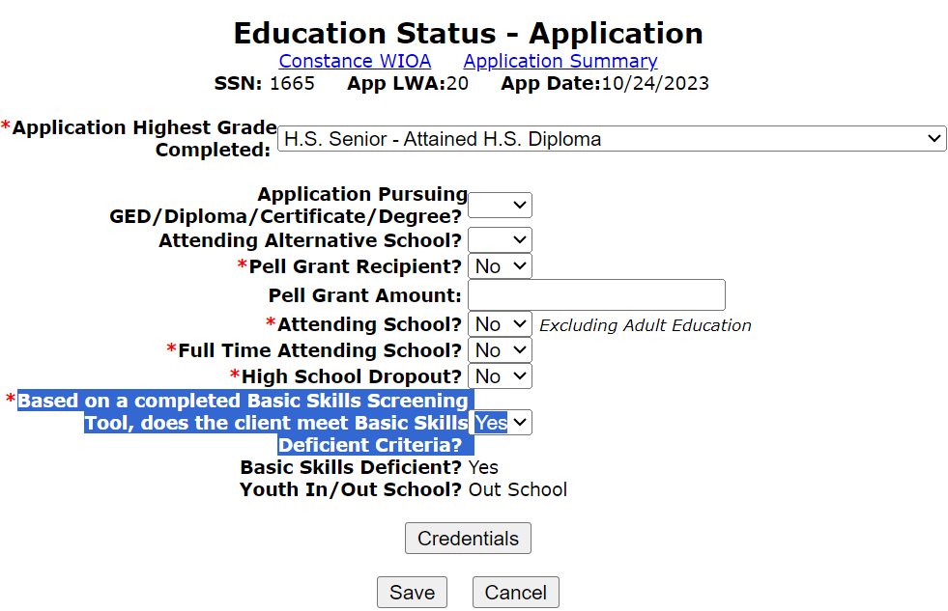
Basic Skills Screening Tool
Demonstrating recording BSD due to the screening tool on the Education Status screen within the application in IWDS:

Slide 26
Basic Skills Screening Tool
It is important to understand, the basic skills screening tool does not take the place of assessment testing.
The purpose of the screening tool is to capture the criteria under the second part of the “Basic Skills Deficient” definition which is “a youth or adult, that the individual is unable to compute or solve problems, or read, write, or speak English, at a level necessary to function on the job, in the individual’s family, or in society.”

Slide 27
English Language Learner
English Language Learner – the term “English language learner” when used with respect to an eligible individual, means an eligible individual who has limited ability in reading, writing, speaking, or comprehending the English language, and (A) whose native language is a language other than English; or (B) who lives in a family or community environment where a language other than English is the dominant language.

Slide 28
English Language Learner
Within IWDS, on the “Characteristics and Barriers” screen within the application, is where the question has been added when a client is being determined an English Language Learner (ELL).
If the question is populated with a “Yes”, the client must select a Language of Preference; (see example on next slide).

Slide 29
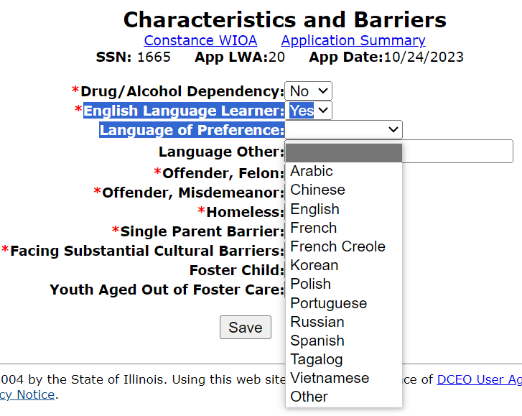
English Language Learner
Demonstrating recording English Language Learner within IWDS; with a response of “Yes” to English Language Learner, must select a Language of Preference:

Slide 30
Youth Offender Barrier
Offender - An adult or youth (A) who is or has been subject to any stage of the criminal justice process, for whom services under this Act may be beneficial; or (B) who requires assistance in overcoming artificial barriers to employment resulting from a record of arrest or conviction.

Slide 31
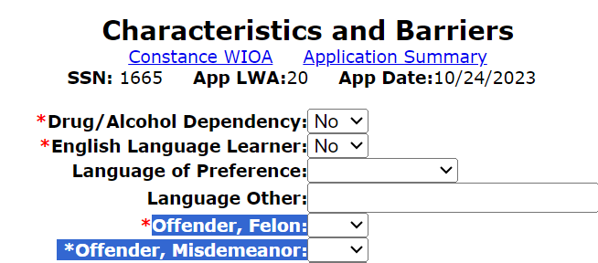
Youth Offender Barrier
Within IWDS, on the “Characteristics and Barriers” screen within the application, if either of the two questions highlighted in blue below are answered with “Yes”, it would meet the criteria for In-School Youth barrier of “Offender”.

Slide 32
Youth Homeless Barrier
Individual who lacks a fixed, regular or adequate nighttime residence; as defined in the Violence Against Women Act of 1994, or
Adult or youth with a primary nighttime residence that is a public or privately operated shelter for temporary accommodation as defined in the McKinney-Vento Homeless Assistance Act

Slide 33
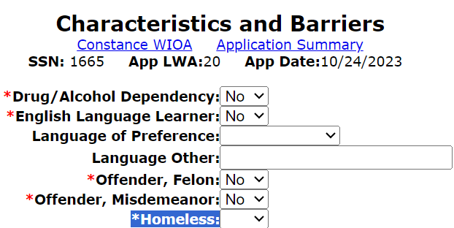
Youth Homeless Barrier
Within IWDS, on the “Characteristics and Barriers” screen within the application, if the question of “Homeless” is answered with “Yes”, it would meet the criteria for the Youth barrier of “Homeless”:

Slide 34
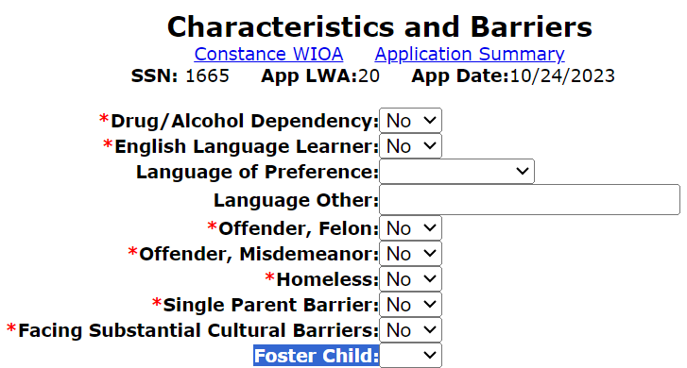
Youth Foster Child Barrier
Within IWDS, on the “Characteristics and Barriers” screen within the application, if the question of “Foster Child” is answered with “Yes”, it would meet the criteria for the Youth barrier of “Foster Child”.

Slide 35
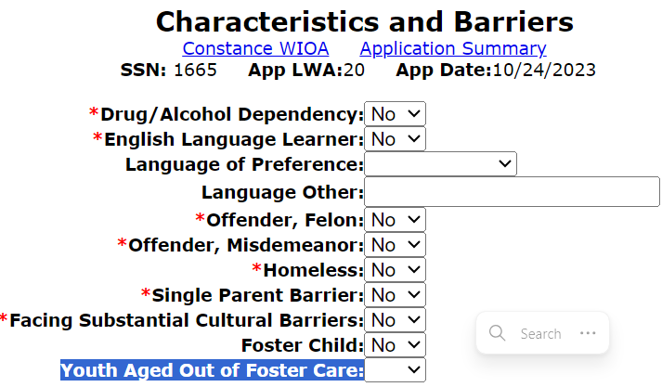
Aged Out of Foster Care
Within IWDS, on the “Characteristics and Barriers” screen within the application, if the question of “Youth Aged Out of Foster Care” is answered with “Yes”, it would meet the criteria for the Youth barrier of “Youth Aged Out of Foster Care”.
For this barrier, it also would include an individual who had been a foster child that was adopted prior to ageing out of foster care.

Slide 36
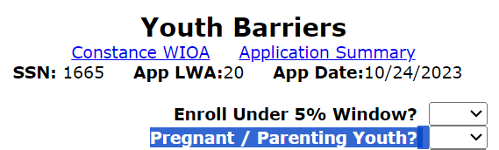
Pregnant or Parenting Barrier
Within IWDS, on the “Youth Barriers” screen within the application, if the question of “Pregnant/Parenting Youth” is answered with “Yes”, it would meet the criteria for the Youth barrier of “Pregnant or Parenting Youth”.
Note: Only a female can be considered to have the barrier of “pregnant”; once the child is born the male could be considered to have the barrier of “parenting”.

Slide 37
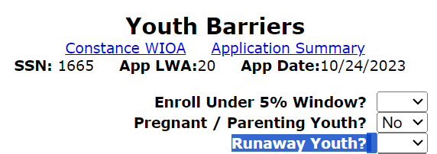
Youth Runaway Barrier
Within IWDS, on the “Youth Barriers” screen within the application, if the question of “Runaway Youth” is answered with “Yes”, it would meet the criteria for the Youth barrier of “Runaway”.
A “Runaway” is defined as a person under the age of 18 who absents himself or herself from home or place of legal residence without the permission of a parent or legal guardian.

Slide 38
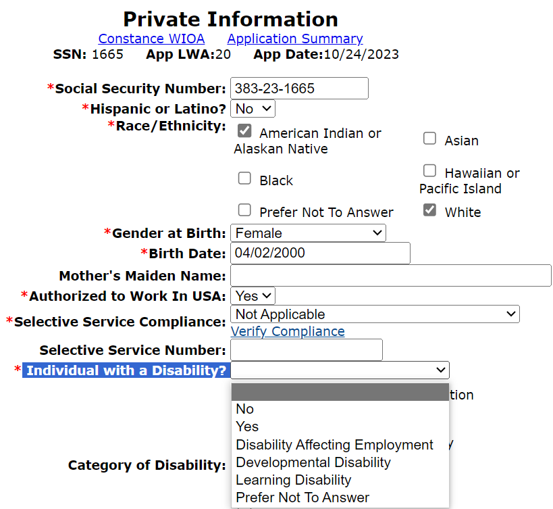
An Individual with a Disability
Within IWDS, on the “Private Information” screen within the application, if the question of “Individual with a Disability“ has any response other than “No” or “Prefer Not to Answer”, the Youth Barrier of “Individual with a Disability” will be identified.

Slide 39
Youth Needing Assistance
Under Youth eligibility, there is a barrier for, “An individual requiring additional assistance to enter or complete an educational program or to secure or hold employment.”
Within IWDS it is recorded on the Youth Barriers Screen with the question of “Youth Needing Assistance” (see example screen print on the next slide).
It is important to understand that the criteria to support this barrier is determined by each Local Workforce Innovation Area (LWIA) in their own Local Policy.
  If this barrier is indicated in an application, staff must explain in the case note (or with appropriate documentation), how the client meets the criteria that is laid out within the LWIA Local Policy.

Slide 40
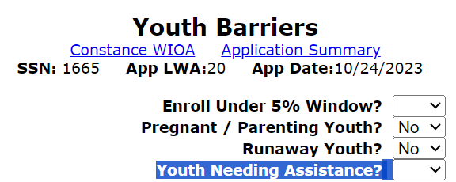
Youth Needing Assistance
Within IWDS, on the “Youth Barriers” screen within the application, if the question “Youth Needing Assistance” is answered with “Yes”, it would meet the criteria for the Youth barrier of “An individual requiring additional assistance to enter or complete an educational program or to secure or hold employment.”

Slide 41
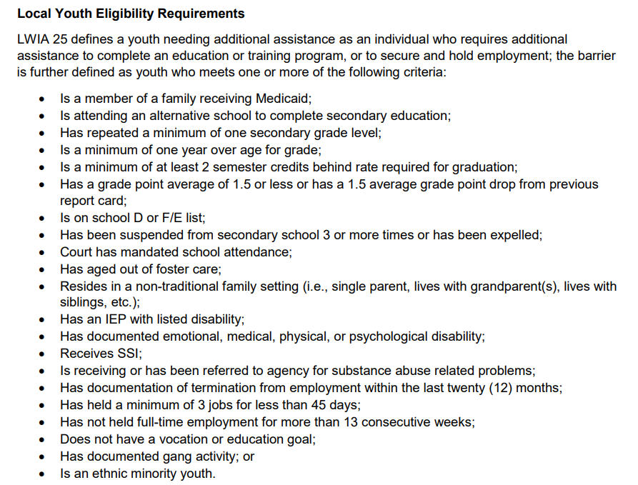
LWIA 25 Local Guidance
On the adjacent screen is the current LWIA 25 policy/guidance around the locally determined criteria for the barrier of “Youth Needing Additional assistance to complete an education or training program, or to secure and hold employment.”

Slide 42
LWIA 24 & 26 Youth Requires Additional Assistance Criteria
For the staff from LWIA 24 & 26, if you are not aware of your Locally determined criteria for the Youth barrier of “An individual requiring additional assistance to enter or complete an educational program or to secure or hold employment”, please reach out to your supervisor/manager to ensure you obtain the local guidance.

Slide 43
Youth Requiring Additional Assistance Limitations
In TEGL 09-22 that was released on March 2nd, 2023, updated guidance that states only record the barrier of “An individual requiring additional assistance to enter or complete an educational program or to secure or hold employment.” when it is a participant’s sole eligibility barrier.
Guidance in TEGL 09-22 states, “WIOA includes a limitation where in each local area only five percent of in-school youth in a given program year can be determined eligible using this barrier”.

Slide 44
Limited to only 5% of ISY
As was previously passed on, TEGL 09-22 provided guidance that,“WIOA includes a limitation where in each local area only five percent of in-school youth in a given program year can be determined eligible using this barrier”.
OET WIOA ISY Youth Policy 5.4.2, that was issued on May 11st, 2023 states under paragraph 1.d.7) - an individual who requires additional assistance to complete an educational program or to secure or hold employment.
  a) This criterion can only be used when no other youth barriers exist.
  b) Local Workforce Innovation Boards (LWIBs) must establish a local policy using this criterion.
  c) LWIBs must ensure that less than five (5) percent of their ISY per program year utilize and report this barrier as the sole reason for eligibility determination.

Slide 45
ISY – Limitations to “Youth Needing Assistance” Barrier
Again, for an ISY, the barrier of “Youth Needing Additional Assistance” should only be used when the client has no other WIOA Youth barriers, and when the individual would meet locally established criteria.
Additionally, as mentioned, there is a limitation that only 5% of the ISY can utilize the barrier of “Youth Needing Additional Assistance”.

Slide 46

ISY – Youth Needing Assistance
If the barrier of “Youth Needing Additional Assistance” was populated at the time of application, the adjacent screen print shows the acceptable documentation choices at certification.
However, the key is to understand your local policy, and how the client met the criteria laid out in the locally determined criteria.
Then the documentation must tie together how the client specifically met the portion of the locally determined criteria.

Slide 47
Concludes In-School Youth (ISY)
This concludes the portion of the presentation on ISY. Key points to remember are that for an ISY, the Youth is required to meet WIOA Low-Income criteria and have one or more of the identified Youth barriers.
The Youth barrier of “An individual requiring additional assistance to enter or complete an educational program or to secure or hold employment.” may only be used on a maximum of 5% of the LWIA’s total ISY in a program year.
If an ISY completes school while in the WIOA program, they will still maintain their status as an ISY until they exit from the WIOA program.

Slide 48
Out-of-School Youth Program
WIOA E-Policy Chapter 5.4.1 – Out-of-School Youth
  Out-of-School Youth – Youth not younger than age 16 or older than age 24;
  Not attending any school as defined under state law;
  Individuals attending Adult Education provided under Title II of WIOA, YouthBuild or Job Corps are also classified as out-of-school youth for eligibility determination.

Slide 49
Guidance from TEGL 21-16
  If a youth graduates' high school and registers for postsecondary education, they would be considered an ISY at the time of application.
  However, if the youth does not ultimately follow through with attending postsecondary education, then such a youth would be considered an OSY if the eligibility determination is made after the point that the youth decided not to attend postsecondary education.
  If the youth is only enrolled in non-credit-bearing postsecondary classes, they would not be considered attending postsecondary school and, therefore, an OSY.

Slide 50
Out-of-School Youth
The following out-of-school youth barriers do not require the individual to meet low-income criteria:
School Dropout;
Within the age of compulsory attendance but has not attended school for at least the most recent complete school year quarter;
Subject to the juvenile or adult justice system;
Homeless
Runaway
Foster Care
Aged Out of Foster Care
Pregnant or Parenting
An Individual with a Disability

Slide 51
High School Dropout
This barrier can only be used for an individual who drops out of High School and has not gone back to school. If they dropped out but went back or obtained their General Equivalency Degree (GED), they are not considered a “Drop Out” under WIOA Eligibility.
Within IWDS, on the “Education Status” screen within the application, if the question of “High School Dropout” is answered with “Yes”, it would meet the criteria for the OSY barrier of “High School Dropout” (see next slide).

Slide 52
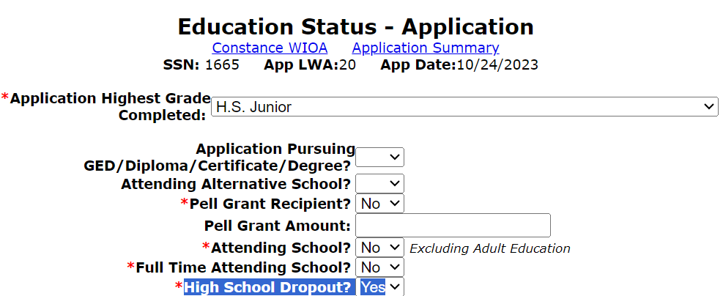
Recording High School Dropout
On the Education Status screen of the application is where the OSY barrier of “High School Dropout” is recorded.

Slide 53
Not Attended High School in Quarter
In some instances, a High School might not consider an individual to be a High School Drop Out until the end of a school year.
Under the WIOA legislation, the Out-of-School Youth barrier of “Within the age of compulsory attendance but has not attended school for at least the most recent complete school year quarter” was added for this reason.

Slide 54
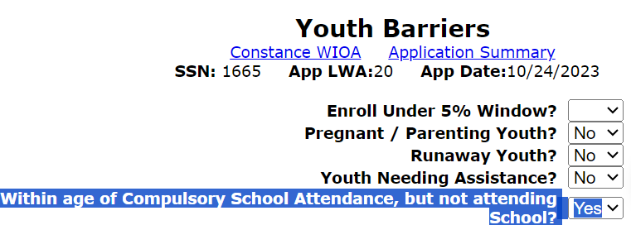
Not Attended High School in Quarter
Within IWDS, on the “Youth Barriers” screen within the application, if the question “Within age of Compulsory School Attendance, but not attending School?” is populated with a “Yes”, the OSY barrier of “Within the age of compulsory attendance but has not attended school for at least the most recent complete school year quarter” will be met.

Slide 55
Subject to Justice System
Under the WIOA legislation, under In-School Youth (ISY), there is a barrier for an ”Offender”. For the Out-of-School Youth (OSY), this barrier is called, “Subject to the juvenile or adult justice system.”
In the March 2017, TEGL 21-16 – WIOA Youth guidance it was clarified that the OSY barrier of “Subject to the juvenile or adult justice system” has the same definition as the ISY barrier of “Offender”.

Slide 56
Subject to Justice System
An adult or youth is “Subject to the Juvenile or Adult Justice System” if, (A) who is or has been subject to any stage of the criminal justice process, for whom services under this Act may be beneficial; or (B) who requires assistance in overcoming artificial barriers to employment resulting from a record of arrest or conviction.

Slide 57
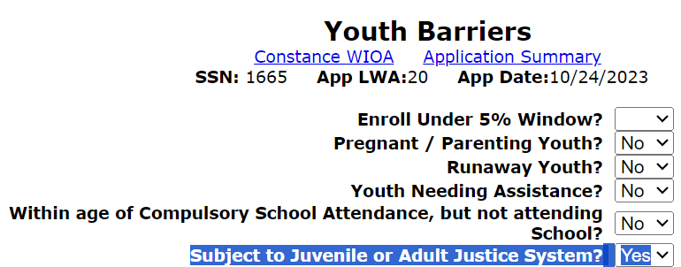
Subject to Justice System
Within IWDS, on the “Youth Barriers” screen within the application, if the question of “Subject to Juvenile or Adult Justice System” is populated with a “Yes”, the OSY barrier of “Subject to Juvenile or Adult Justice System” will be met.

Slide 58
Out-of-School Youth Barriers
The other Out-of-School Youth barriers that do not require a client to meet WIOA low-income criteria are shown in the adjacent column; we have already covered the details where those questions are addressed within the Youth application in IWDS.
Homeless
Runaway
Foster care
Aged out of foster care
Pregnant or parenting
An individual with a disability

Slide 59
Out-of-School Youth Barriers
If an Out-of-School Youth (OSY) did not meet any of the previously addressed barriers, there are two more possible barriers that could support OSY eligibility, but both require the client to meet WIOA Low-Income criteria with the barrier.

Slide 60
Out-of-School Youth Barriers
The following Out-of-School Youth barriers require the individual to meet WIOA low-income criteria:
A recipient of a secondary school diploma or its recognized equivalent who is a low-income individual and is
  Basic Skills Deficient, or
  An English language learner
A low-income individual requiring additional assistance to enter or complete an educational program or to secure or hold employment (must be supported based on local policy criteria.)

Slide 61
High School Diploma or GED and is either BSD or ELL
For this barrier, the client will need to have been an OSY that has already graduated H.S. or completed their GED but is Basic Skills Deficient or an English Language Learner as was discussed and demonstrated on slides 20-29 of this PowerPoint.

Slide 62
LWIA 25 Out-of-School Youth – Youth Requiring Additional Assistance
An important detail, under the Federal and State guidance, there are not limitations on the number of Out-of-School Youth who can utilize this barrier.
  See next slide for the LWIA 25 criteria for this barrier.

Slide 63
LWIA 25 Youth Requires Additional Assistance OSY Criteria

Slide 64
Youth Needing Assistance
For the barrier of the OSY is required to meet WIOA Low Income criteria, as well as “requiring additional assistance to enter or complete an educational program or to secure or hold employment” which in IWDS is under the question of “Youth Needing Assistance”:

Slide 65
OSY – Youth Needing Assistance
If the barrier of “Youth Needing Additional Assistance” was populated at the time of application, the adjacent screen print shows the acceptable documentation choices at certification.
However, the key is to understand your local policy, and how the client met the criteria laid out in the locally determined criteria.
Then the documentation must tie together how the client specifically met the particular portion of the locally determined criteria

Slide 66
Staff from LWIA 24 & 26
For the staff from LWIA 24 & 26 if you are not aware of your Locally determined criteria for the Youth barrier of “An individual requiring additional assistance to enter or complete an educational program or to secure or hold employment”, please reach out to your supervisor/manager to ensure you obtain the local guidance.

Slide 67
WIOA 5% Non-Low-Income Youth Rule
A last point to cover for Youth, WIOA Legislation allows for a LWIA to serve up to 5% of their Youth, that are required to meet WIOA Low-Income criteria as part of the eligibility (either ISY or OSY), who do not in fact meet WIOA Low-Income criteria.
The Youth is still required to have at least one or more of the Youth barriers.
Each LWIA is responsible for tracking their own 5% Youth non-low-income, so check with the individual who is responsible for providing oversight of your Youth program if you feel you have a good client for the 5% Youth criteria

Slide 68
Youth Wrap Up
In conclusion –all WIOA Youth must meet WIOA General Eligibility tied to Authorized to Work in the U.S. criteria. All clients born male who have turned age 18 must be in compliance with Selective Service.
95% of In-School Youth must meet WIOA Low-Income criteria and have at least one or more of the identified Youth Barriers.
For Out-of-School Youth, most of the clients are not required to meet WIOA Low-Income criteria unless their only barriers are tied to being a High School Graduate who is Basic Skills Deficient or an English Language Learner, or if the Youth Needing Assistance barrier is the only barrier.

Slide 69
Concludes this PowerPoint
This concludes the presentation on building a WIOA Youth Eligibility.
If you have questions related to this presentation, feel free to contact me at James.potts@Illinois.gov or you can phone me at (217) 299-4532.

