Slide 1
WIOA General Eligibility
June 22nd, 2023

Slide 2
Objective
The primary objective of this presentation is to discuss the details around Workforce Innovation and Opportunity Act (WIOA) General Eligibility criteria.
Secondarily, it will demonstrate how the various WIOA General Eligibility criteria are recorded on a client's electronic record in the Illinois Workforce Development System (IWDS).

Slide 3
Federal Guidance
Workforce Innovation and Opportunity Act of 2014 is the overall driving factor for all the WIOA programs.
TEGL 19-16 – Guidance on Services Provided through Adult and Dislocated Worker under WIOA – dated April 1st, 2017.
TEGL 21-16 – Third WIOA Title I Youth Formula Program Guidance – dated April 2nd, 2017.
Change 1 to TEGL 21-16 was issued July 30th, 2021 – Deals with updated process for Determining Low Income for Youth Living in a High Poverty Area.
TEGL 09-22 – WIOA Title I Youth Formula Guidance – dated March 2nd, 2023

Slide 4
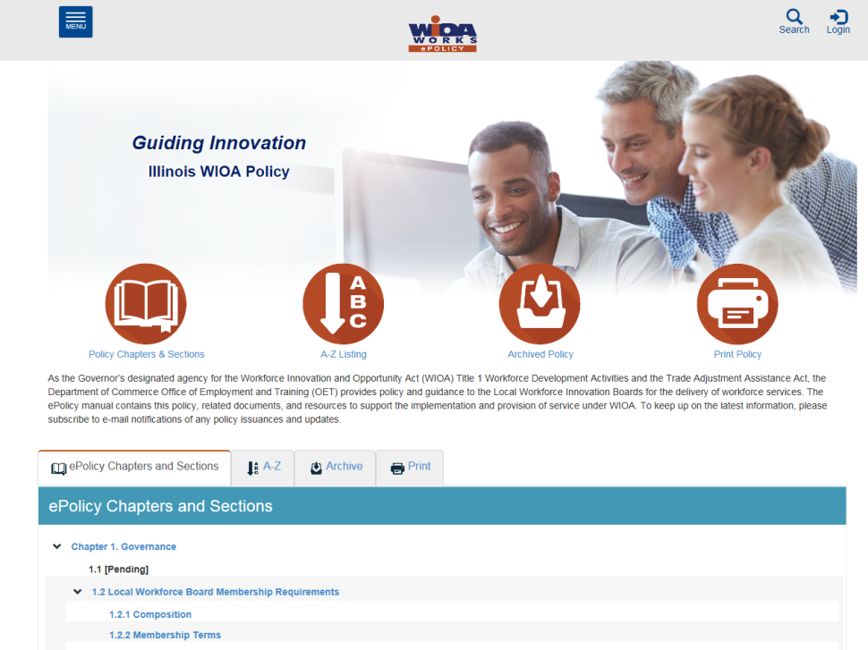
Understanding the ePolicy Manual
The Illinois Department of Commerce and Economic Opportunity, Office of Employment and Training (OET) utilizes a WIOA ePolicy portal where all current and new guidance issued by the Illinois Workforce Innovation Board (IWIB) and OET will be maintained.
Homepage: www.illinoisworknet.com/DCEOPolicies

Slide 5
State Policy Guidance
WIOA ePolicy Chapter 5 Section 1 – General Eligibility.
WIOA ePolicy Chapter 5 Section 1.1 – Selective Service Guidance.
WIOA ePolicy Chapter 5 Section 7 – Veteran’s Priority of Service Requirements.

Slide 6
Before we get into Eligibility
U.S. Department of Labor put out guidance on Handling and Protection of Personally Identifiable Information (PII) in TEGL No. 39-11.

Slide 7
Protection of PII
Illinois State Laws
Identity Protection Act (5 ILCS 179)
Personal Information Protection Act (815 ILCS 530)
Illinois Data Security on State Computers Act (20 ILCS 450/25)
WIOA Final Rule at 20 CFR 683.220 – Recipients and Subrecipients of WIOA Title 1 funds must have an internal control structure and written policies in place to protect PII and sensitive information.

Slide 8
Protection of PII
Federal Uniform Guidance
2 CFR 200.303(e) – Must take reasonable measures to safeguard protected personally identifiable information and other information the Federal awarding agency or the non-Federal entity designates as sensitive.
Your Employer’s/Pass-Through Entity’s Policies and Procedures
TEGL 39-11 requires that DOL ETA grantees must have policies and procedures in place under which personnel, before being granted access to PII, acknowledge their responsibilities for safeguarding data.

Slide 9
Definition of PII
DOL definition of PII
PII is Information that can be used to distinguish or trace an individual’s identity, either alone or when combined with other personal or identifying information that is linked or linkable to a specific individual. Note: There is a similar definition of PII in the Uniform Guidance at 2 CFR 200.79.

Slide 10
Protection of PII
Protected PII
Information that if disclosed could result in harm to the individual. According to the Uniform Guidance at 2 CFR 200.82, this does not include PII that is required by law to be disclosed.
Non-Sensitive PII
Information that if disclosed, by itself, could not reasonably be expected to result in personal harm.
Note – Non-sensitive PII linked to protected PII (example: Name linked to a Social Security Number) could result in harm to an individual.

Slide 11
Protection of PII
PII and other sensitive information must be protected.
Don’t email sensitive PII unless it is encrypted.
Don’t store sensitive PII on portable drives or media unless it is encrypted.
Access to any PII created by the ETA grant must be restricted to only those employees who need it in their official capacity to perform duties in connection with the scope of work in the grant agreement.

Slide 12
Protection of PII
Bottom line – you must keep all client’s personal information protected from unauthorized personnel.

Slide 13
General Eligibility
DCEO ePolicy – WIOA General Eligibility Policy 5.1
All clients must be authorized to work in the U.S. before they meet WIOA General Eligibility.
All clients born male, who have turned age 18 and were born on or after January 1st, 1960 must be compliant with Selective Service before they meet WIOA General eligibility.

Slide 14
General Eligibility
When you review DCEO ePolicy – WIOA General Eligibility Policy Chapter 5 Section 1 you will also notice it gives guidance about signature requirements for an application and other miscellaneous guidance that is applicable to all WIOA clients.

Slide 15
Authorized to Work in U.S.
Participation in WIOA programs and activities is limited to United States citizens, lawfully admitted permanent resident aliens, lawfully admitted refugees and parolees, and other persons authorized by the Attorney General to work in the United States.

Slide 16
TEGL 02-15 – Related to DACA
As of Wednesday, June 22nd, 2023 – the Federal Guidance in Training and Employment Guidance Letter 02-14 – Eligibility of Deferred Action for Childhood Arrivals (DACA) Participation is still current DOL guidance.

Slide 17
TEGL 02-14
Under TEGL 02-14 – paragraph 3. background provides the detailed guidance related to the specifics.
If a WIOA client does meet the criteria laid out under the guidance in TEGL 02-14, within Attachment “A” under acceptable documentation to support Authorized to Work in the U.S. it does include “Self Attestation on how to meet DACA requirements outlined in – DOL TEGL 02-14.

Slide 18
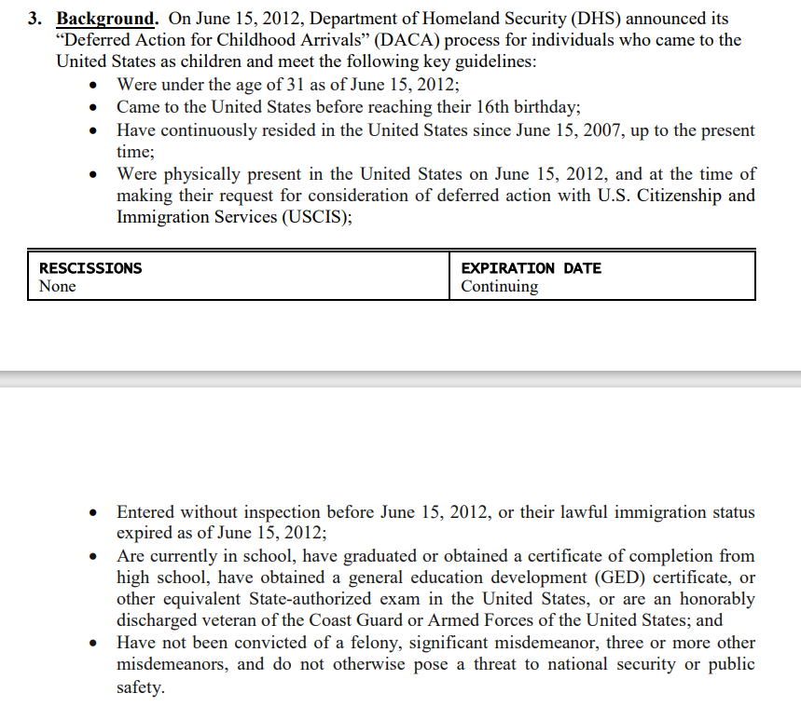
TEGL 02-14
Under section 3. Background. On the bottom of page 1., and top of page 2 of TEGL 02-14 is the section that addresses the specific circumstances for an individual to fall under the DACA criteria:

Slide 19
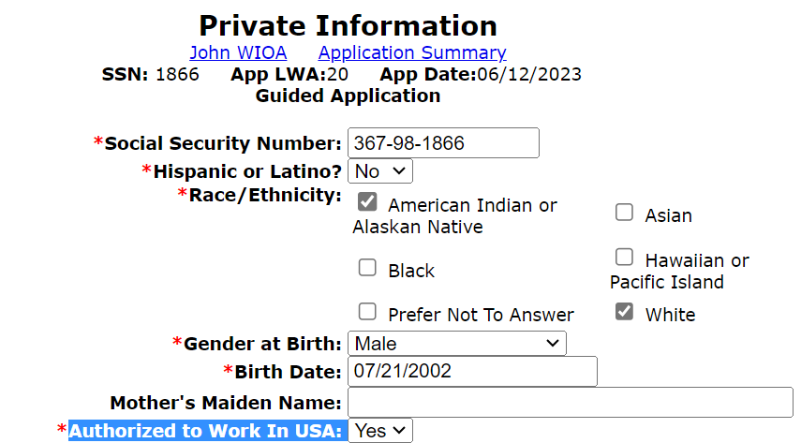
Authorized to Work in the U.S.
The question related to Authorized to Work in the U.S. is captured on the Private Information Screen within the IWDS application.
Only a response of “Yes” will pass the internal edit logic for WIOA Eligibility.
The client must provide documentation at time of eligibility certification to support Authorization to work in the U.S.

Slide 20
Selective Service Compliant
Most individuals who were born a male, who are 18 years or older and who were born on or after January 1st, 1960 will have registered with Selective Service. However, there are instances where sometimes an individual might not have registered with Selective Service, if they have not and are under the age of 26, they can still register with Selective Service.
If a male who was born on or after 1/1/1960 and is now over age 26 and not compliant with Selective Service, they must get a locally approved selective service waiver to receive WIOA services. (More about the waiver in a moment.)

Slide 21
Selective Service Compliant
If the client is a female or a male born prior to 1/1/1960, the Selective Service Compliant question is “Not Applicable”.
If the client was born a male under the age of 18, Selective Service Registration is “Not Applicable” at the time of application.

Slide 22
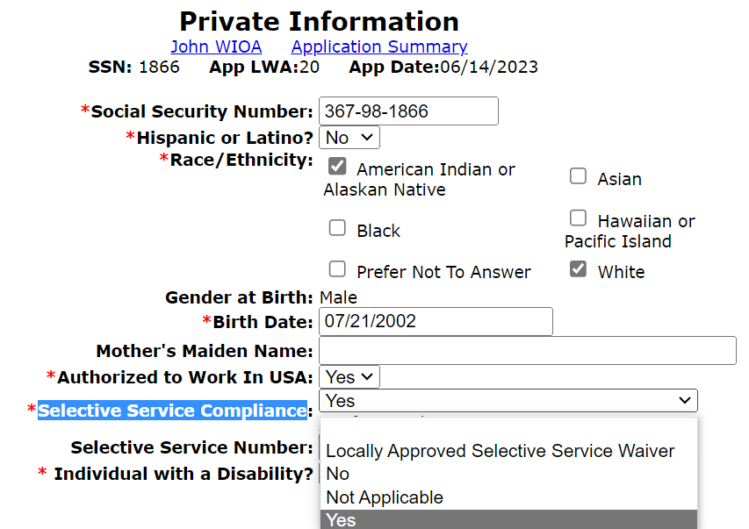
Selective Service Compliant
“Selective Service Compliance” is documented on the Private Information Screen within the IWDS application of every client.

Slide 23
Selective Service Compliant
Most individuals born male, who have turned age 18 will have been compliant with Selective Service, however, most will probably not know their Selective Service Number.
To obtain the Selective Service Number, on the “Private Information” screen - go into the Selective Service Website via Verify Compliance.

Slide 24
Selective Service System

Slide 25
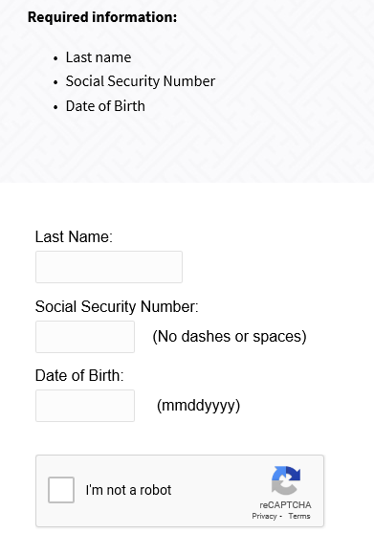
Selective Service Verification
The verification will require the client’s last name, SSN and Date of Birth.
Then must prove you are not a “robot” for the search to continue.

Slide 26
Selective Service Verification
Once the search is completed, if the individual was already registered with Selective Service, the details including the Selective Service number will be provided. (See the next slide for an example.)

Slide 27
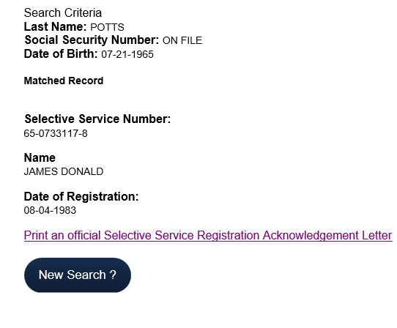
Selective Service Verification

Slide 28
Selective Service Verification
The Career Planner would print the verification document with the selective service number and place it in the file to support selective service compliance.
The Career Planner would transcribe the selective service number from the website over into the application’s “Private Information” screen in the block for “Selective Service Number”.

Slide 29
Selective Service Verification
The first two digits of the selective service number will always begin with the individuals last two numbers of their birth year, this “example” client was born in 1965, so we know the first two numbers of their selective service would begin with 65.

Slide 30
Selective Service Waiver
The real issue comes to play when a male client who was born on or after 1/1/1960, that is now age 26 or older and is not compliant with selective service.
Most often reasons an individual might not be compliant with Selective Service?
Entered the country for the first time after they had turned age 26.
Was in the military from age 18 and did not register.
Was incarcerated from age 18 and did not register.

Slide 31
Selective Service Waiver
The Office of Employment and Training (OET) Policies referenced directly below provide specific details about the steps needed for “Locally Approved Selective Service Waivers” when a male client, who has turned age 26 or older and has not registered with Selective Service:
OET ePolicy - Chapter 5 Section 1.1.1 – Selective Service Guidelines.
OET ePolicy – Chapter 5 Section 1.1.3 - Written Local Policy Selective Service Compliance Requirements address the details required for a “Locally Approved Selective Service Waiver”.

Slide 32
Selective Service Waiver
In all instances, if a male client who had been born on or after 1/1/1960 and who did not register for Selective Service, the client is first required to complete a DCEO/SS Form #001 - Selective Service Verification Form.
The client must support why he did not willingly and knowingly fail to register.
Meaning if he states, “yes I knew I was supposed to register with Selective Service and I chose not to”, he cannot receive a Locally Approved Selective Service Waiver.

Slide 33
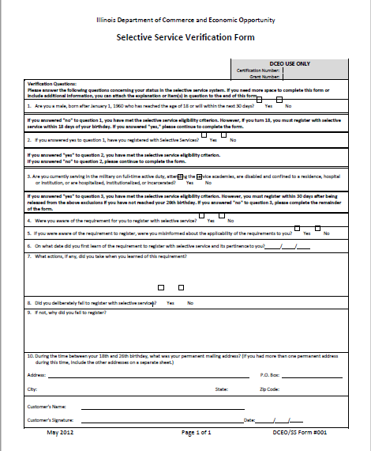
Selective Service Waiver
On the adjacent screen is an example of a blank DCEO/SS Form #001, this form is part of OET Policy Chapter 5 Section 1.1.1 – the client must complete, sign and date this form as part of any “Locally Approved Selective Service Waiver”.

Slide 34
Selective Service Waiver
The next step is called the Status Information Letter (SIL) from Selective Service.
However, in the case of an individual who first entered the U.S. on or after his 26th birthday he is not required to obtain a SIL for the waiver.
Also, if an individual is a Veteran, he is not required to obtain a SIL for the waiver.
All other individuals who need a waiver, must receive the SIL as part of the waiver approval.

Slide 35
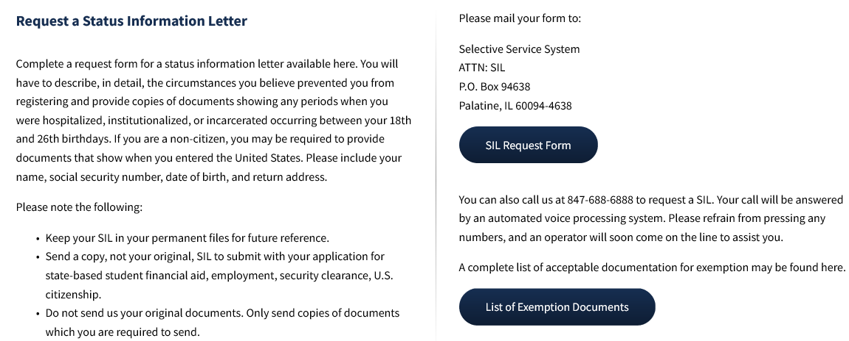
Details about SIL

Slide 36
Selective Service Waiver
OET ePolicy - Selective Service Policy Chapter 5 Section 1.1.3 – requires each LWIA establish their own Local Selective Service Waiver requirements, which must include who is the approval authority at the LWIA for the Locally Approved Selective Service Waiver.
But at a minimum the local policy must still follow those steps explained in the previous slides, including but not limited to the completed DCEO/SS Form #001 starts the Locally Approved Selective Service Waiver.

Slide 37
Selective Service Waiver
Whomever is the approval authority for a LWIA’s locally approved selective service waiver, must take the following into consideration:
Circumstances of why the man did not register (This should be documented on the DCEO/SS Form #001).
If required, the approval authority would review the DCEO/SS Form #001 and the SIL and then the grantee must determine if the client did not knowingly and willfully fail to register for Selective Service.

Slide 38
Selective Service Waiver
If Waiver is approved, then the IWDS record would be populated with “Locally Approved Selective Service Waiver” in the Selective Service Compliance block on Private Information Screen (see example on the next slide).

Slide 39
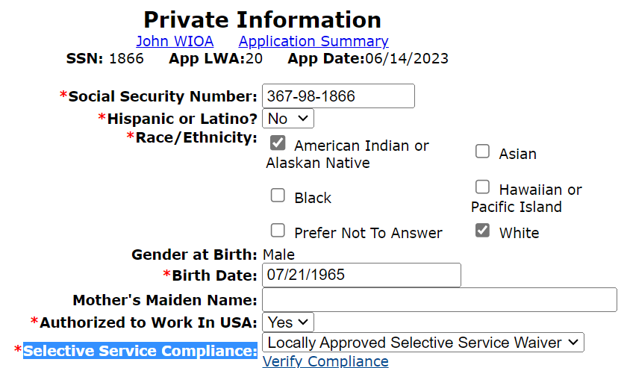
Selective Service Waiver
Only populate if you have an approved “Locally Approved Selective Service Waiver”.

Slide 40
Selective Service Waiver
If Locally Approved Selective Service Waiver is approved, all documentation supporting the approved waiver needs to be placed in the clients record so when the file is monitored, all information must be present to support the waiver.

Slide 41
Selective Service Waiver
Guidance on Locally Approved Selective Service Waiver – “if the failure is deemed knowing and willful, then the client must be denied WIOA services”.
Decisions are to be made on a case-by-case basis meaning there should never be a cart blanc approval process.

Slide 42
Male Registrants Under 18
When a Male entered the WIOA program under the age of 18, he was not required to be compliant with Selective Service.
However, to continue to receive WIOA services when he turns age 18, he must register with Selective Service no later than 30 days after turning age 18.

Slide 43
Male Registrants Under 18
When a male who entered the WIOA program under the age of 18 gets within 30 days of his 18th birthday, he can register with selective service.
When the male is within 30 days of turning age 18, the information related to Selective Service on the “Private Information” screen on his WIOA application is available to update.
See next few slides demonstrating what must occur to update the record.

Slide 44
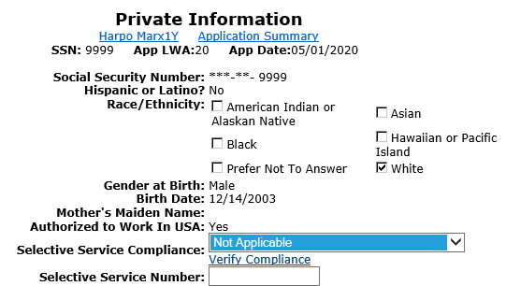
Male Registrants Under 18
From the client’s “Application Menu”, click on “Private Information” in the middle column, third from top:

Slide 45
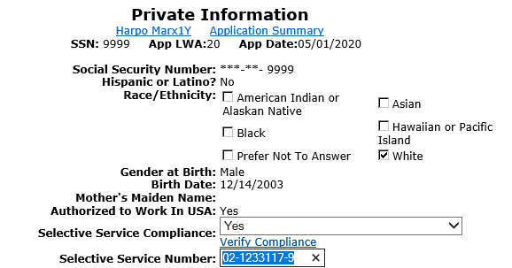
Update Selective Service Information on Private Information Screen of Application
After switching “Not Applicable” to “Yes”, then populate with the Selective Service number, and hit “Save”.

Slide 46
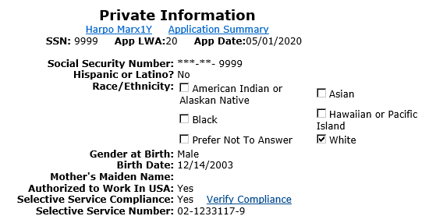
Update Selective Service Information on Private Information Screen of Application
Once record has been updated with Selective Service information and record has been saved, the “Private Information” screen will again be locked as shown in example client below:

Slide 47
Failure/Refuses to Register
If a male who entered the WIOA program under the age of 18, refuses to register with Selective Service when he turns age 18, all WIOA Services must be closed until he becomes compliant with Selective Service.
If the client is Selective Service non-compliant 90 days after his services were closed, he must be exited.

Slide 48
Disallowed Costs
If a male who entered the WIOA program under the age of 18, refuses to register with Selective Service when he turns age 18; and “IF” he continued to receive WIOA services, any services provided after the 18th birthday could be disallowed costs.

Slide 49
Selective Service Compliance
Bottom line, any WIOA client who was born a male, on or after 1/1/1960 who has turned age 18 must have his Selective Service status of either “Yes” or a “Locally Approved Selective Service Waiver”.
“Locally Approved Selective Service Waivers” are only for clients born a male, on or after 1/1/1960 who have turned age 26 and can no longer register with Selective Service.

Slide 50
Veteran’s Priority of Service
OET ePolicy – Veterans Policies Chapter 5 Sections 7.1 and 7.2 offers further guidance on various Veterans and Veterans Priority of Service issues.
Let us first review the definitions related to a Veteran, Qualified Spouse of a Veteran, and Transitioning Service Member.

Slide 51
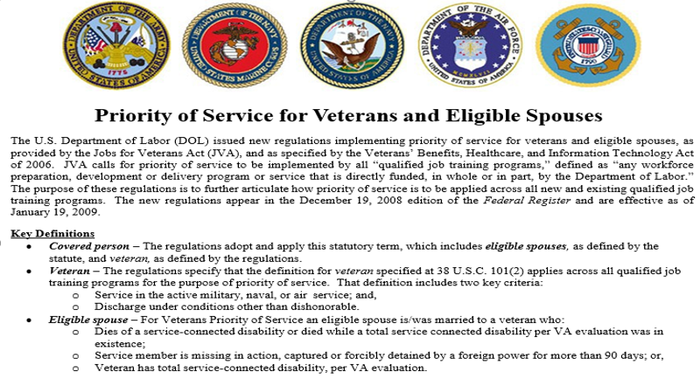
Veteran Key Definitions

Slide 52
Veterans Priority of Service
What does “Veteran’s Priority of Service” mean?
If you have an individual that is a Veteran or a Qualified Spouse of a Veteran, or a transitioning service member they are considered a “Covered Person”.
However, for WIOA Eligibility, the “Covered Person” is not an eligibility factor, the individual must still meet the eligibility for the particular WIOA program (Adult, Dislocated Worker or Youth) to receive “Veteran’s Priority of Service”.

Slide 53
Veterans Priority of Service
What does “Veteran’s Priority of Service” mean?
If an individual meets criteria, the individual gets front of line service, first opportunity, and if opportunities are limited due to funding, the LWIA/Grantee staff must ensure the “Covered Person” receives services before an individual who does not meet “Veteran’s Priority of Service” requirements.

Slide 54
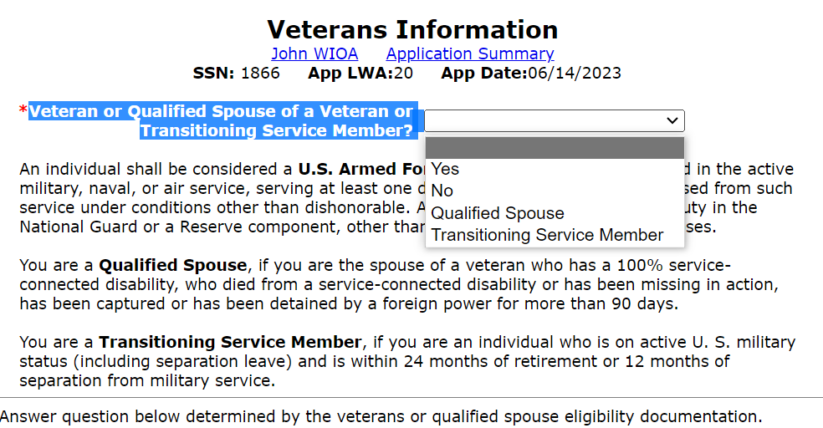
Veteran Status
Veterans Status is captured on the Veterans Information Screen within the application.

Slide 55
WIOA General Eligibility
In conclusion – for all titles of WIOA Eligibility, it is important to realize Protection of Personally Identifiable Information (PII) is of the utmost importance.
All individuals must meet Authorized to Work in the U.S. criteria.
It is important to understand the intricacies of Selective Service criteria for any client born a male, who was born on or after 1/1/1960 and has turned age 18.
Lastly Veteran’s Priority of Service is required to be followed for every Department of Labor funded program including but not limited to WIOA.

Slide 56
Questions
This concludes the presentation on WIOA General Eligibility:
If you have questions related to this presentation, feel free to contact me at James.potts@Illinois.gov or you can phone me at (217) 416-7097.

