Slide 1
WIOA Basic Skills Deficient
June 15th, 2023

Slide 2
Objective
The primary objective of this presentation is to discuss the various ways an individual could meet the criteria of Basic Skills Deficient (BSD) and to demonstrate the various ways the BSD criteria could be recorded as part of a client’s WIOA application within Illinois Workforce Development System (IWDS).

Slide 3
WIOA Definition
Basic Skills Deficient – with respect to an individual—
who is a youth, that the individual has English reading, writing, or computing skills at or below the 8th grade level on a generally accepted standardized test; or
who is a youth or adult, that the individual is unable to compute or solve problems, read, write, or speak English, at a level necessary to function on the job, in the individual’s family, or in society.

Slide 4
Basic Skills Deficient
Under WIOA, Basic Skills Deficient (BSD) has eligibility/priority criteria under both the Adult and Youth titles.
Under the Adult title, if an eligible client is determined BSD, the client is considered a priority.
If a client meets BSD criteria, it is equal to the priority an Adult client receives for meeting WIOA Low Income criteria.
Under the Youth titles (In-School Youth and Out-of-School Youth), being BSD is a barrier that is part of the Youth eligibility criteria.

Slide 5
Federal Guidance
Workforce Innovation and Opportunity Act (WIOA) of 2014.
Training and Employment Guidance Letter (TEGL) 19-16 – Guidance on Services Provided through Adult and Dislocated Worker under WIOA – dated March 1st, 2017.
TEGL 09-22 – WIOA Title IB Youth Formula Guidance – dated March 2nd, 2023.
TEGL 21-16 – Third WIOA Title I Youth Formula Guidance – dated March 2nd, 2017.
Change 1 to TEGL 21-16 was issued July 30th, 2021 – Deals with updated process for Determining Low Income for Youth Living in a High Poverty Area.
TEGL 07-20 – Implementation of Priority of Service in WIOA Adults – dated November 24th, 2020.

Slide 6
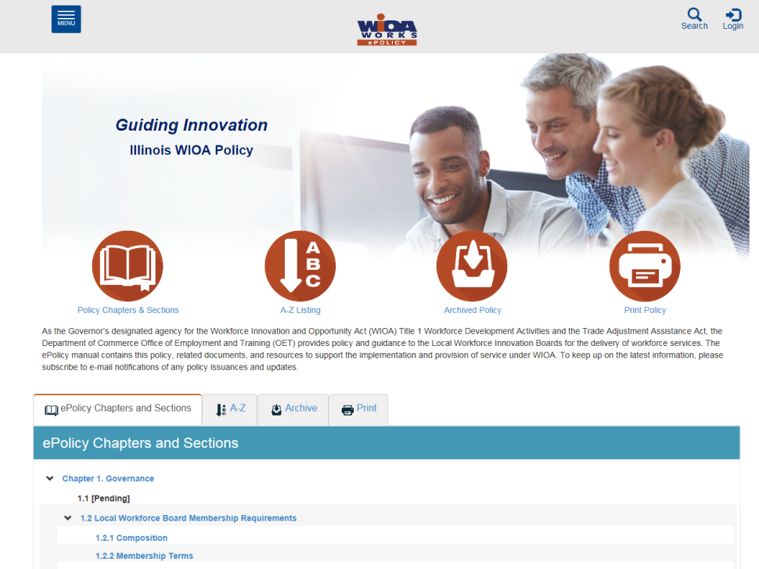
Understanding the ePolicy Manual
The Illinois Department of Commerce and Economic Opportunity, Office of Employment and Training (OET) utilizes a WIOA ePolicy portal where all current and new guidance issued by the Illinois Workforce Innovation Board (IWIB) and OET will be maintained.
Homepage: www.illinoisworknet.com/DCEOPolicies

Slide 7
State Policy Guidance
Office of Employment and Training (OET) WIOA ePolicy Chapter 4.2 – Career Planning –3-14 -2023
OET WIOA ePolicy Chapter 5.2 –Adult Eligibility – 12-8-21
OET WIOA ePolicy Chapter 5.4 – Youth Eligibility – 5-11-23
OET WIOA ePolicy Chapter 5.6 - Service Priorities – 12-8-21
OET WIOA ePolicy Chapter 5.9 – Basic Skills Deficiency Assessment Requirements – 5-17-23

Slide 8
Different Ways to Be Determined Basic Skills Deficient (BSD)
If an individual scores at or below 8th Grade Level on either their Math or Reading Assessment test they would be determined BSD.
In OET WIOA ePolicy Chapter 5.9 – Basic Skills Deficiency Assessment Requirements, it includes an alternative way an individual can be determined BSD by using a Basic Skills Screening Tool.
Lastly, if an individual is assessed as an English Language Learner (ELL), they could also be determined to meet BSD criteria.

Slide 9
BSD Based on Assessment Testing
A key internal logic issue that is important to understand about BSD within IWDS:
The assessment test date must be, on or before the application date before the internal logic within IWDS is going to pick up the client as BSD due to the assessment test:
Example, if a client has an application date of 3/1/2023, but if the individual had taken the assessment tests on a date after the application date, even if the client scores at or below 8th Grade Level on the assessment test(s), the internal IWDS logic will not determine the client BSD.

Slide 10
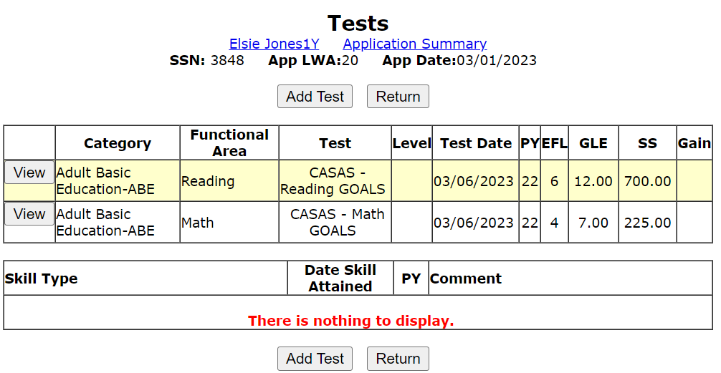
Example Client Testing Results
Based on internal IWDS logic, would the results from the assessment tests recorded below determine this client as Basic Skills Deficient?

Slide 11
Dates
Look close at the application date and the test date; notice the test date is after the application date.

Slide 12
Not with this Application Date
The reading assessment test recorded on the previous slide was at or below 7th Grade Level, however, the test is dated 3/6/2023 and the client’s application is dated 3/6/2023.
For this example, the internal logic within IWDS would not determine this client BSD due to the assessment test, because the assessment tests were taken after the client’s actual WIOA application date.

Slide 13
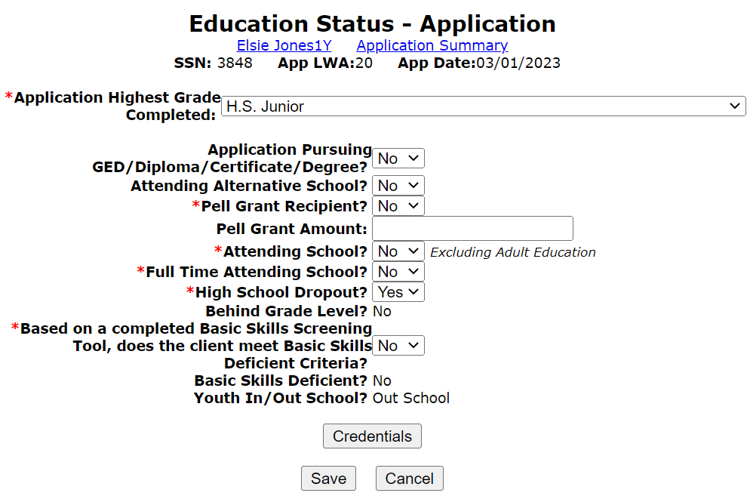
Education Status Screen
As demonstrated on the Education Status screen of the adjacent screen print from the application, as shown that even though the client had scored at the 7th Grade Level Equivalency (GLE) on CASAS Math test, the Basic Skills Deficient? Towards the bottom is appearing as “No” .
This is due to the application date needs to be on or after the test dates to get picked for eligibility criteria.

Slide 14
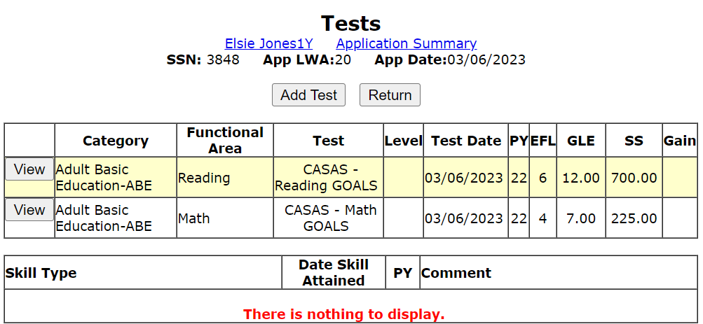
New Example
Based on internal IWDS logic, would the results from the assessment tests recorded below now determine this client as Basic Skills Deficient?

Slide 15
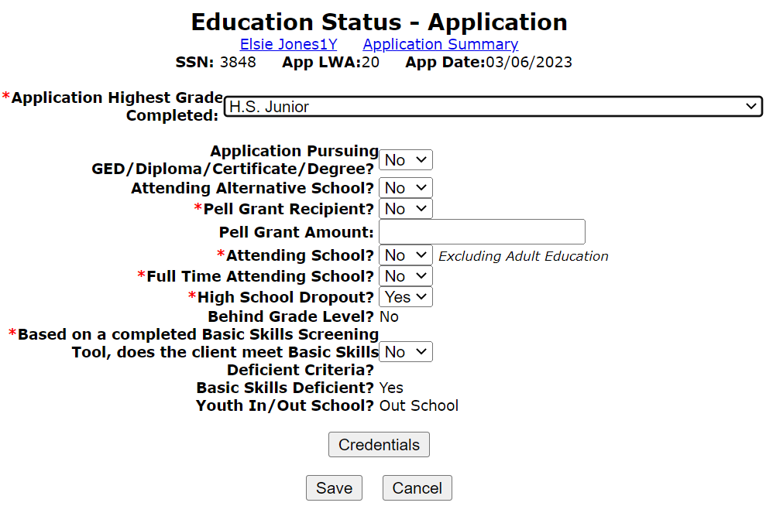
BSD Due to Test Results
Based on the application date being updated now to 3/6/2023, the internal logic within IWDS will now pick up those test results for the 3/6/2023 Math Assessment test and the client is now displayed as BSD as demonstrated on the clients Education Status screen.

Slide 16
Determining BSD due to Tests
Key points to understand about determining BSD due to assessment tests within IWDS.
A client will be determined BSD with a score at or below 8th Grade Level on either the math or reading assessment tests, if the tests are dated on or before the client’s application date.
Note – for an Adult client, valid assessment tests must be dated within one year of the application date.
Note – for a Youth client, the assessment tests must be dated within six months of the application date.

Slide 17
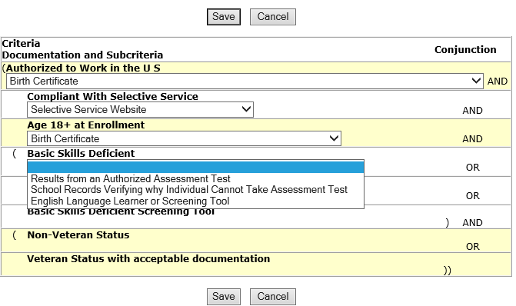
Documentation for Testing
The client was determined BSD due to assessment tests (scoring at or below 8th Grade Level), then the choice of “Results from an Authorized Assessment Test” would be the correct documentation choice to support “Basic Skills Deficient”.

Slide 18
Basic Skills Screening Tool
We will now transition to the next way a client could be determined BSD.
Based on guidance in OET WIOA ePolicy Chapter 5.9 – Basic Skills Deficiency Assessment Requirements – 5-17-23.
Attachment “A” within this policy is a Basic Skills Screening Tool (see example on next slide.)
If a client has a response of “No” to any of the questions on the screening tool, they would be determined BSD.

Slide 19
Purpose of Screening Tool
It is important to understand, the screening tool does not take the place of assessment testing.
The purpose of the screening tool is to capture the criteria under the second part of the “Basic Skills Deficient” definition which is “a youth or adult, that the individual is unable to compute or solve problems, read, write, or speak English, at a level necessary to function on the job, in the individual’s family, or in society.”

Slide 20
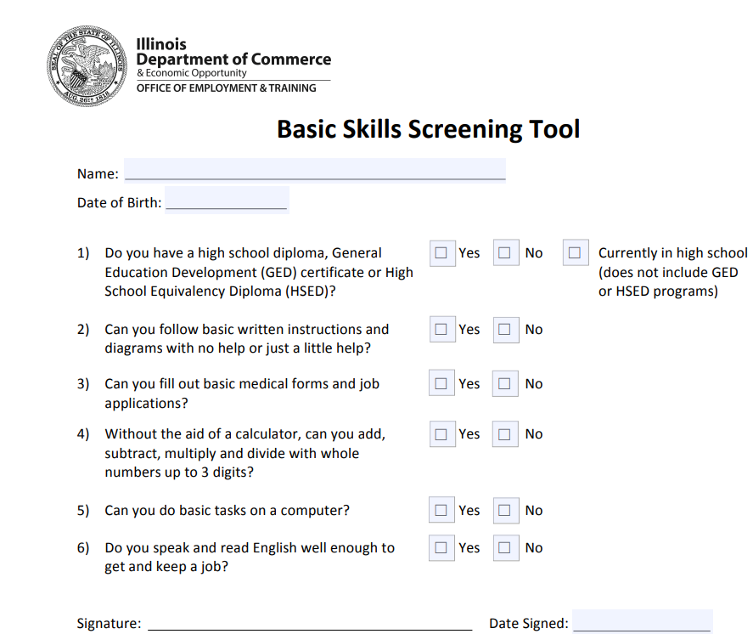
Basic Skills Screening Tool

Slide 21
Basic Skills Screening Tool
On the “Education Status” screen within the IWDS application, is where the question, “Based on a completed Basic Skills Screening Tool, does the client meet Basic Skills Deficient Criteria?” has been added.
If any question on the screening tool was answered “No” by the client, then the question related to the BSD screening tool on the “Education Status” screen should be answered “Yes”; (see example on next slide).

Slide 22
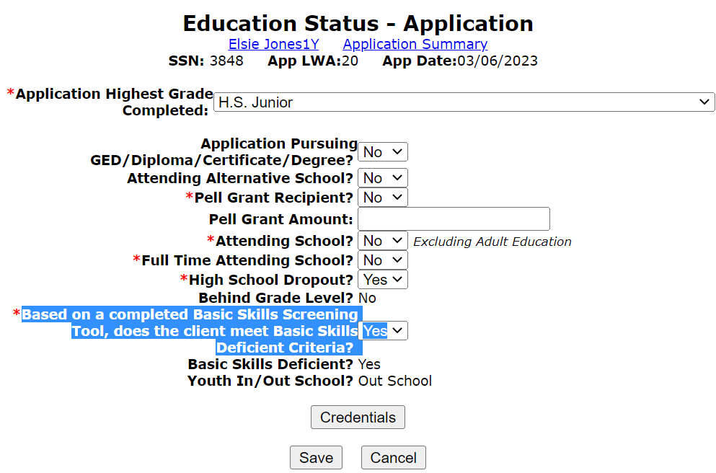
Basic Skills Screening Tool

Slide 23
Basic Skills Screening Tool
If a client is being indicated as meeting BSD criteria due to the Basic Skills Screening tool, the only acceptable documentation to support this criteria is the completed screening tool (with one or more response(s) of “No” indicated on the tool).
The screening tool must have been signed and dated by the client and the bottom portion of the screening tool must be completed by Career Planer staff (see example of bottom of tool on next slide.)

Slide 24
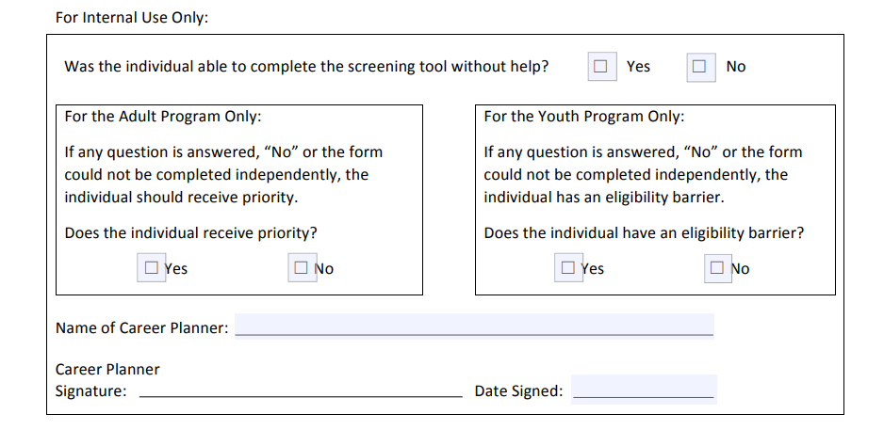
Bottom Portion of the Basic Skills Screening Tool
Must be signed and dated by the Career Planner:

Slide 25
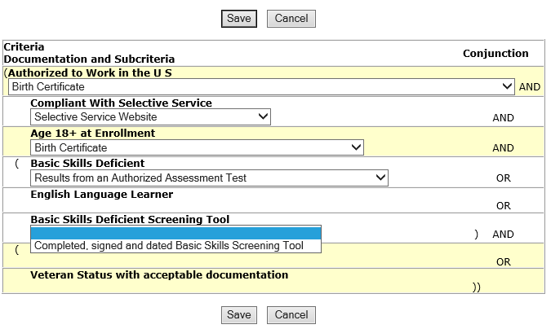
Documentation of BSD from Screening Tool
If a client is being determined BSD due to the Basic Skills Screening Tool, the only acceptable documentation to support this criteria is the completed, signed and dated (by both the client and the Career Planner) Basic Skills Screening Tool.

Slide 26
BSD Criteria
We have now covered how an individual could be determined BSD due to assessment testing.
We have also covered how an individual could be determined BSD utilizing the Basic Skills Screening tool.
One last way an individual could be determined BSD is, if an individual is assessed as an English Language Learner (ELL).

Slide 27
English Language Learner
The term “English Language Learner” when used with respect to an eligible individual, means an eligible individual who has limited ability in reading, writing, speaking, or comprehending the English language, and
whose native language is a language other than English; or
who lives in a family or community environment where a language other than English is the dominant language.

Slide 28
Where ELL in Recorded IWDS
Within IWDS, on the “Characteristics and Barriers” screen within the WIOA application, is where the question related to an English Language Learner (ELL) has been added.
If the “English Language Learner” question is populated with a “Yes”, the internal logic within IWDS will determine the client to meet BSD criteria (see example on next slide).

Slide 29
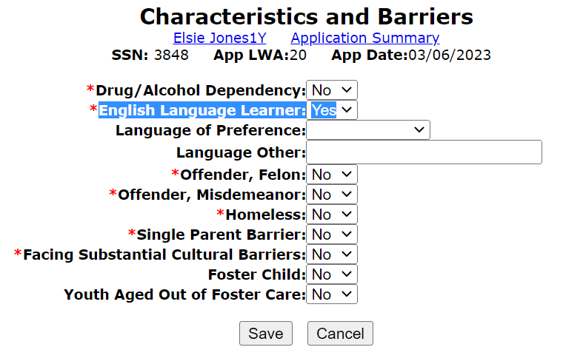
English Language Learner
Demonstrating the barrier of ELL being recorded:

Slide 30
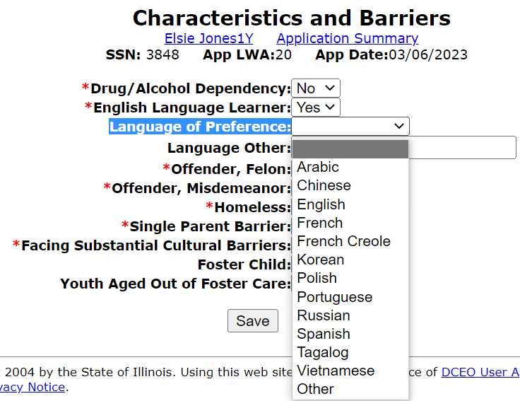
English Language Learner
If “Yes” to the ELL question, the client must indicate a language of preference as part of WIOA Federal reporting criteria.
If none of the languages listed are the “Language of Preference, then the block below allows the Career Planner to record the language “Other”.

Slide 31
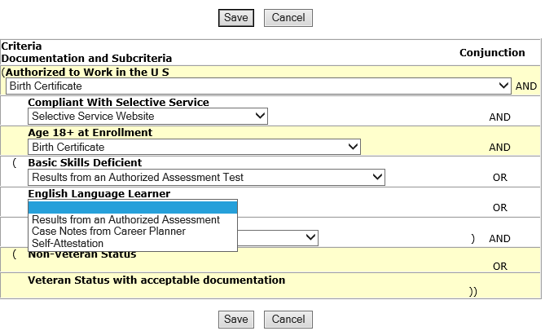
Documentation of BSD from ELL
If a client is recorded as an English Language Learner based on the response to the question on the Characteristics and Barriers screen, the only acceptable documentation choices would be the career planner assessment on how the client met the criteria or the client’s self attestation on meeting the ELL definition.

Slide 32
Overview of the Three Different Ways to Record BSD
To recap, an individual could meet WIOA criteria of Basic Skills Deficient (BSD) three different ways:
Scoring at or below 8th Grade Level on either a math or reading pre-assessment tests.
Due to a “No” response to any question on the Basic Skills Screening tool.
If an individual is assessed as an English Language Learner.

Slide 33
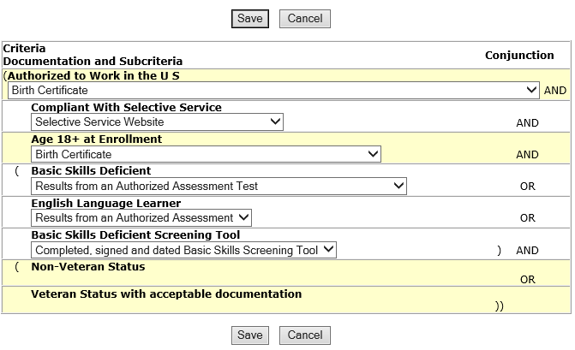
Determined BSD Multiple Ways
In instances where an individual has been recorded as BSD multiple ways, then the expectation would be that there would be documentation provided for all different ways the BSD criteria is claimed.

Slide 34
Overview
Under WIOA, Basic Skills Deficient (BSD) has eligibility/priority criteria under both the Adult and Youth titles.
If a qualified WIOA Adult client meets any of the three BSD criteria discussed in the previous slide, they would be considered a priority client under WIOA.
Under the Youth titles (In-School Youth and Out-of-School Youth), meeting any of the three BSD criteria is a barrier that is part of the Youth eligibility criteria.

Slide 35
Questions
This concludes the presentation on WIOA Basic Skills Deficient criteria and the ways to record this criteria.
If you have questions related to this presentation, feel free to contact me at James.potts@Illinois.gov or you can phone me at (217) 416-7097.

